Slide 1

SEC285 Fundamentals of Information System Security
By: Louimiah Lavinier

Slide 2
Introduction
This project delves into the core aspects of information security, encompassing asymmetric key encryption, file encryption and decryption, stateful firewalls, and vulnerability assessments. Through detailed analysis and practical demonstrations, this presentation aims to provide a comprehensive understanding of essential security mechanisms and their application in protecting computing resources. Each module is designed to highlight specific security challenges and solutions, ensuring a robust grasp of the critical concepts in information system security.

Slide 3

Asymmetric Key Encryption

Slide 4
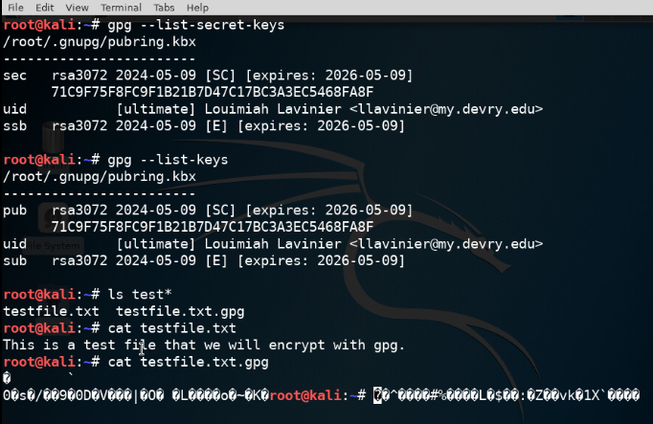
File Encryption
This screenshot should show the following.
Content of the plaintext file
Content of the encrypted file

Slide 5
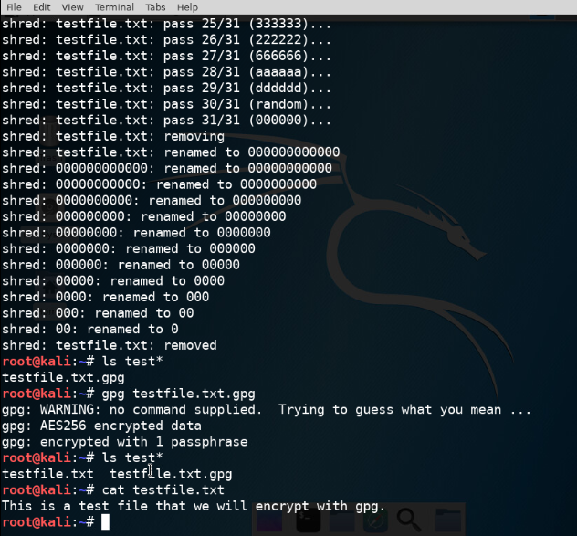
File Decryption
This screenshot should show the following.
The encrypted file being listed by itself
The decrypting process
Both the encrypted file and the original plaintext file being listed

Slide 6

Stateful Firewall

Slide 7
Question
What effect does the sudo iptables --policy INPUT DROP command have on the access to computing resources?
Answer here: This command restrict access to computing resources by blocking incoming traffic that doesn't match a rule in the INPUT chain.
References:
1. Keary, T., & Keary, T. (2022, December 6). The Beginner’s Guide to IP Tables. Comparitech. https://www.comparitech.com/net-admin/beginners-guide-ip-tables/
2. Instructional guide in the project

Slide 8
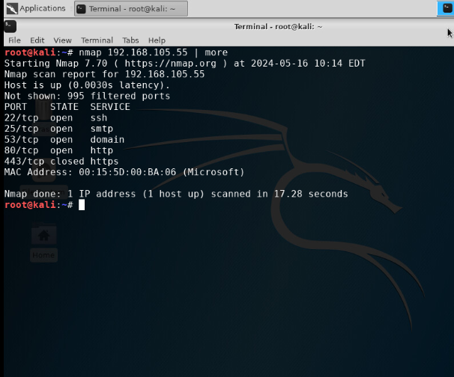
Nmap Scan
This screenshot should show the Nmap scan result of the Linux Server VM.

Slide 9

Bring Your Own Device (BYOD)
Security Policy

Slide 10
Overview:
In modern enterprises, tablets, smartphones, and laptops are widely used due to their portability and ability to enhance communication and productivity. Tablets are common in field services and healthcare for presentations and accessing applications, while smartphones are essential for constant connectivity and remote work. Laptops are favored for their balance between portability and powerful functionality, suitable for complex tasks like software development and data analysis. However, these devices pose several threats, such as data breaches from stolen devices, malware infections, and vulnerabilities from unpatched software. To mitigate these risks, enterprises should implement device management solutions, ensure regular updates, use strong authentication methods, and educate employees on security best practices.
2. Purpose:
The primary objective of any IT security policy is to safeguard the confidentiality, integrity, and availability (CIA) of data. Accordingly, a BYOD security policy is essential to pinpoint devices that may introduce unnecessary vulnerabilities to the organization's computing resources. By discovering these vulnerabilities in a timely manner, organizations can reduce the attack vector, minimizing the risk of unauthorized access and data breaches. Early detection allows for immediate remediation, such as applying security patches, enforcing stronger authentication, or restricting access, thereby safeguarding the organization's computing environment from potential threats.

Slide 11
3. Scope:
As part of our enterprise security policy, personal devices such as smartphones, tablets, and laptops are allowed on our network only if they meet security standards and are equipped with necessary security software, including antivirus and Mobile Device Management (MDM) solutions. Personnel must receive formal approval from the IT department, which involves registering the device and ensuring compliance with security requirements. Permitted activities on personal devices are strictly defined, restricting access to sensitive data and limiting the use of unauthorized applications, with compliance monitored through MDM solutions. Employees are responsible for keeping their devices updated and adhering to security guidelines, with regular training sessions provided to educate them on risks and best practices. The IT department oversees the approval process and ensures compliance, while the security team defines requirements, conducts risk assessments, and responds to incidents, and HR assists in policy enforcement and employee education. This comprehensive approach aims to manage personal device use effectively, minimizing risks while maintaining productivity and flexibility.
4. Policy:
ABC Corporation allows personal devices on the network only if they meet stringent security standards and pass a security assessment. To be compliant, devices must have the specified operating system with the latest patches, up-to-date antivirus software, and an active firewall. Formal IT approval is required, involving device registration and verification of security requirements. Noncompliant devices must undergo IT-managed remediation. Permitted activities are limited to prevent access to sensitive data and unauthorized applications, with compliance monitored via MDM solutions. Employees must keep devices updated and follow security guidelines, with regular training provided. The IT department oversees the approval and compliance process, the security team handles risk assessments and incidents, and HR assists with policy enforcement and education. This approach ensures secure and productive personal device use.

Slide 12
5. Policy Compliance:
The InfoSec team will ensure compliance with this policy through various methods, including periodic walk-throughs, video monitoring, intrusion detection tools, business tool reports, internal and external audits, and feedback to the policy owner. Employees who do not follow the security policy may face disciplinary actions. These actions can range from warnings to more severe consequences, up to and including termination of employment. This strict enforcement underscores the importance of adhering to the security policy to protect the organization's computing resources and data integrity.
6. Related Standards, Policies, and Processes:
This policy can be linked to several regulatory standards and frameworks, such as HIPAA and PCI-DSS, due to their emphasis on protecting sensitive information. HIPAA (Health Insurance Portability and Accountability Act) sets national standards for the protection of health information, ensuring that healthcare providers, insurers, and their business associates safeguard patient data. Similarly, PCI-DSS (Payment Card Industry Data Security Standard) establishes requirements for organizations that handle credit card information to maintain a secure environment. Linking this policy to HIPAA and PCI-DSS highlights the importance of adhering to industry-specific regulations that mandate stringent data protection measures, thus reinforcing the need for robust security practices within the organization to ensure compliance and protect sensitive data. This policy can also be linked to the General Data Protection Regulation (GDPR), the National Institute of Standards and Technology (NIST) Cybersecurity Framework, and the ISO/IEC 27001 standard. GDPR ensures data protection and privacy for EU citizens, while NIST provides guidelines for managing cybersecurity risk across various sectors. ISO/IEC 27001 helps organizations systematically secure sensitive information, reinforcing comprehensive data protection measures and compliance with international standards.

Slide 13
7. Definitions and Terms:
BYOD (Bring Your Own Device) - It refers to a policy where employees are allowed to use their personal devices, such as smartphones, tablets, and laptops, for work purposes.
CIA(Confidentiality, Integrity, Availability) - Confidentiality restricts access to authorized users. Integrity ensures data accuracy and prevents unauthorized changes. Availability guarantees that information and systems are accessible to authorized users when needed.
HIPAA (Health Insurance Portability and Accountability Act) - A U.S. law that protects patient health information and ensures privacy and security standards.
PCI-DSS (Payment Card Industry Data Security Standard) - a set of security guidelines designed to protect cardholder data and ensure secure transactions.
GDPR (General Data Protection Regulation) - an EU law that governs data protection and privacy for individuals within the European Union.
NIST (National Institute of Standards and Technology) - a U.S. federal agency that develops and promotes measurement standards, including guidelines for cybersecurity.
ISO/IEC 27001 - an international standard for managing information security, providing a framework for establishing, implementing, maintaining, and continually improving an information security management system (ISMS).
8. Revision History:
Date of change | Responsible | Summary of change
August 2019 | SANS policy team | Updated and converted to new format
May 2024 | Louimiah Lavinier | Updated and converted to new format

Slide 14

Multifactor Authentication (MFA)

Slide 15
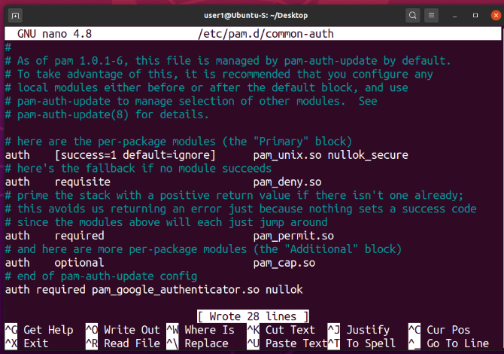
Common-auth Configuration File
This screenshot should show the entry that indicates the use of the Google Authenticator module.

Slide 16
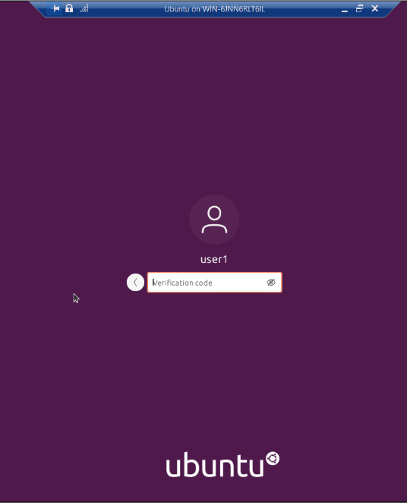
MFA Logon Screen
This screenshot should show the logon screen where a verification code is required.

Slide 17
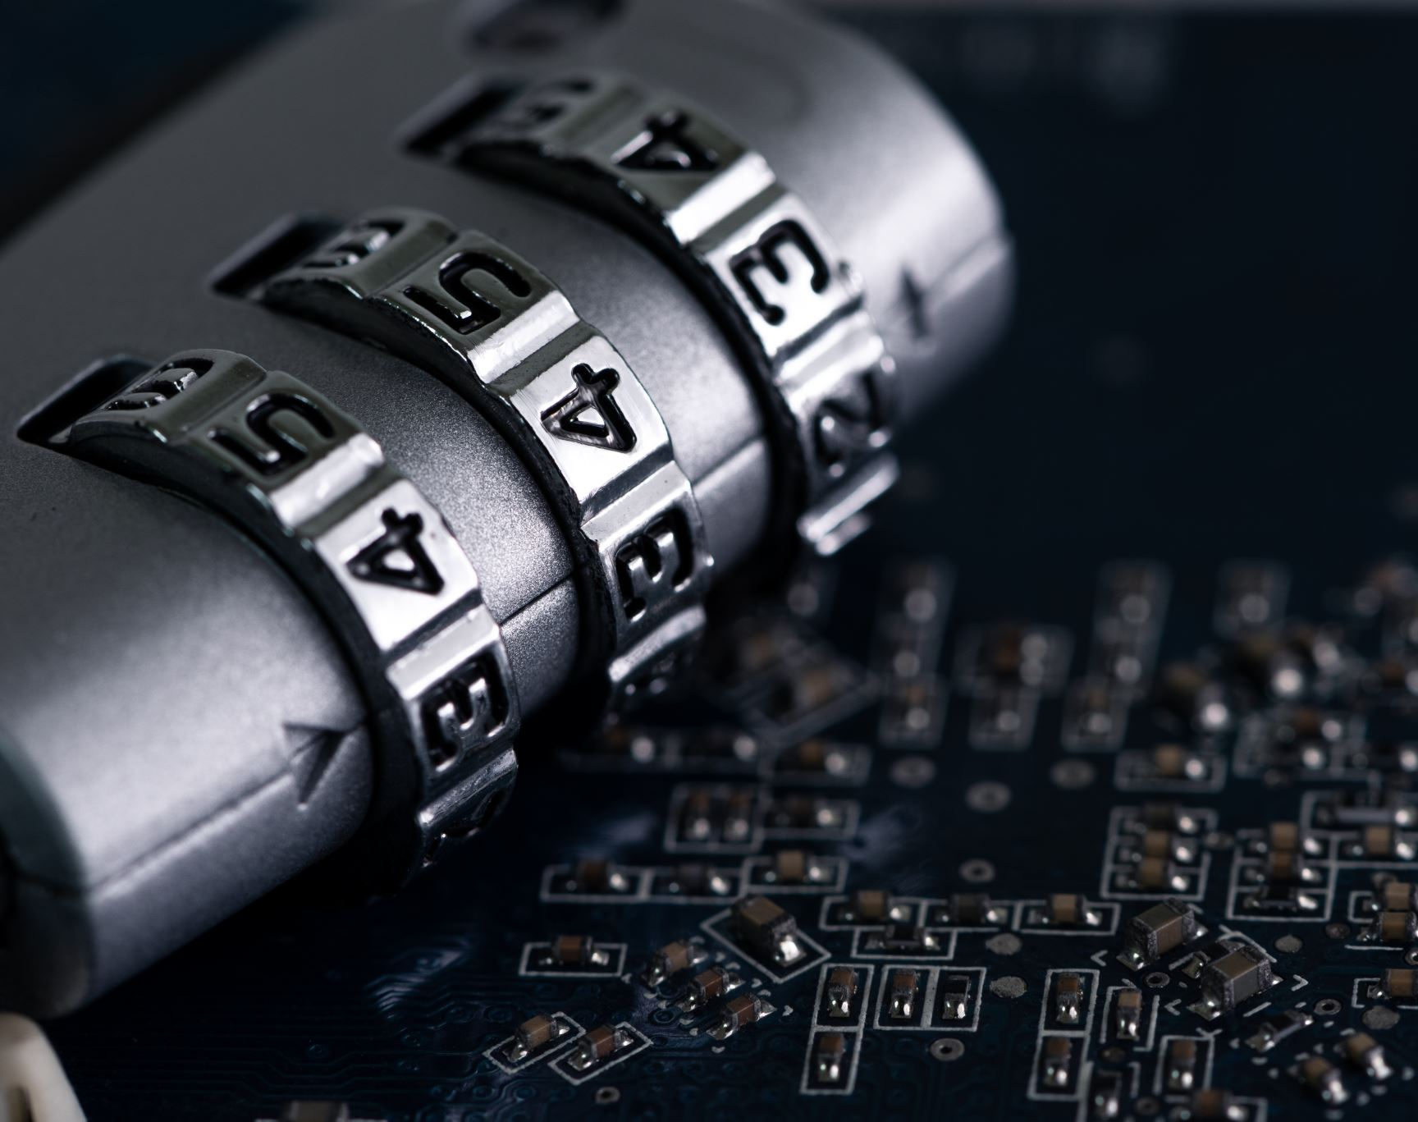
Vulnerability Assessment

Slide 18
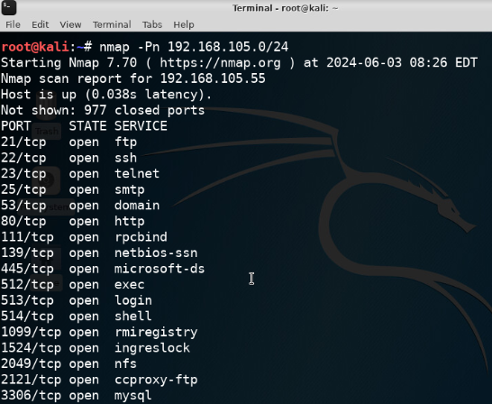
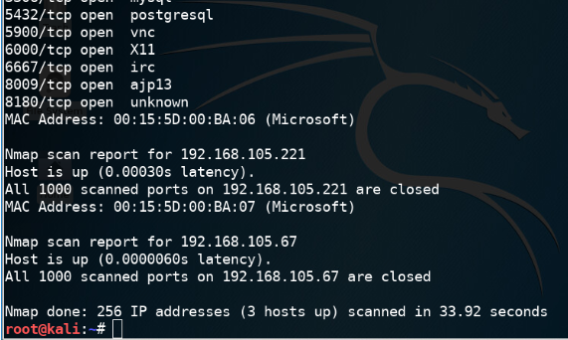
Nmap
This screenshot should include the scan result showing both the Kali and Linux Server VMs.

Slide 19
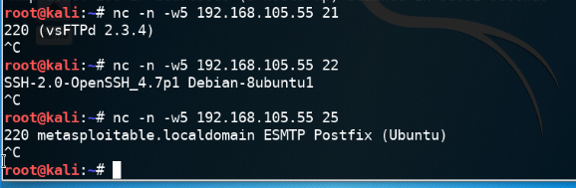
NetCat
This screenshot should include the scan result showing both the Kali and Linux Server VMs.

Slide 20
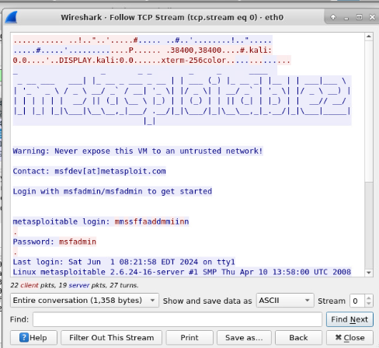
Wireshark
This screenshot should include the Wireshark—Follow TCP Steam window showing the Telnet username and password.

Slide 21
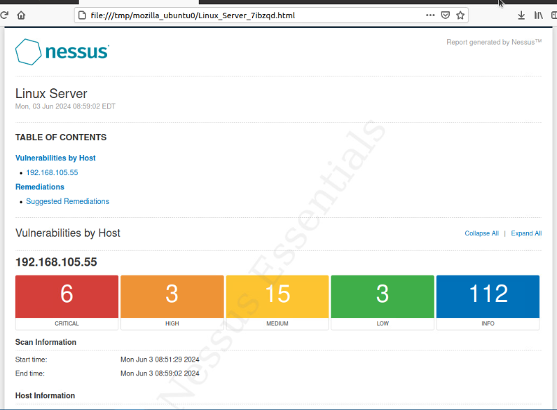
Nessus
This screenshot should include the high-level view of the Nessus vulnerability scan report (showing categories of vulnerability in different colors).

Slide 22
Challenges
Several challenges were encountered, including the complexity of setting up asymmetric key encryption and managing firewall rules. Developing a comprehensive BYOD security policy and configuring multifactor authentication also posed significant difficulties. Additionally, effectively using vulnerability assessment tools like Nmap and Nessus required a deep understanding of their functionalities and accurate interpretation of results.

Slide 23
Career Skills
Encryption Techniques: Understanding and applying asymmetric key encryption for securing data transmission.
Firewall Configuration: Configuring and managing stateful firewalls to control network traffic and prevent unauthorized access.
BYOD Security Policy Development: Creating and enforcing security policies for personal devices in the workplace, including the implementation of Mobile Device Management (MDM) solutions.
Multifactor Authentication (MFA): Configuring and utilizing MFA to enhance security by requiring multiple forms of verification.
Vulnerability Assessment: Using tools like Nmap, NetCat, Wireshark, and Nessus to identify and address security vulnerabilities in information systems.
Security Compliance: Ensuring compliance with security standards and frameworks such as HIPAA, PCI-DSS, GDPR, NIST, and ISO/IEC 27001.
Incident Response: Developing and implementing procedures for responding to security incidents and mitigating potential threats.
Security Awareness Training: Educating employees on security best practices and the importance of adhering to security guidelines.
Risk Management: Conducting risk assessments to identify potential security threats and implementing measures to mitigate these risks.
Technical Documentation: Creating detailed security policies, procedures, and reports to document and communicate security measures and findings.

Slide 24

Conclusion
This Fundamentals of Information System Security project has comprehensively covered critical aspects of information security. Through modules on asymmetric key encryption, stateful firewalls, BYOD security policies, multifactor authentication, and vulnerability assessments, the project has highlighted essential strategies for safeguarding computing environments. The practical demonstrations of encryption, firewall configuration, device management, and security tools have provided valuable insights into protecting data confidentiality, integrity, and availability. By implementing these security measures, organizations can effectively mitigate risks and enhance their overall security posture. This project underscores the importance of a multi-layered approach to information security, ensuring robust protection against evolving threats.

Slide 25

References
1. Keary, T., & Keary, T. (2022, December 6). The Beginner’s Guide to IP Tables. Comparitech. https://www.comparitech.com/net-admin/beginners-guide-ip-tables/
2. Instructional guide in the project

