Slide 1


CEIS 101 COURSE PROJECT SMART HOME AUTOMATION AND SECURITY SYSTEM
Presented by: Louimiah J. Lavinier

Slide 2

INTRODUCTION
I built this smart home automation and security system by first building the prototype with Tinkercad, using the Tech Core Kit to build the hardware, and using Arduino IDE to program it.
The smart home system is comprised of several components to detect different conditions of the home. The smart home consists of a door sensor to check if the door is opened or closed, distance sensor monitor for home intruders, automated lights that detects when its dark and turns on, water level sensor to monitor for possible flooding, temperature and humidity sensor to monitor weather conditions.

Slide 3

CIRCUIT SIMULATION IN TINKERCAD

Slide 4
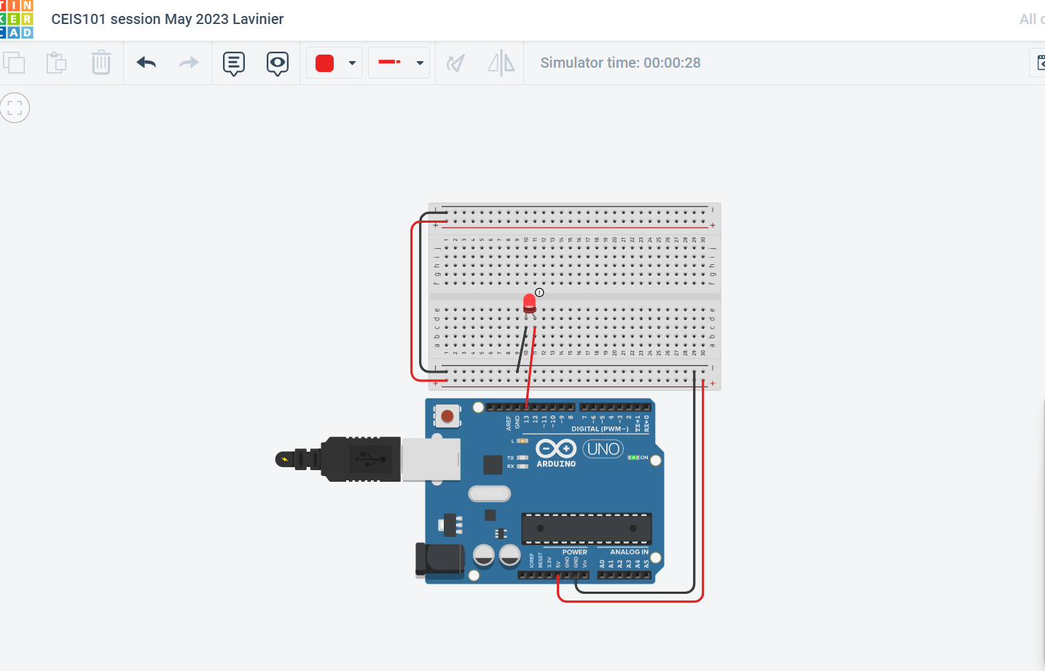
TINKERCAD CIRCUIT

Slide 5
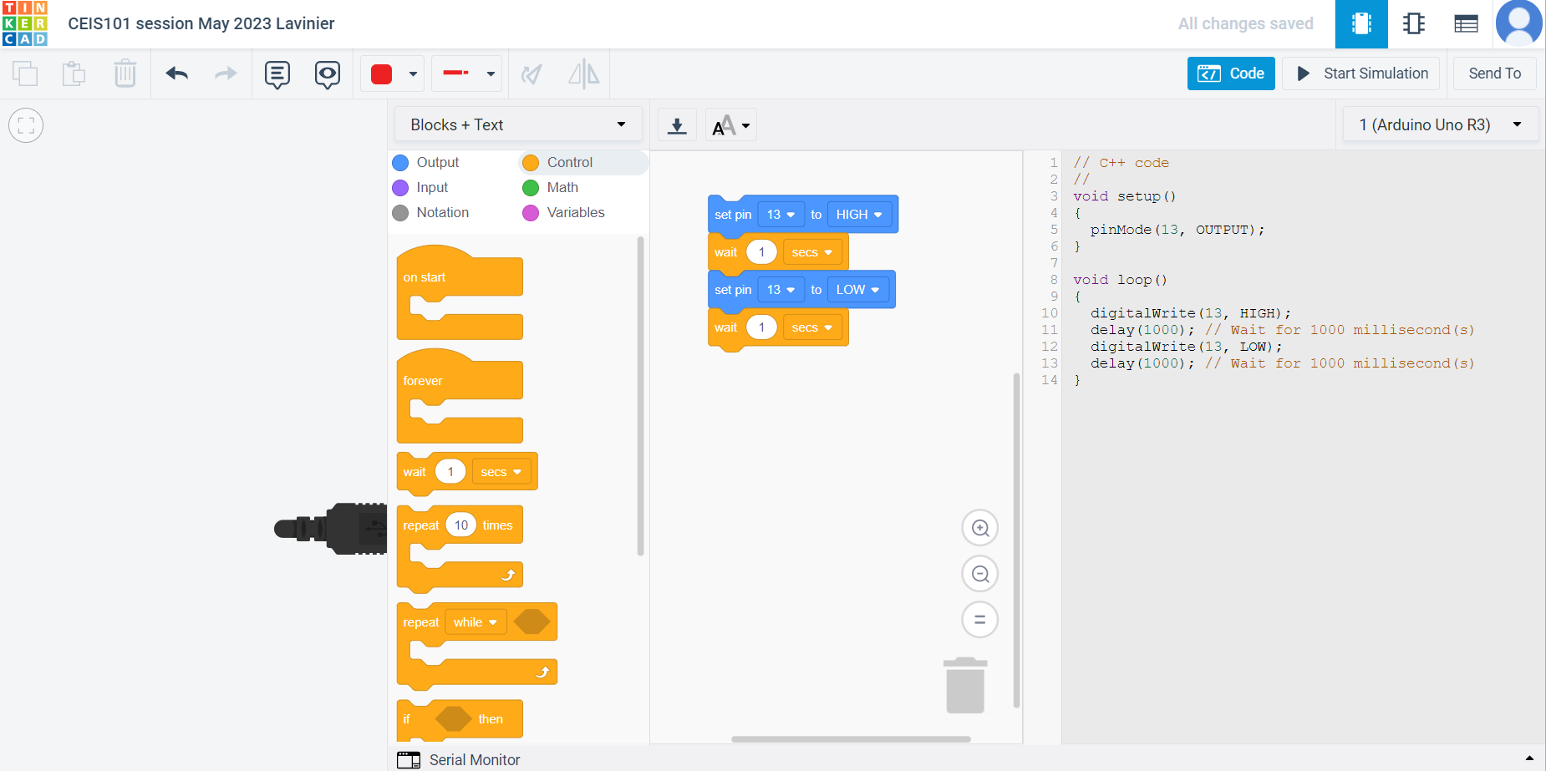
Tinkercad
Code

Slide 6
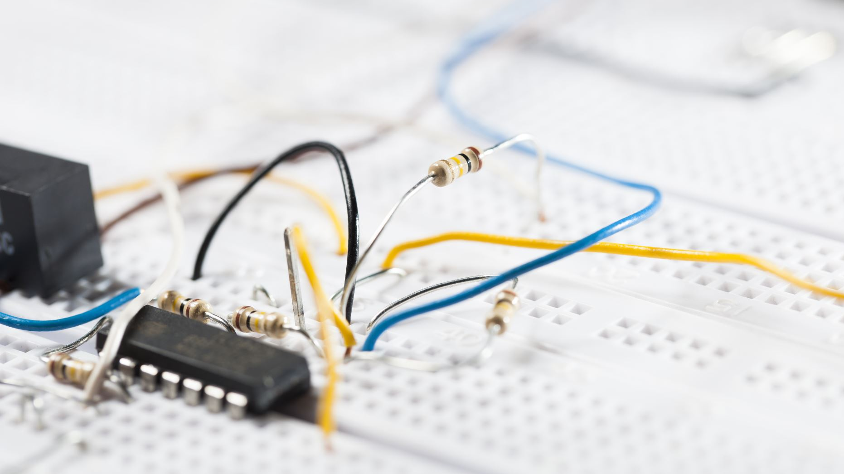
INVENTORY OF PARTS, CIRCUIT BUILDING, AND DISPLAYING OF MESSAGES

Slide 7
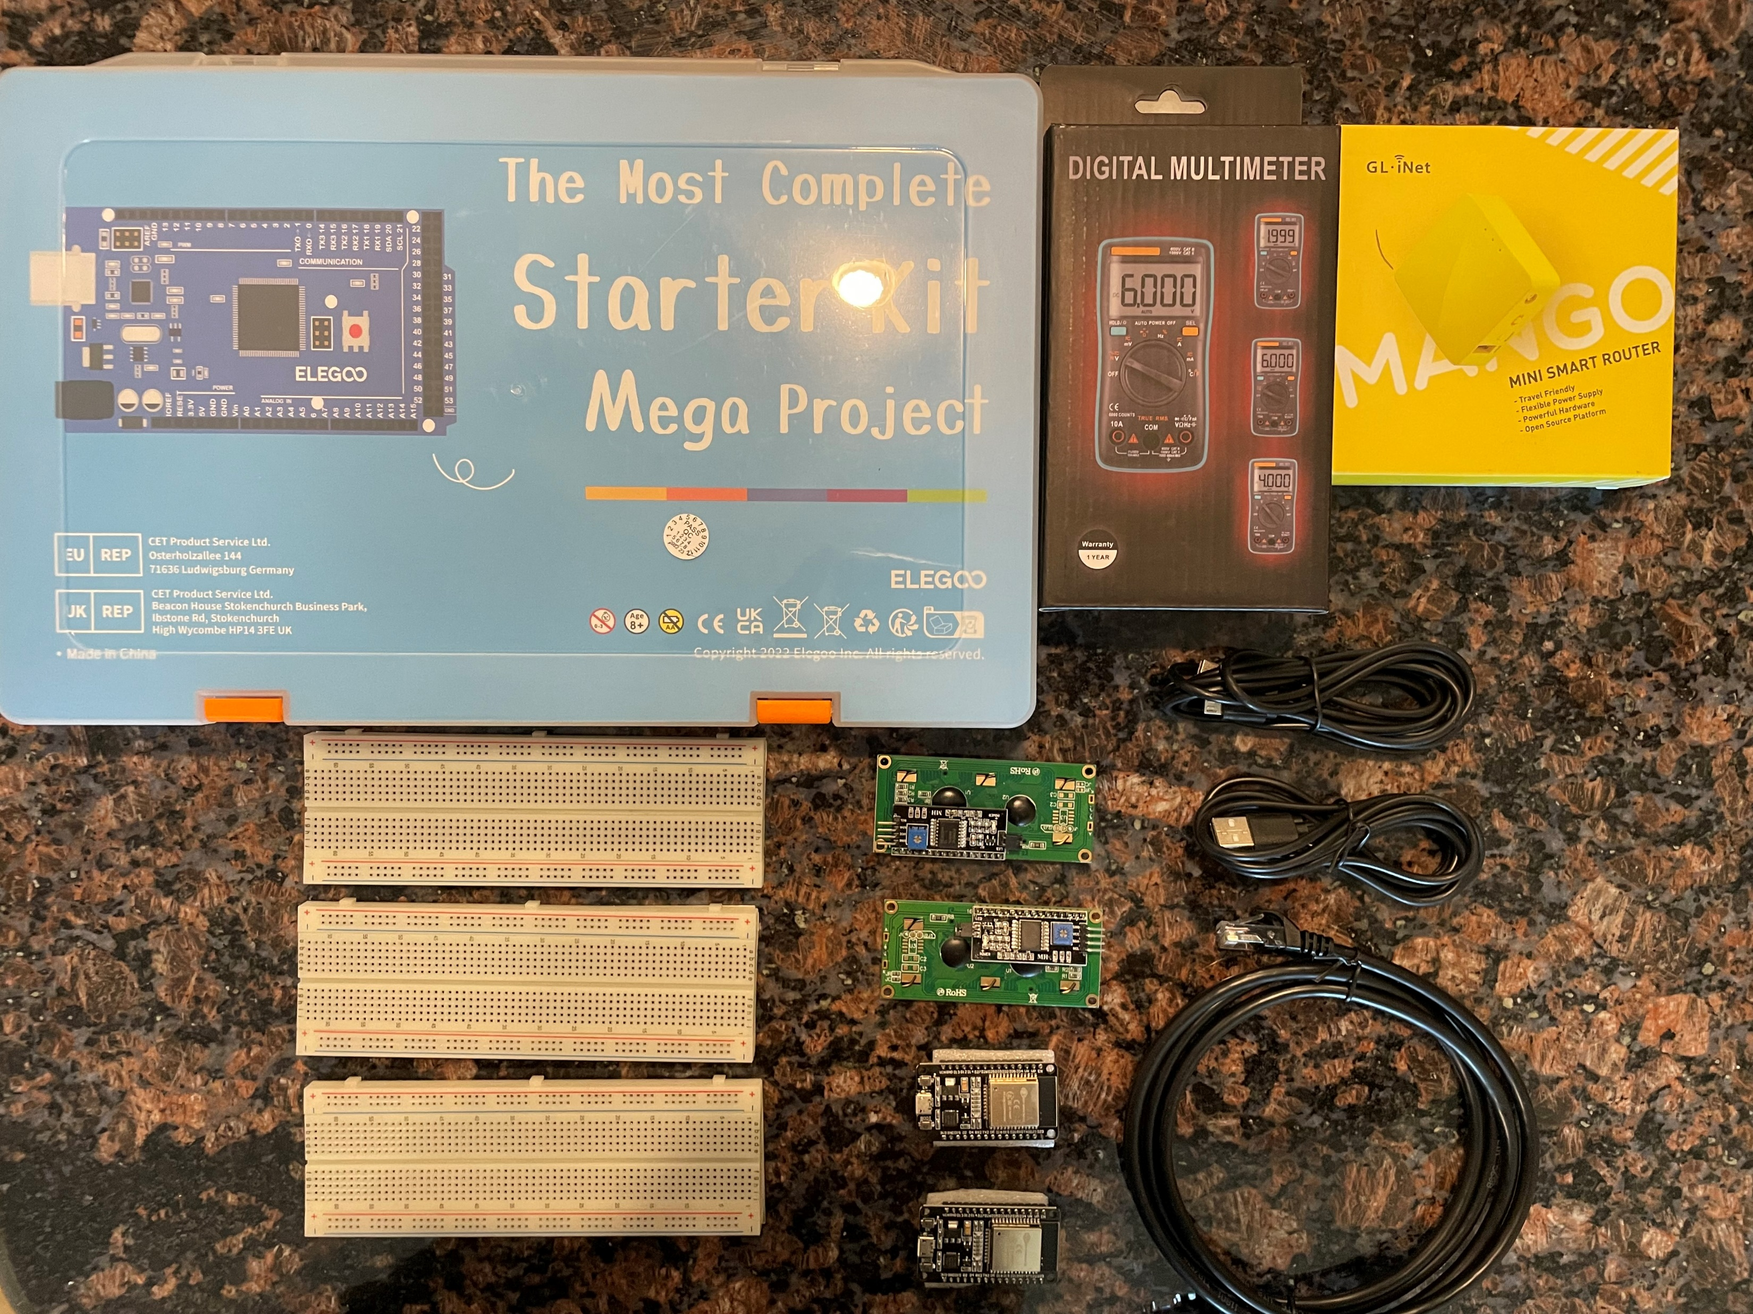
INVENTORY OF IOT KIT
Tech Core Lab Kit
ESP32 (2)
LCD Modules (2)
Breadboards (3)
Mini Router
Patch Cable
Digital Multi meter
USB to Micro USB (2)

Slide 8
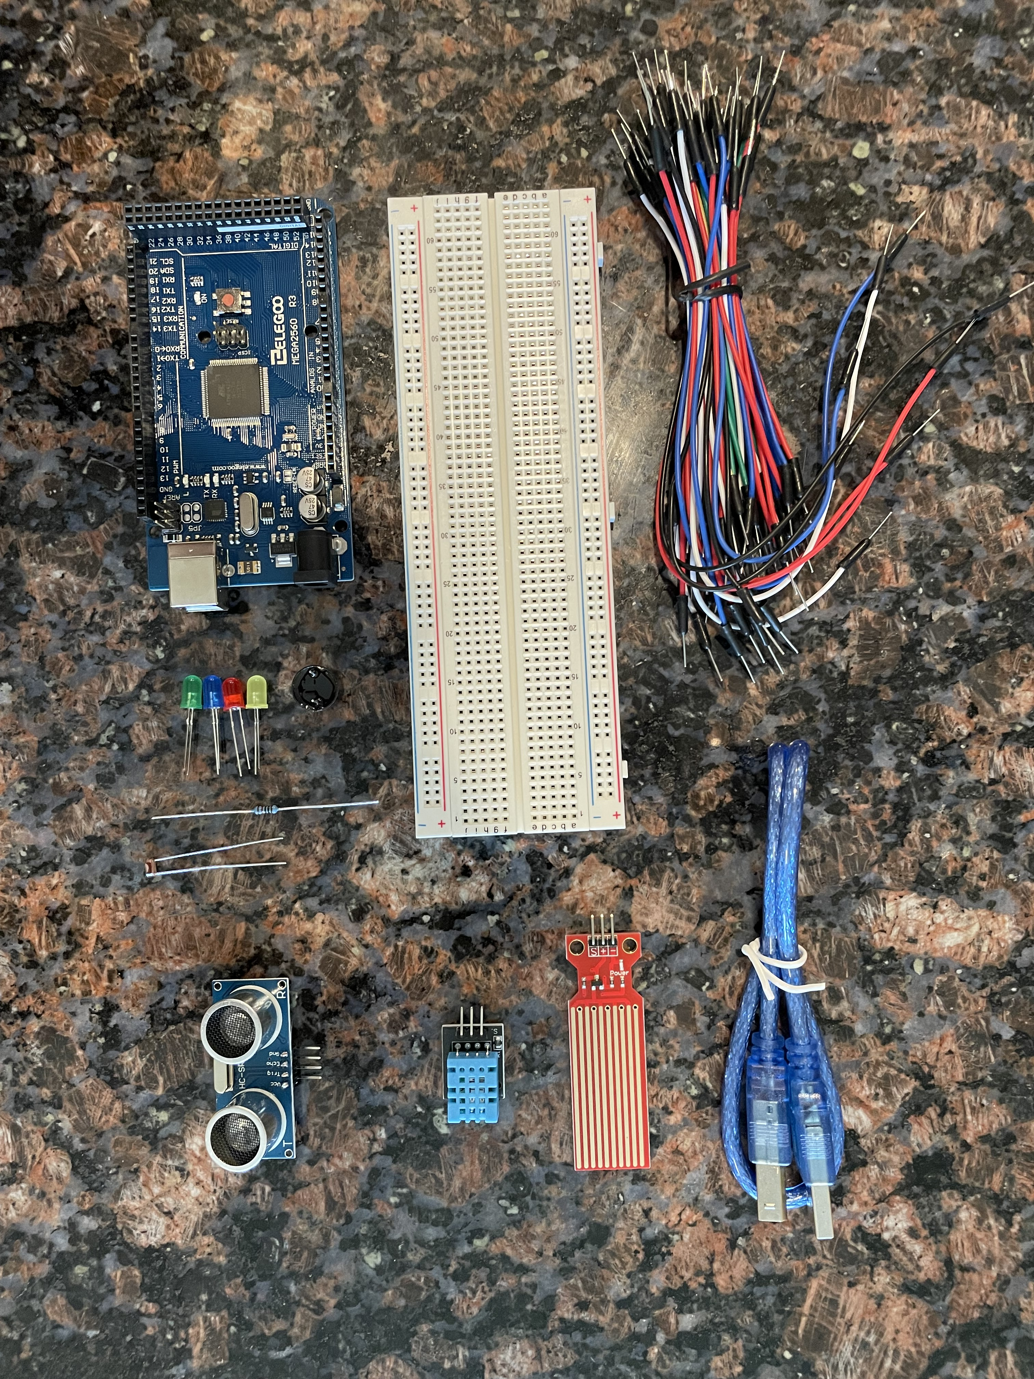
ORGANIZATION OF PROJECT COMPONENTS
Arduino Mega 2560
Breadboard
Resistor 10k
LEDs
Ultrasonic Sensor
Passive Buzzer
Photoresistor
Wires
USB Type B cable
Water Sensor
DHT-11 Sensor

Slide 9
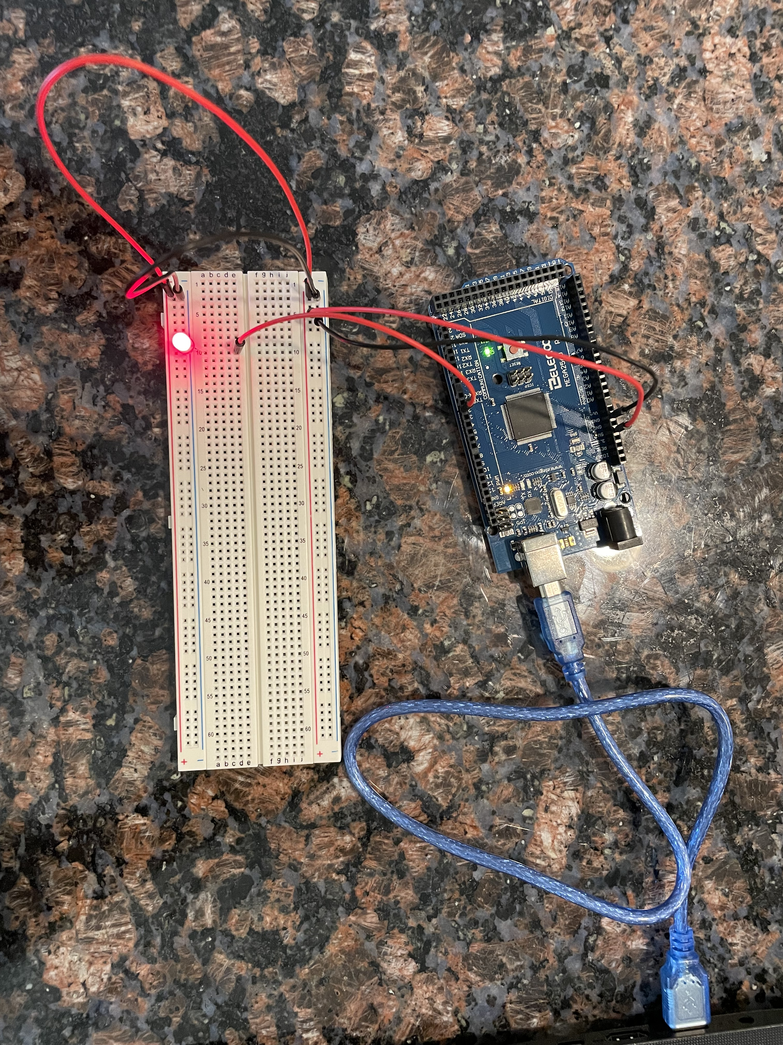
CIRCUIT WITH RED LIGHT ON

Slide 10
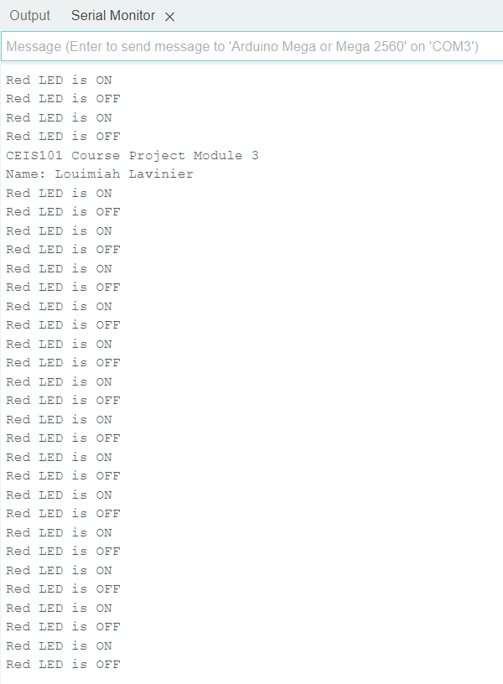
SERIAL MONITOR

Slide 11

ADDING DOOR SENSOR TO SMART HOME SYSTEM

Slide 12
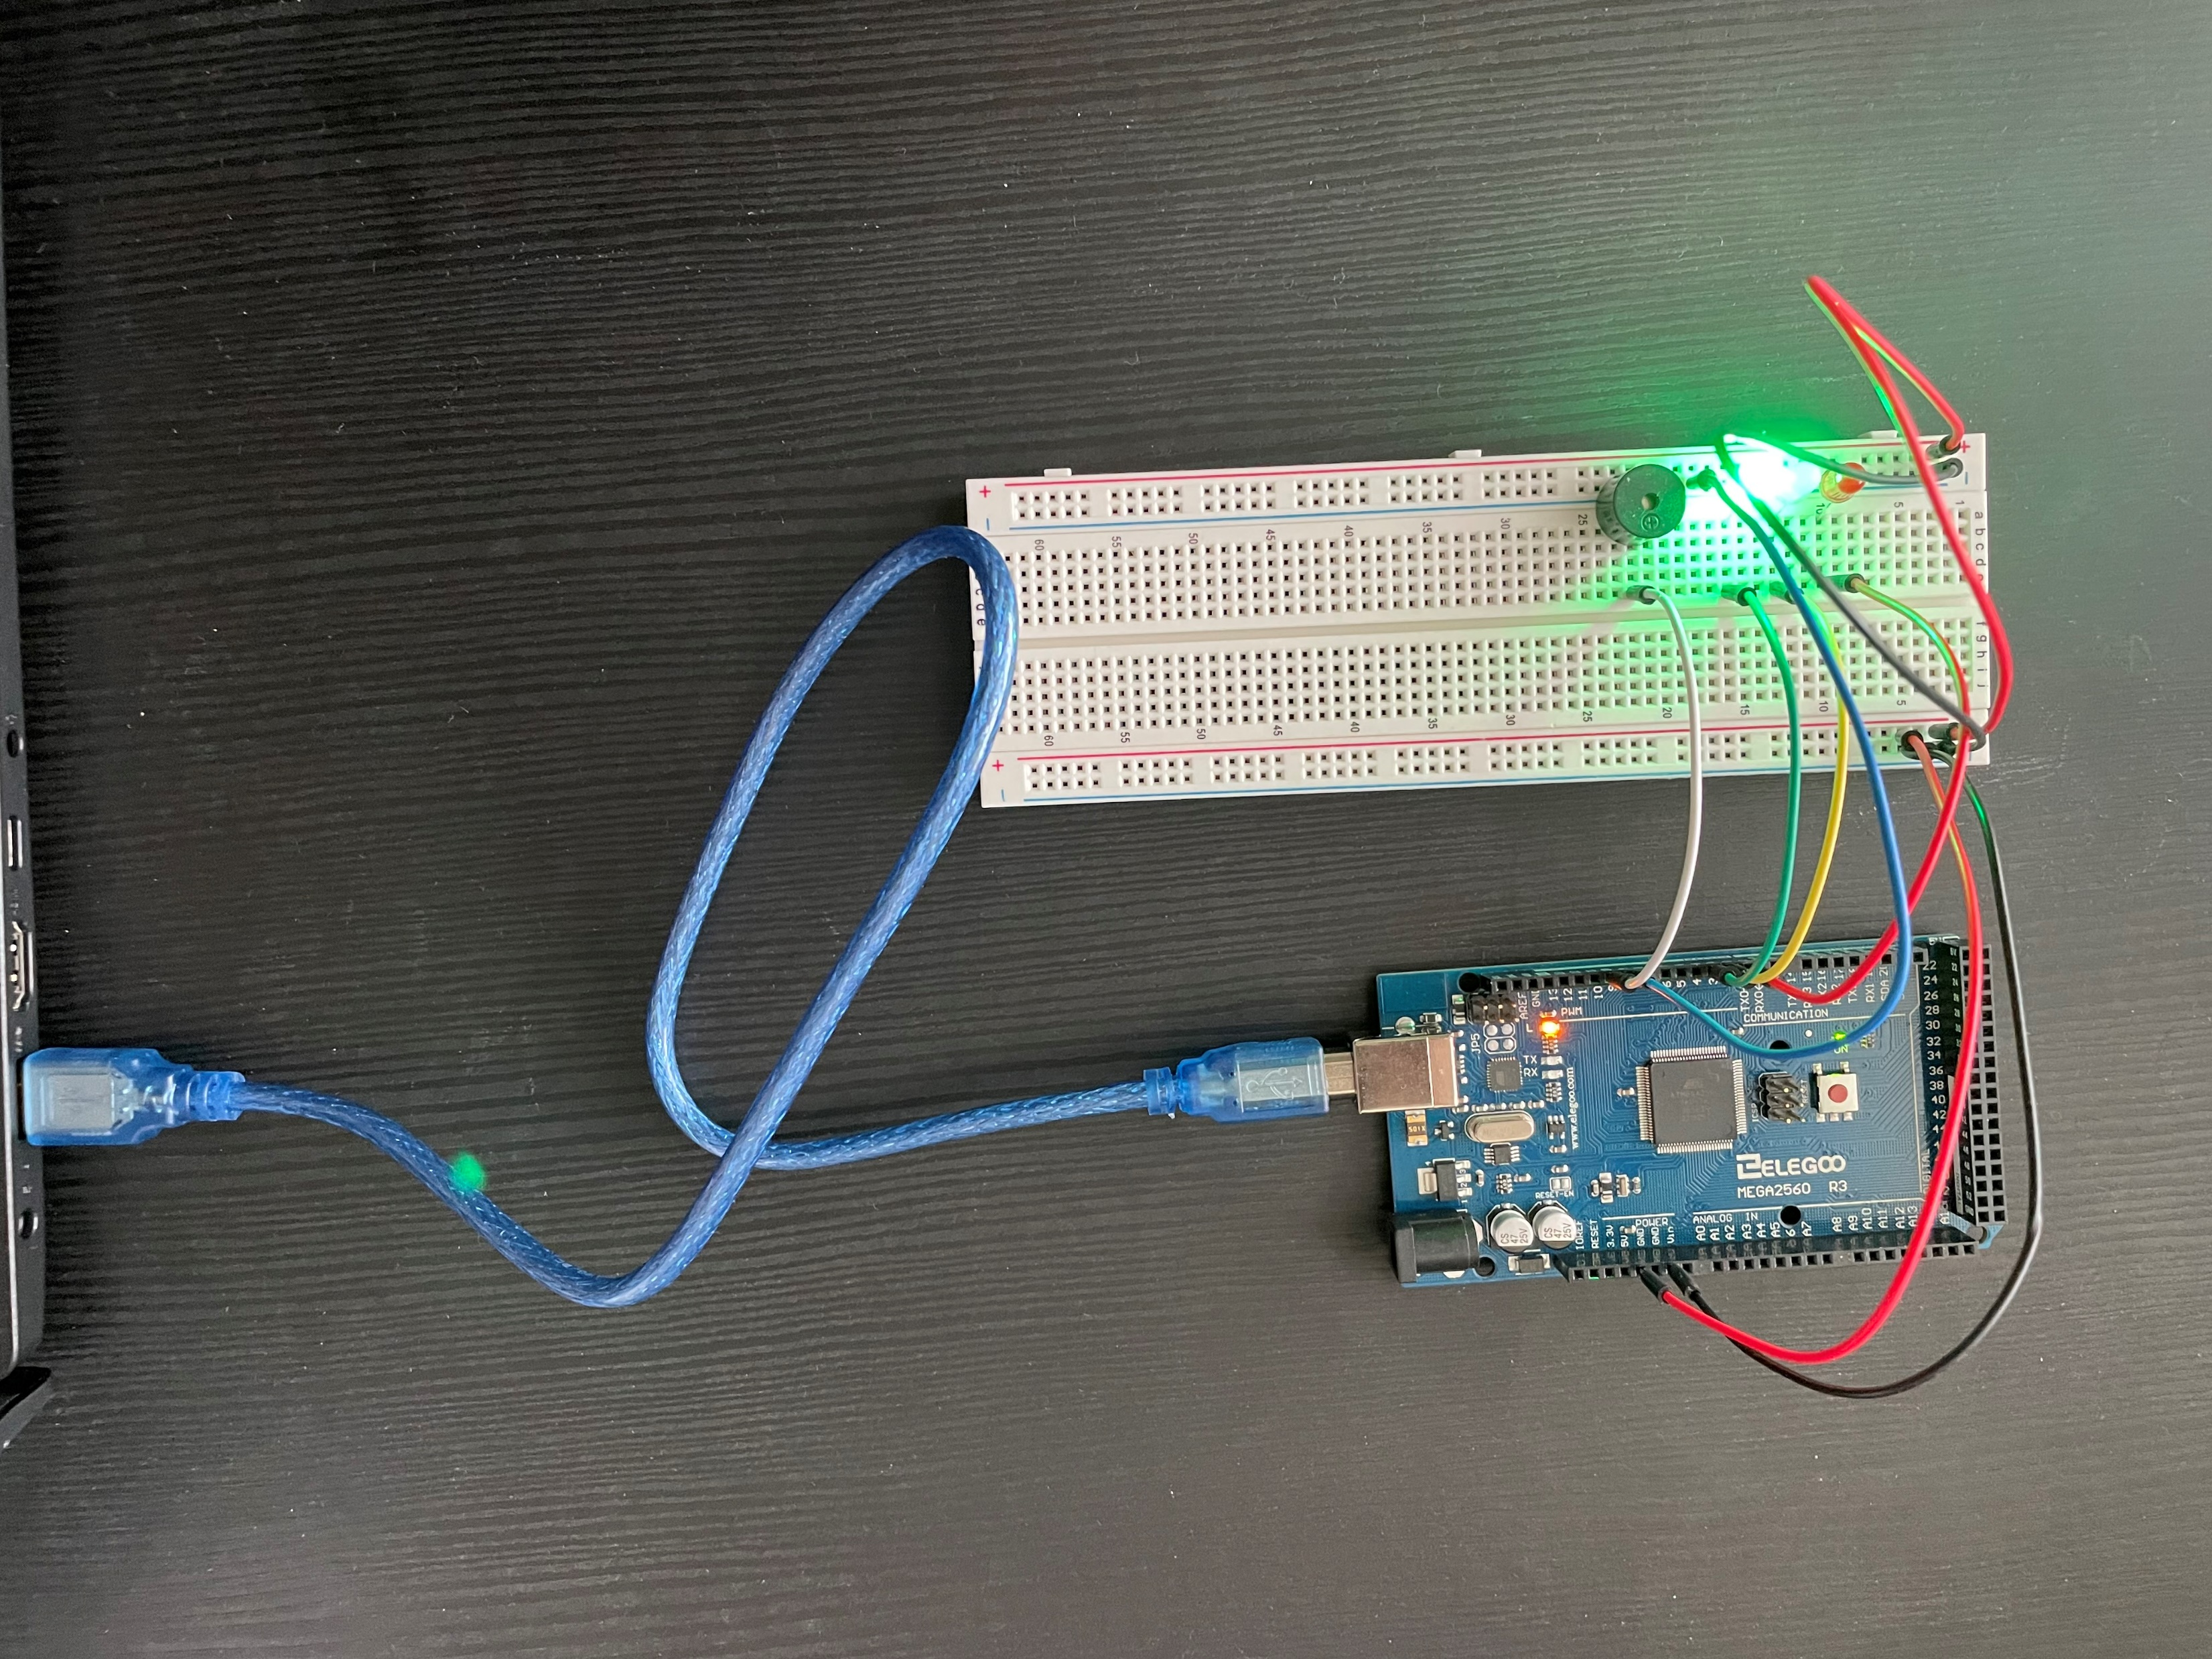
CIRCUIT OF DOOR CLOSED WITH GREEN LED ON

Slide 13
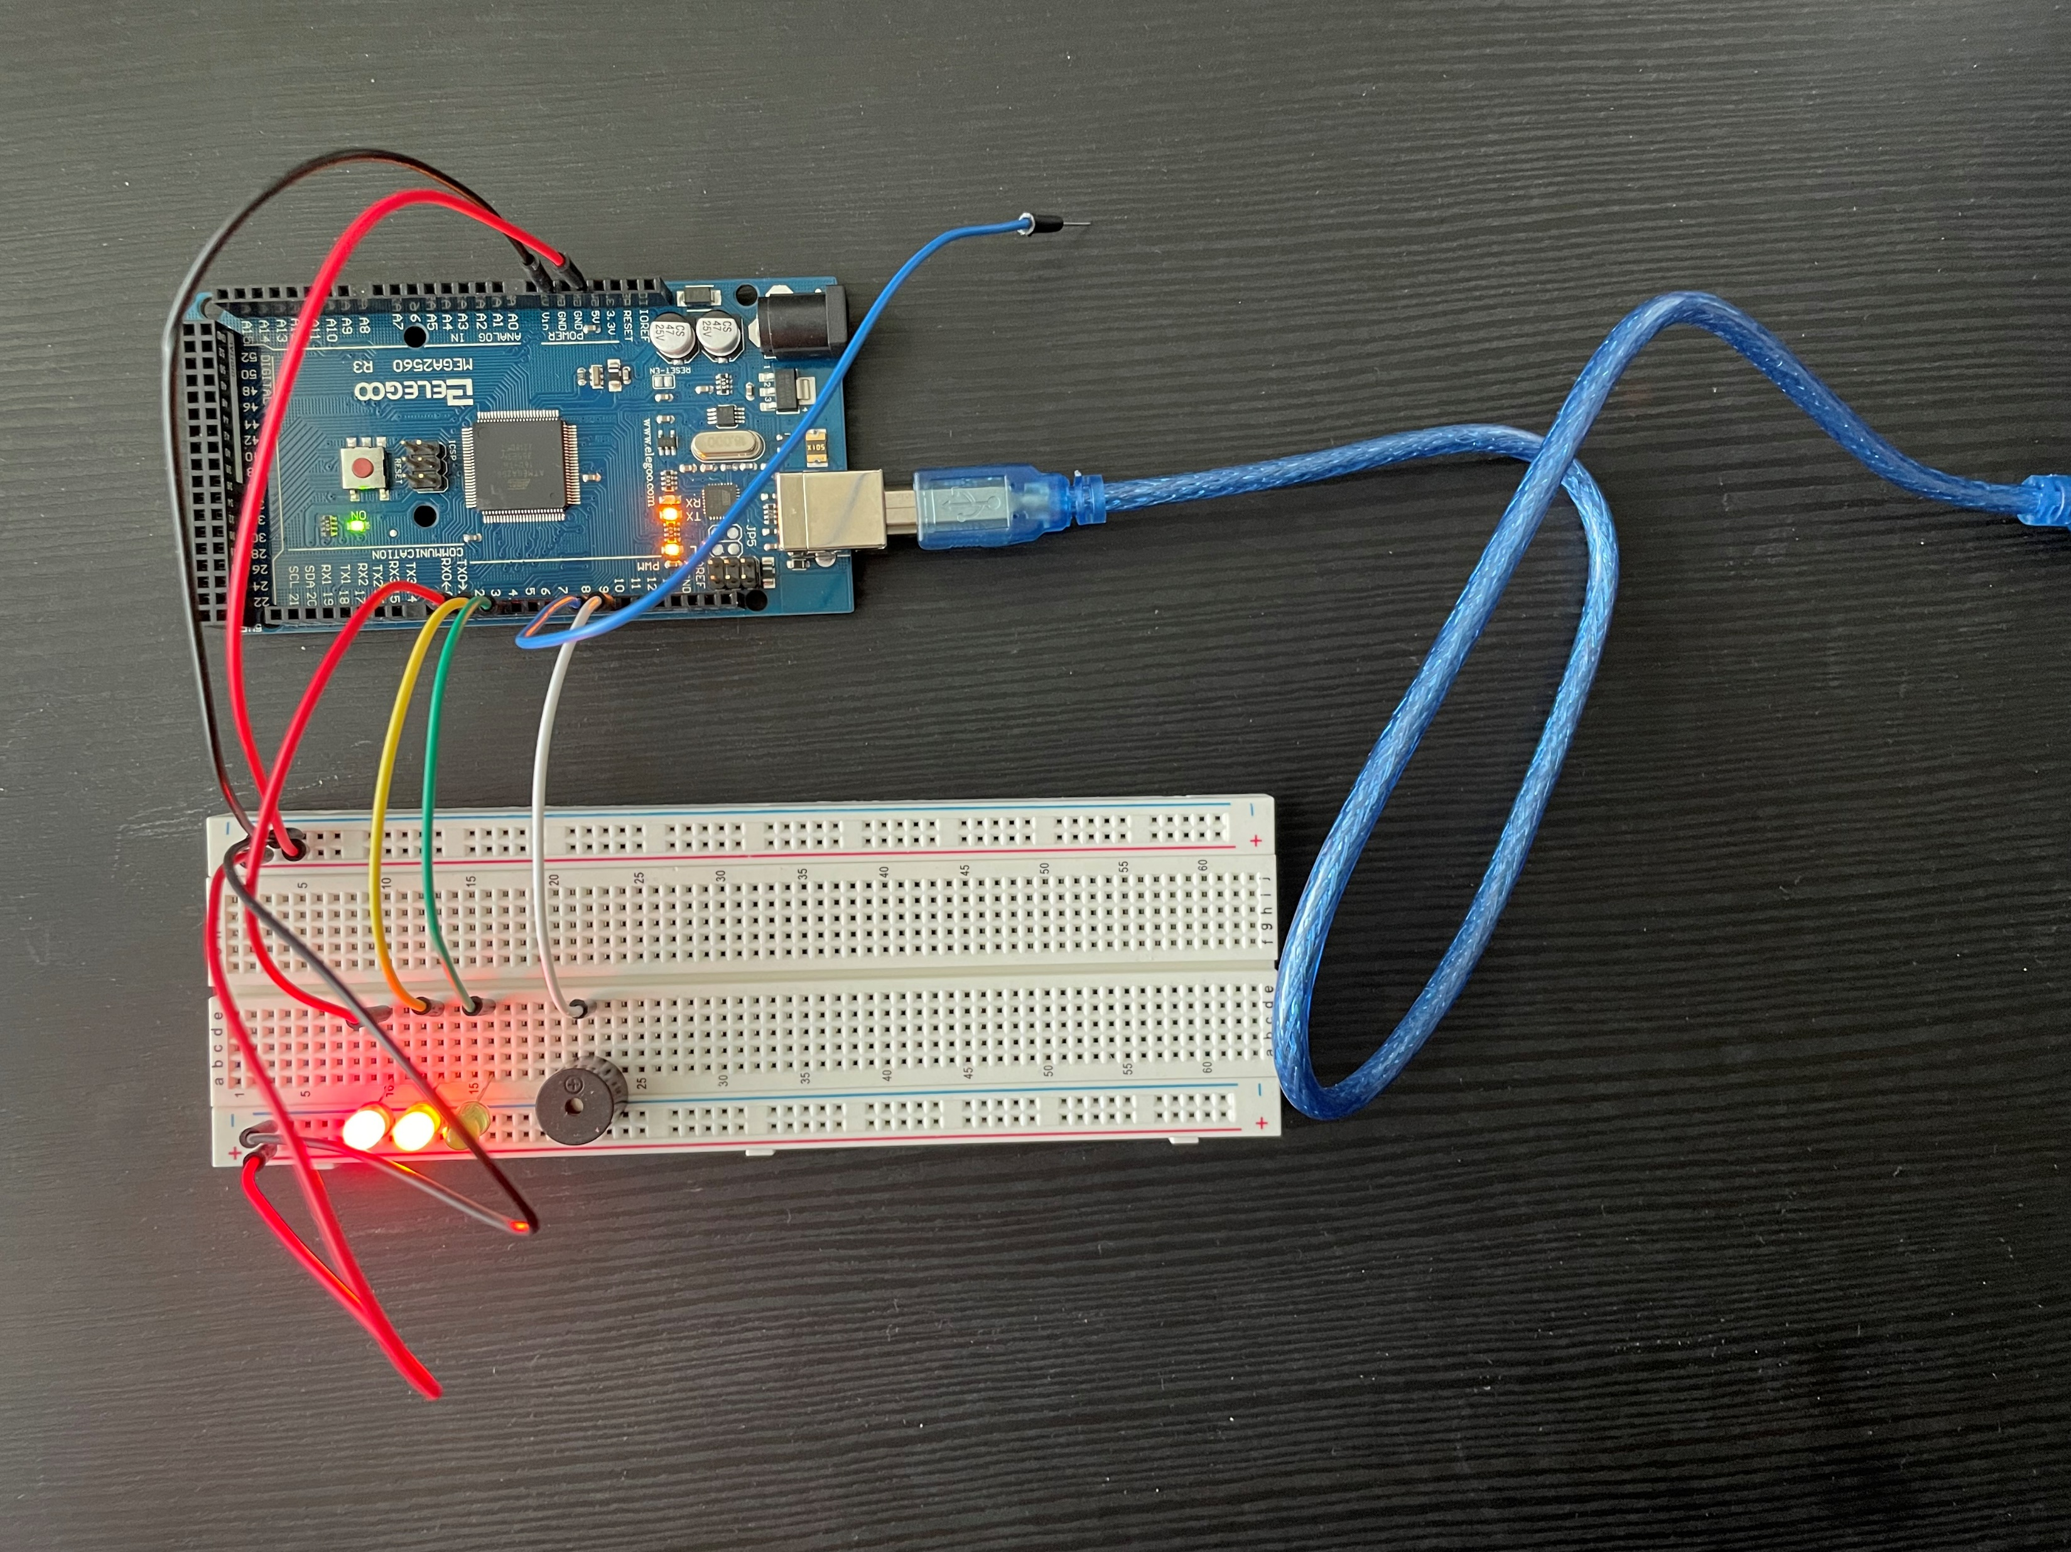
CIRCUIT OF DOOR OPENED WITH GREEN LED OFF

Slide 14
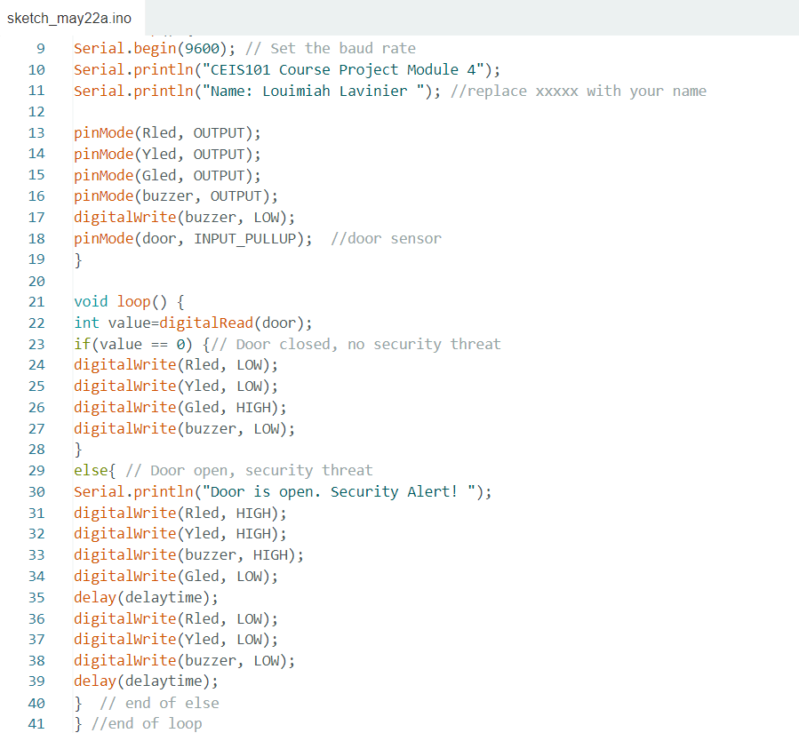
ARDUINO CODE

Slide 15
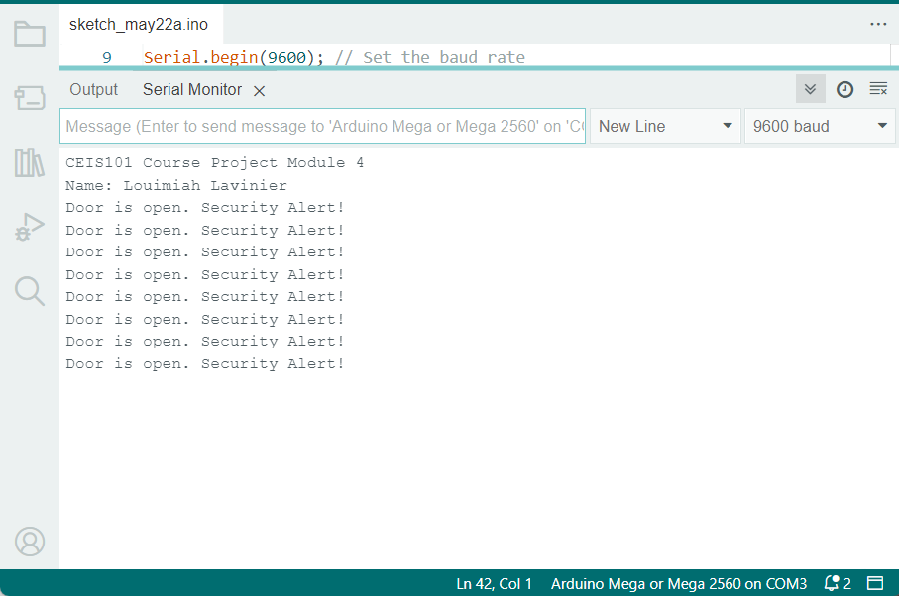
SERIAL MONITOR

Slide 16
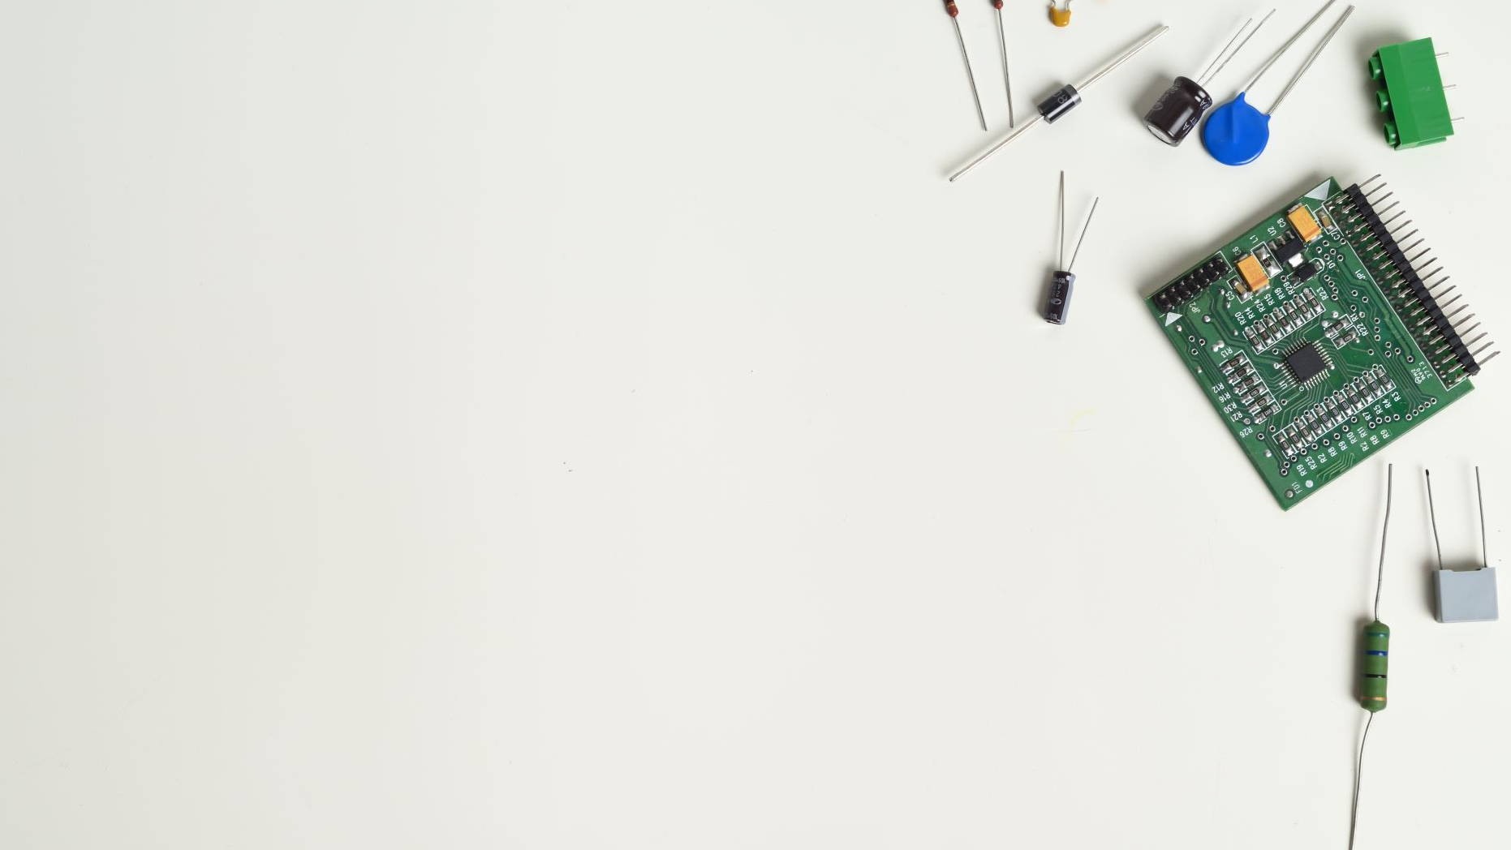
ADDING DISTANCE SENSOR TO SMART HOME SYSTEM AND CONDUCTING DATA ANALYSIS

Slide 17
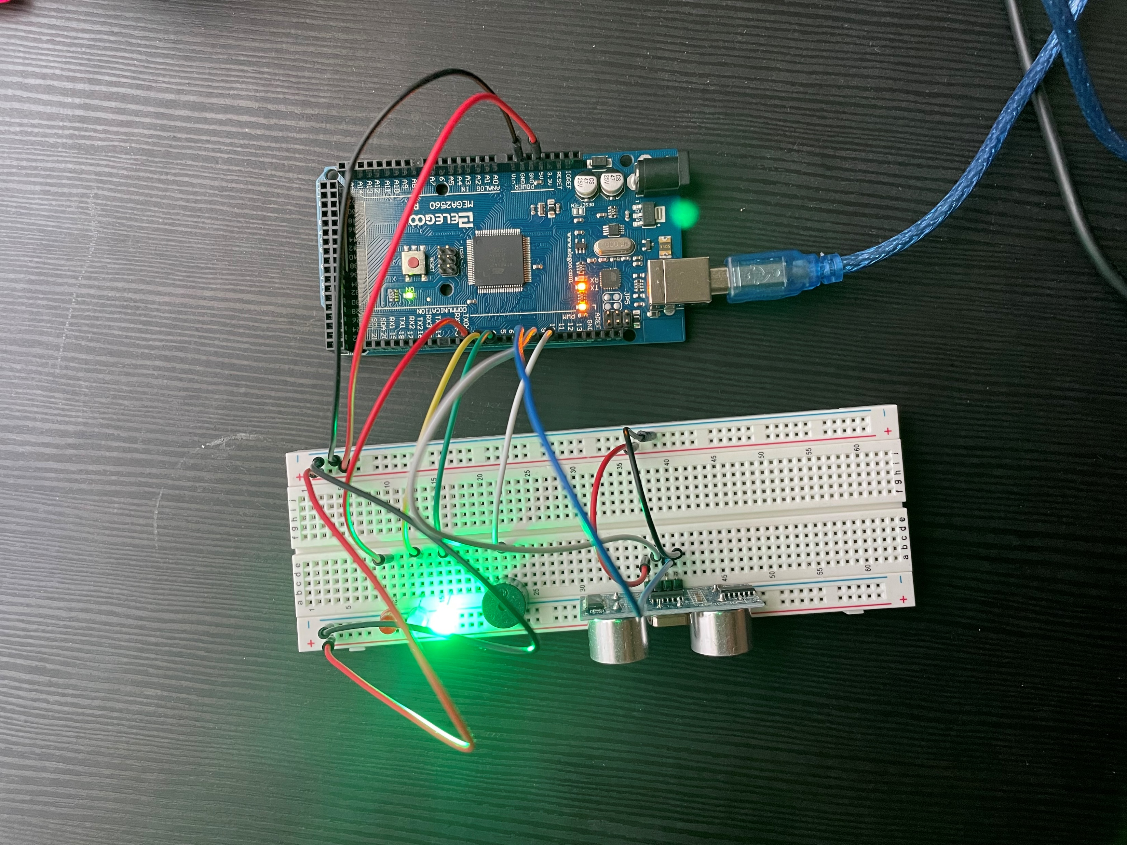
CIRCUIT WITH GREEN LED ON

Slide 18
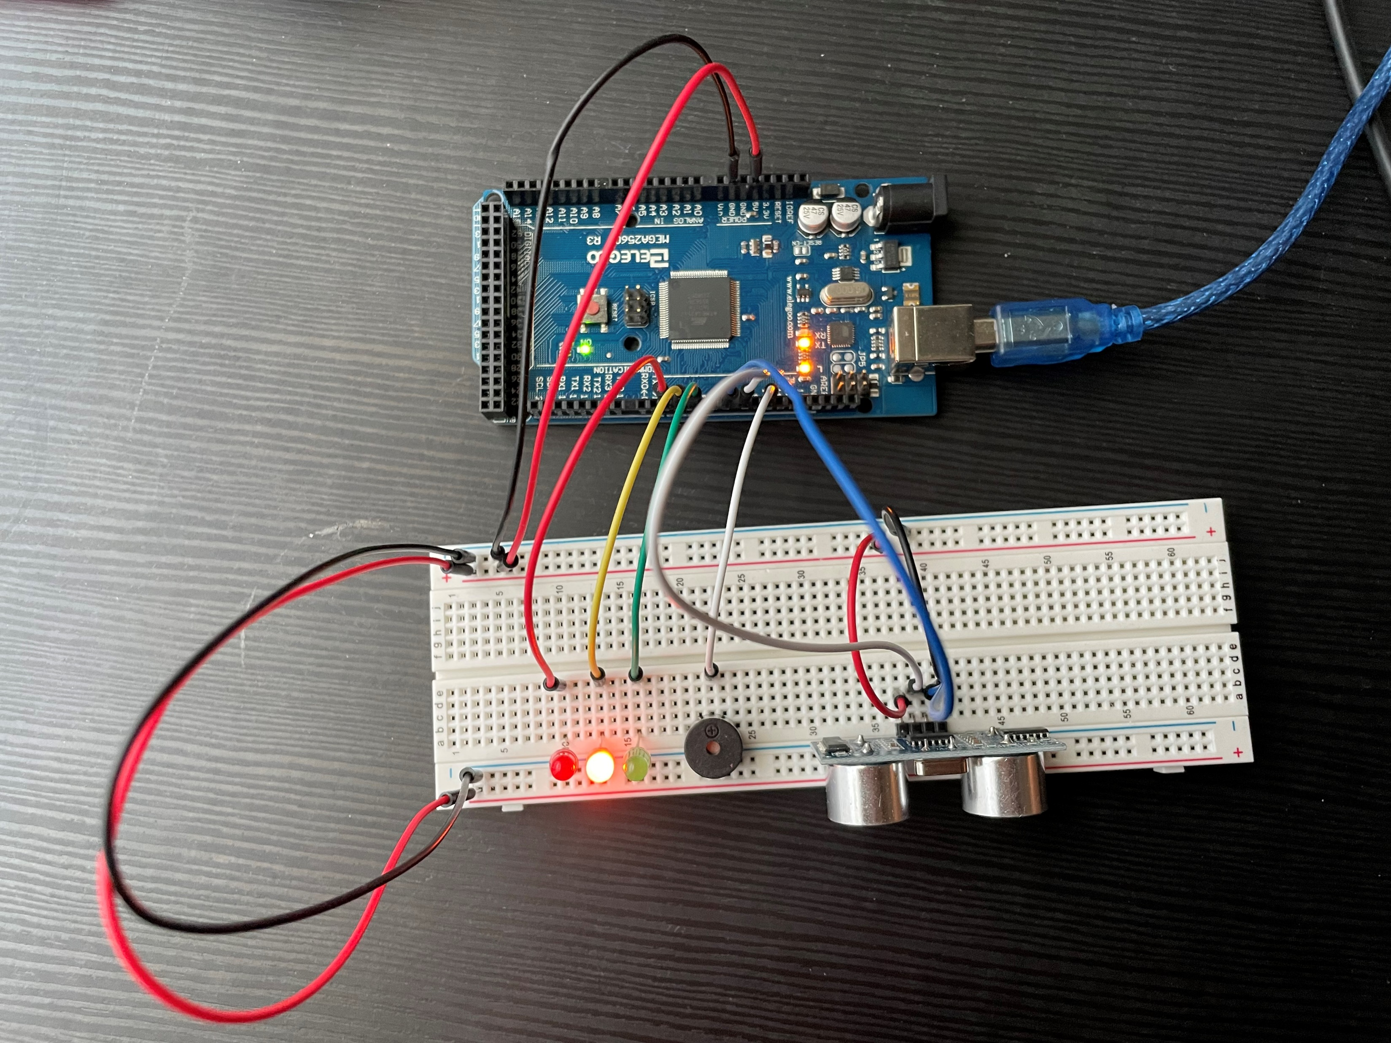
CIRCUIT WITH YELLOW LED

Slide 19
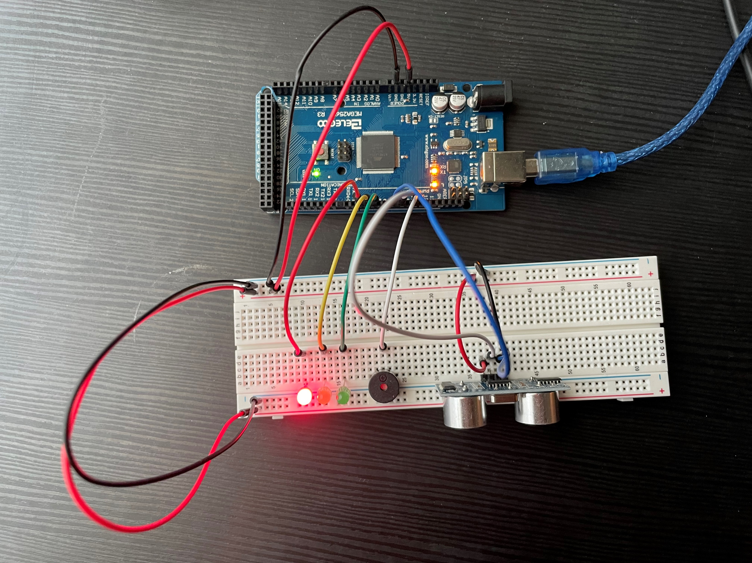
CIRCUIT WITH RED LED ON

Slide 20
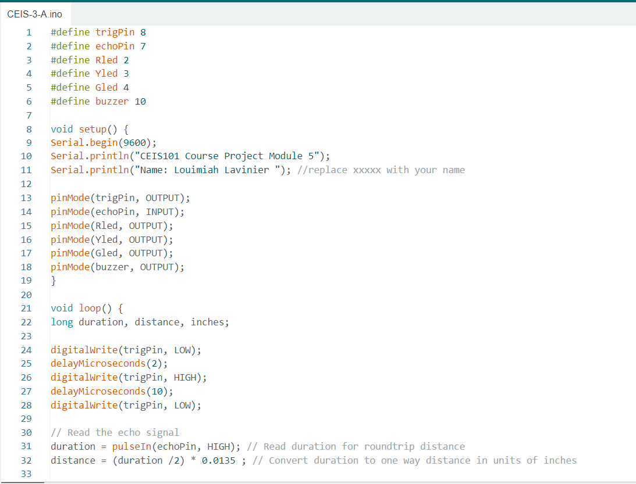
ARDUINO CODE

Slide 21
PLOT OF DATA

Slide 22

ADDING AUTOMATED LIGHT TO SMART HOME SECURITY SYSTEM

Slide 23
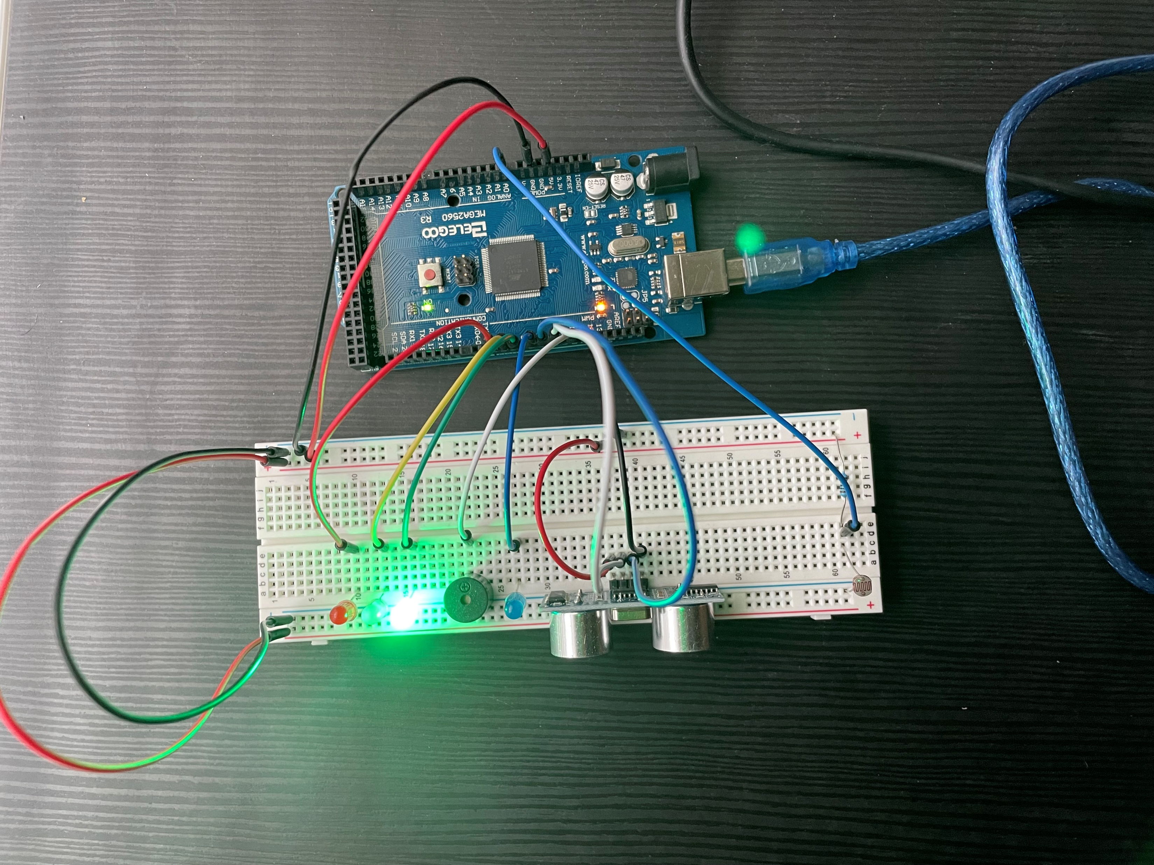
CIRCUIT WITH AUTOMATED LED OFF

Slide 24
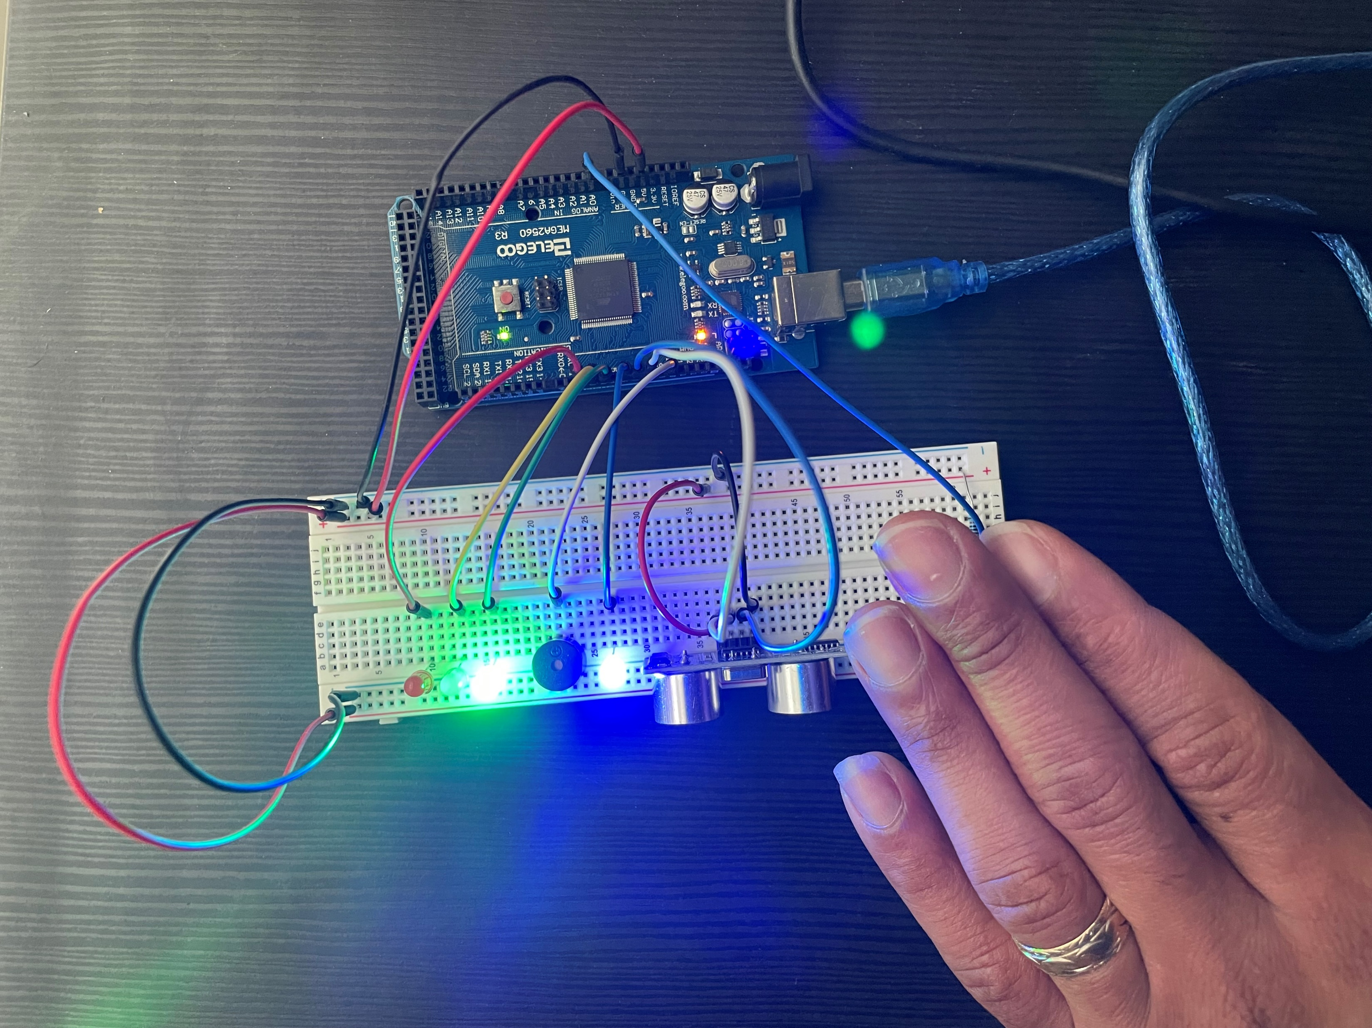
CIRCUIT WITH AUTOMATED LED ON

Slide 25
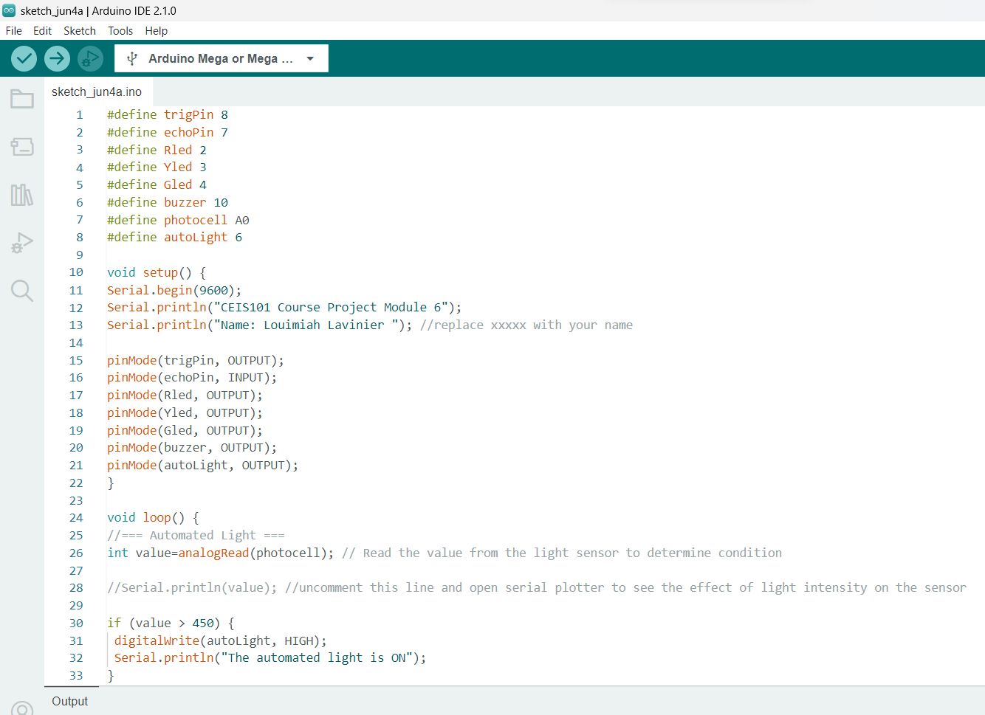
ARDUINO CODE

Slide 26
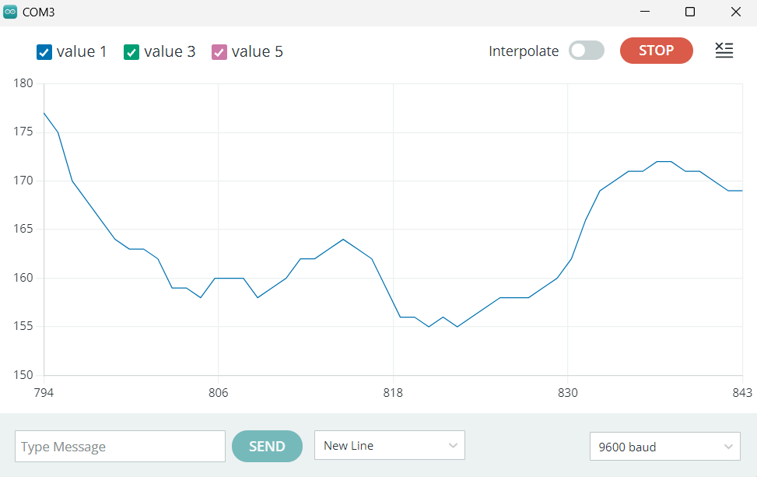
SERIAL PLOTTER

Slide 27

ADDING WATER LEVEL SENSOR AND DHT-11 SENSOR TO SMART HOME SECURITY SYSTEM

Slide 28
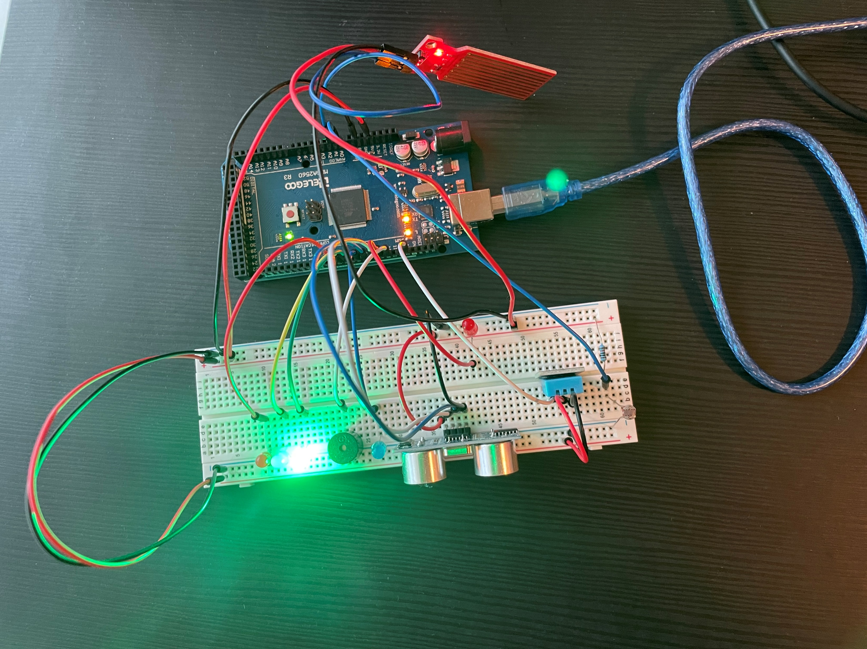
CIRCUIT

Slide 29
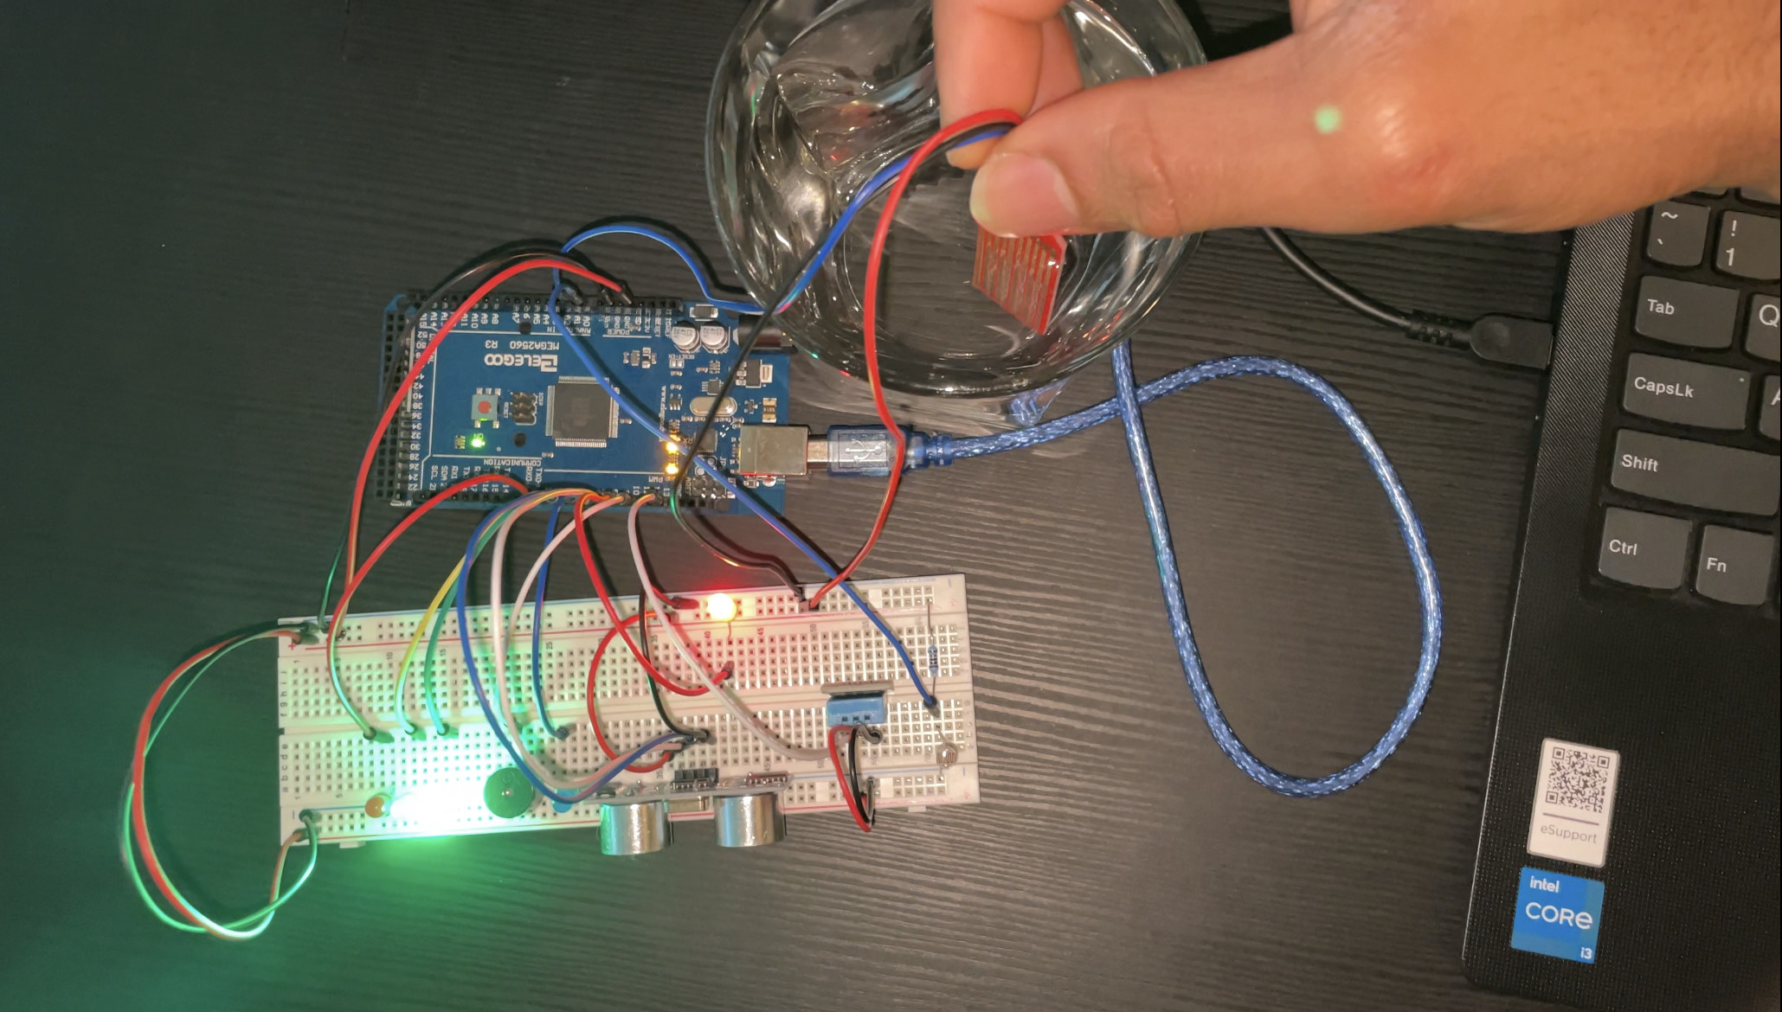
RED LED ON FOR WATER SENSOR

Slide 30
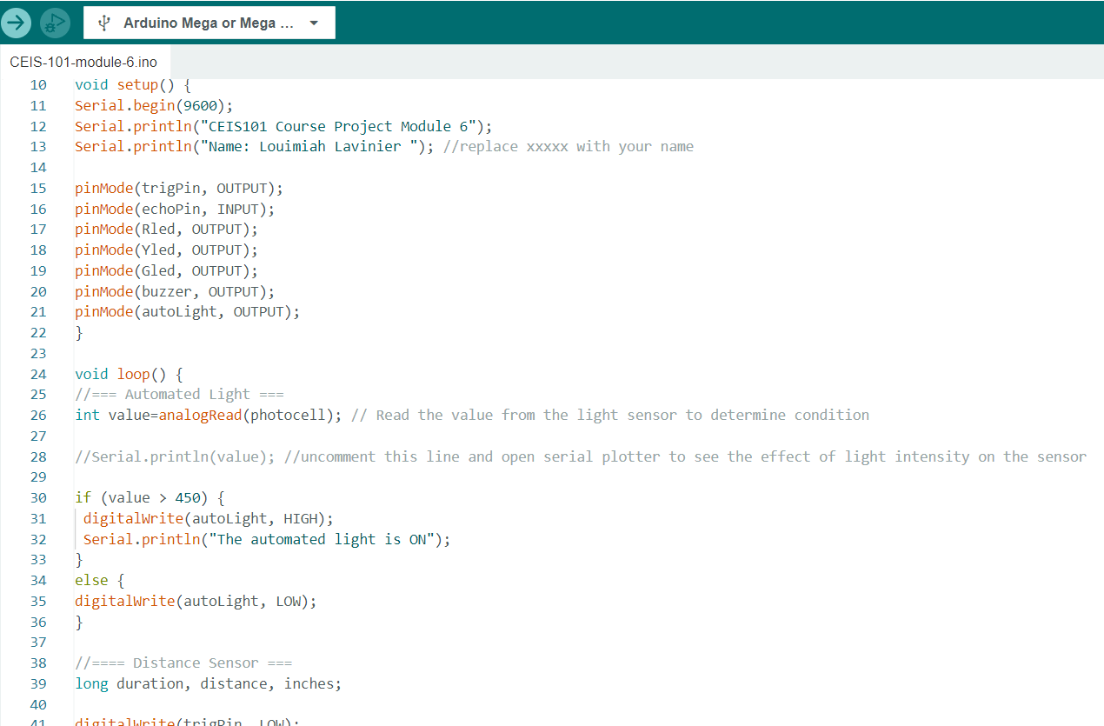
Arduino Code

Slide 31
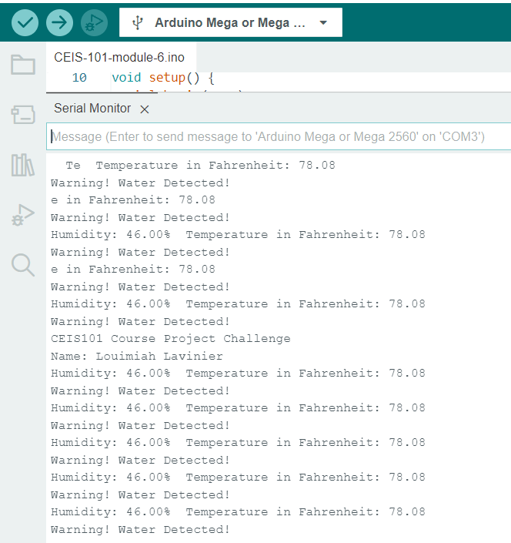
SERIAL MONITOR

Slide 32

CHALLENGES
For the most part everything came together perfectly. I took my time to understand what I was doing and making sure that I was connecting all the wires and parts correctly. Didn’t have any problems with the code until I tried to get the serial plotter output for the light sensor that was the first challenge I faced. Did some research and learnt that the serial plotter uses the Serial.println() function. I went in, checked the code, and realized that the code had already had the function it needed but it was just commented out, so I uncommented it and it started working. The next challenge I faced was the water sensor. Seemed like the power wire had a short because when I put it into the water it wasn’t working until I touched the power wire, and my last challenge was the humidity sensor. I just had to swap the data pin wire and the VCC wire. After doing so everything worked properly.

Slide 33
CAREER SKILLS
Hardware/device knowledge
Networking/connectivity ability
Coding/programming
Operating system fundamentals
Basic business intelligence and data analytic knowledge
Automation
Security awareness (at a minimum)

Slide 34
CONCLUSION
This project was a fun hands-on introduction to the internet of things (IoT) world. This project gave an insight to how many different steps there are to creating a functional IoT device. I learned to use Tinkercad to build a virtual prototype. Using the Arduino mega board, ESP32 board, and all the other components, I learned how to put/connect hardware together to build a working IoT device. I learned to program the smart home security system using Arduino IDE and bring the smart home system to life.

