Slide 1

CEIS 110 Programming with Data
By: Louimiah Lavinier

Slide 2


Introduction
The amount of data that is being collected is increasing at a rapid pace. In this project, temperature and humidity data are being collected by means of a cloud-based system. Data is then analyzed using programming and data analytics techniques to make sense of the data.

Slide 3

Software Inventory
Anaconda
Spyder(Python IDE)
Microsoft Excel
SQLite Studios

Slide 4

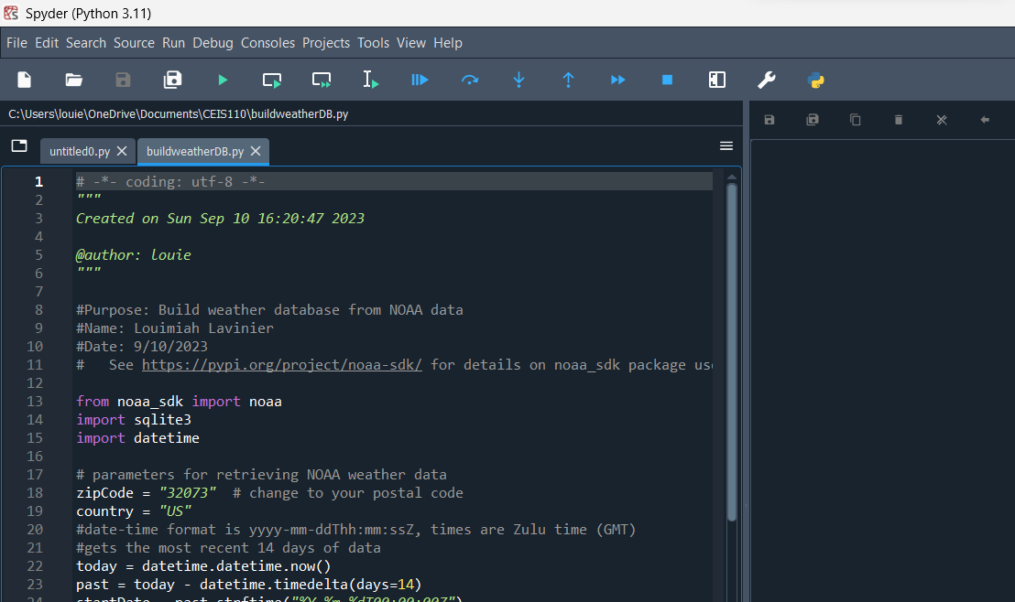
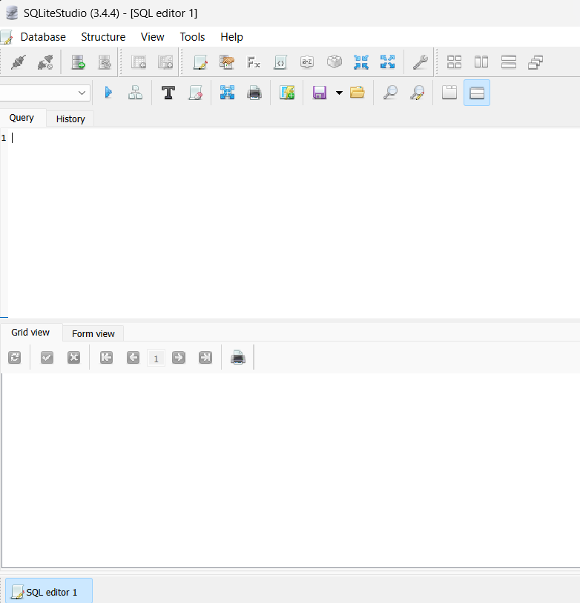
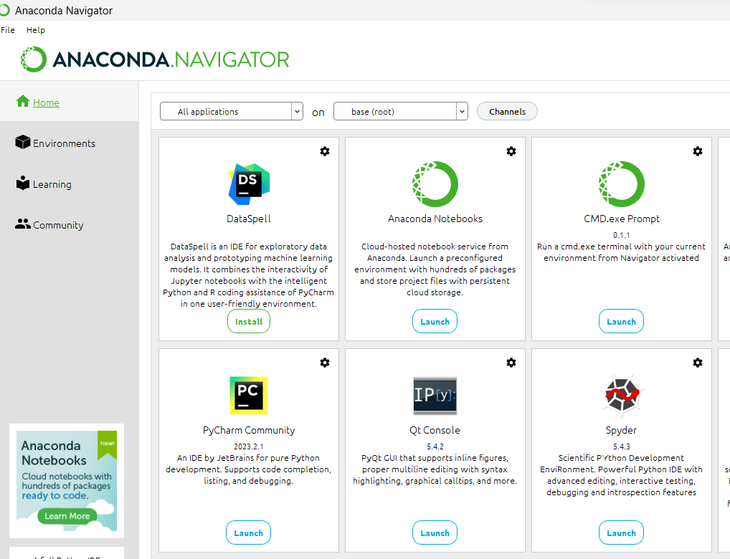
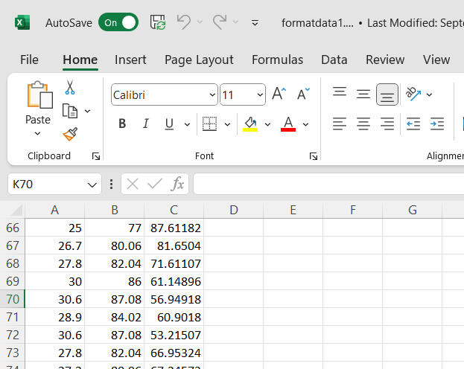
Software Screenshots
Spyder(Python IDE)
SQLite Studios
Anaconda
Microsoft Excel

Slide 5

Planning and Design
The first step in developing the plan for the temperature data project was performing a thorough inventory of the software necessary for the project. As a part of planning the overall design of the project, a flowchart was created. For the development process to be understood, it is critical for the planning and design of the project to be complete.

Slide 6

What are Flowcharts?
Flow charts are visual representations of processes and workflows. In this software development project, the flowchart developed illustrates the process and the output of the project in a graphical format.

Slide 7

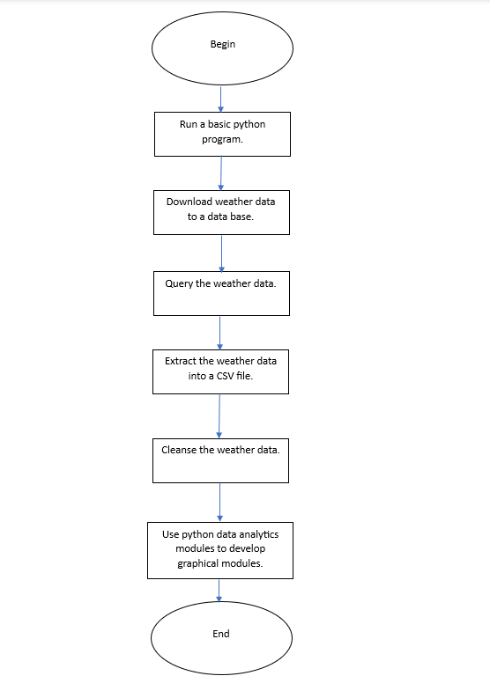



Flowchart
Include the following processes:
  Run a basic python program
  Download weather data to a database.
  Query the weather data
  Extract weather data from database into a comma separated file with python
  Cleanse weather data
  Use python data analytics modules to develop graphical models

Slide 8
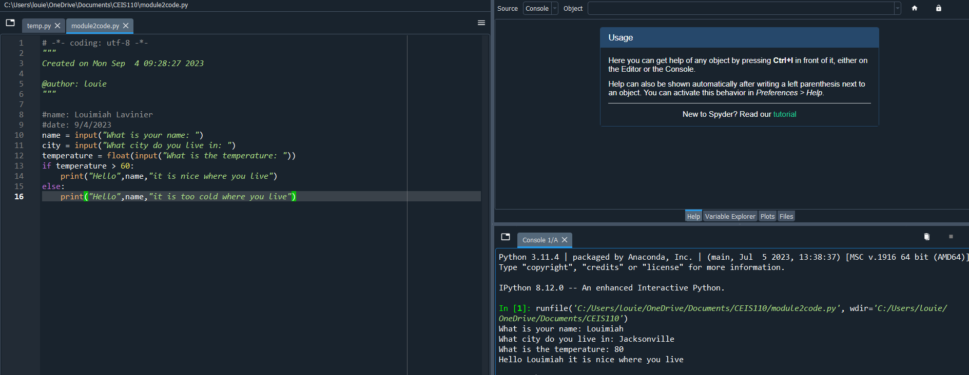
Python program
(Screenshot)
Include screenshot of successful python program

Slide 9

Gathering Temperature and Humidity Data
Following the planning and design phase, the code was implemented to retrieve a collection of weather observations. The resulting data was subsequently stored in a local database table for future analysis.

Slide 10
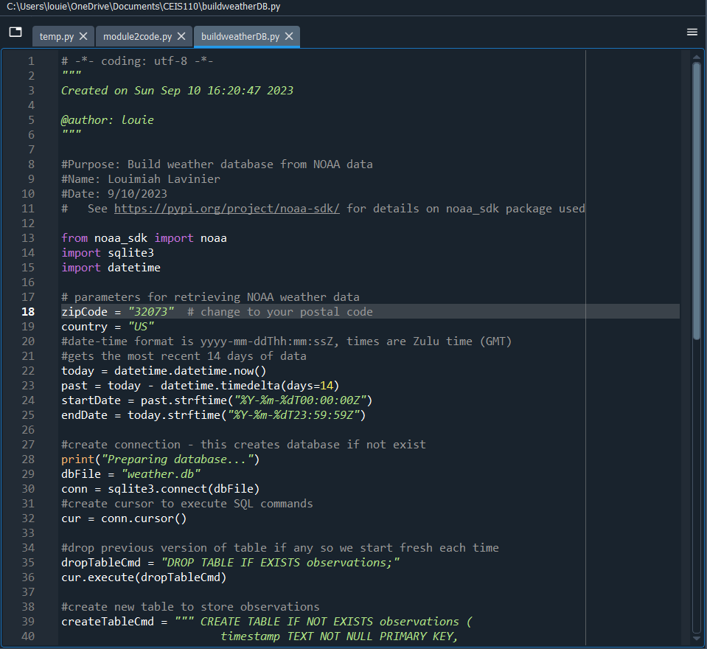
BuildWeatherDb.py Code (Screenshot)
Screenshot of code in Spyder
Must have your name and date in comments
Must have your zip code

Slide 11
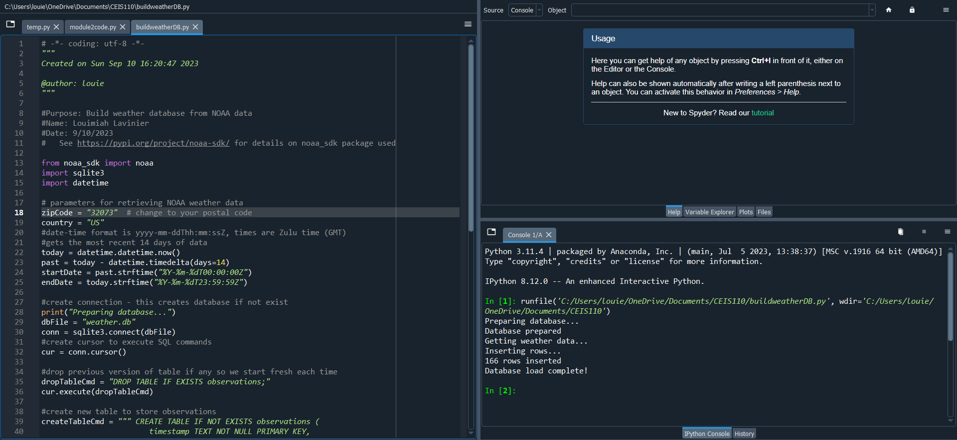
Python Console
(Screenshot)
Screenshot of program output in Python console showing program executed successfully

Slide 12
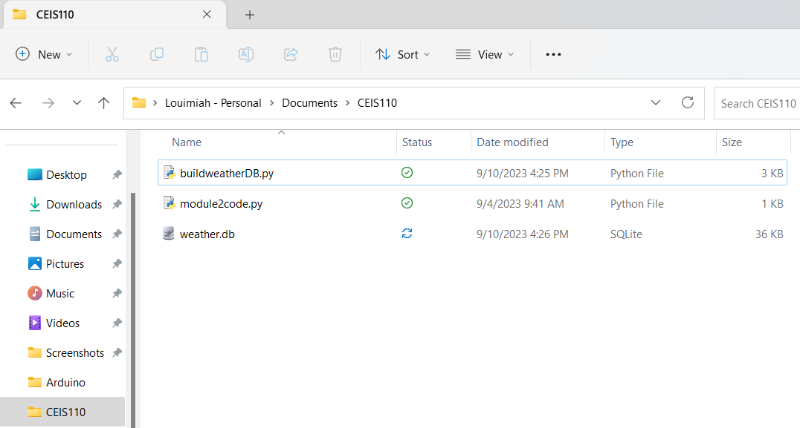
Weather.db File
(Screenshot)
Screenshot of Windows Explorer showing database file Weather.db was created

Slide 13

Querying the Data Using SQL
Structured Query Language (SQL) is a programming language that is commonly used for managing relational databases. SQL was utilized to query the database and view the results.

Slide 14
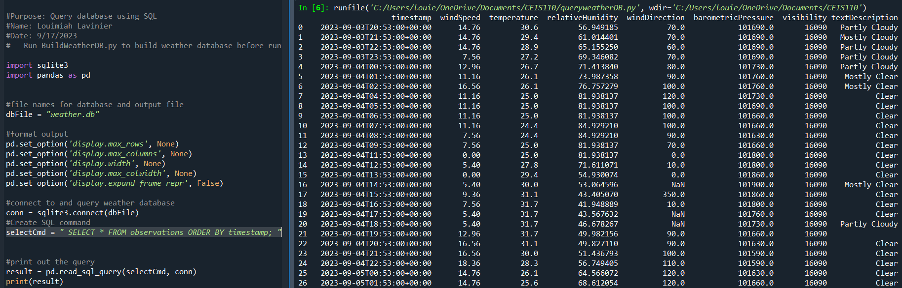
Query to retrieve all columns and all rows (Screenshot)
Screenshot of SQL query command and results

Slide 15
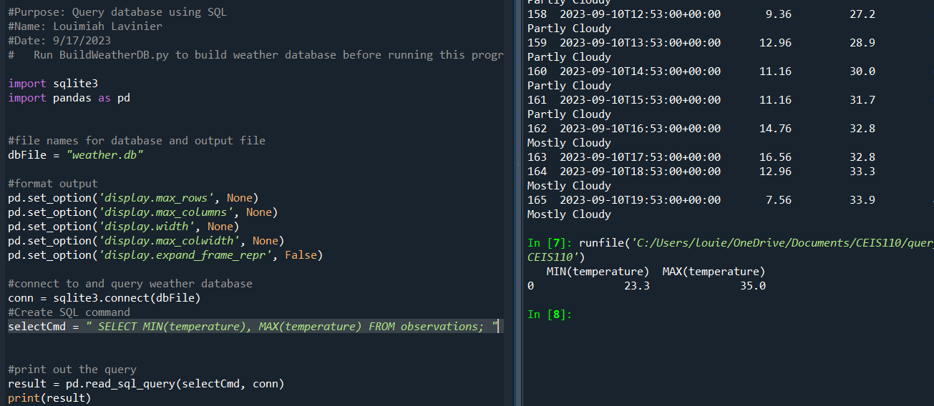
Query to retrieve lowest and highest temperatures
(Screenshot)
Screenshot of SQL query command and results

Slide 16
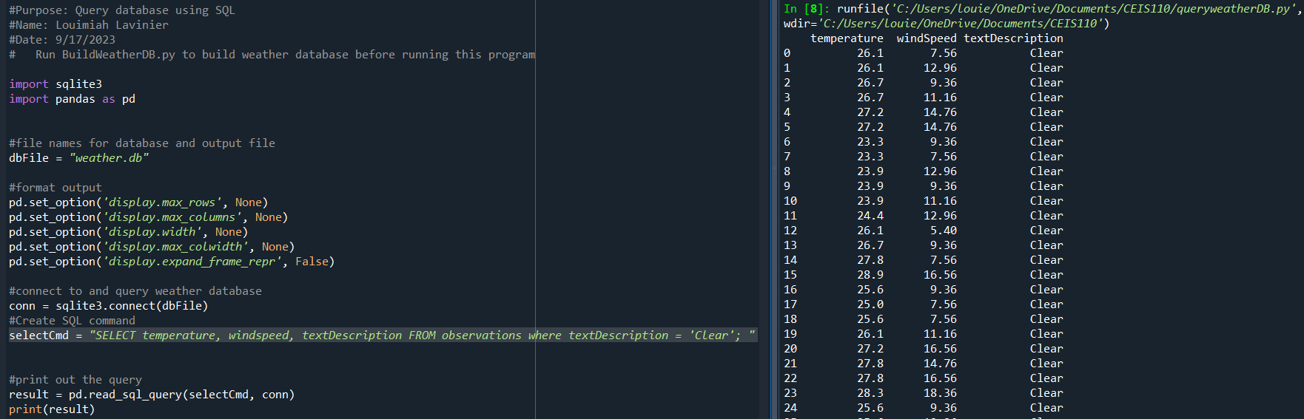
Query to retrieve all clear days
(Screenshot)
Screenshot of SQL query command and results

Slide 17

Data Cleansing
Data output from machines can potentially contain errors or extraneous data. In order to rectify this, software programs have the capability to automatically transform the data into a format that is compatible with other programs. In this specific case, a Python program is being utilized to read the data output generated by another Python program, and subsequently saving it in a cab file for the purpose of being read by Excel.
Frequently, it becomes necessary to cleanse datasets by eliminating spurious or missing values. This process ensures that the data is both comprehensive and accurate.

Slide 18
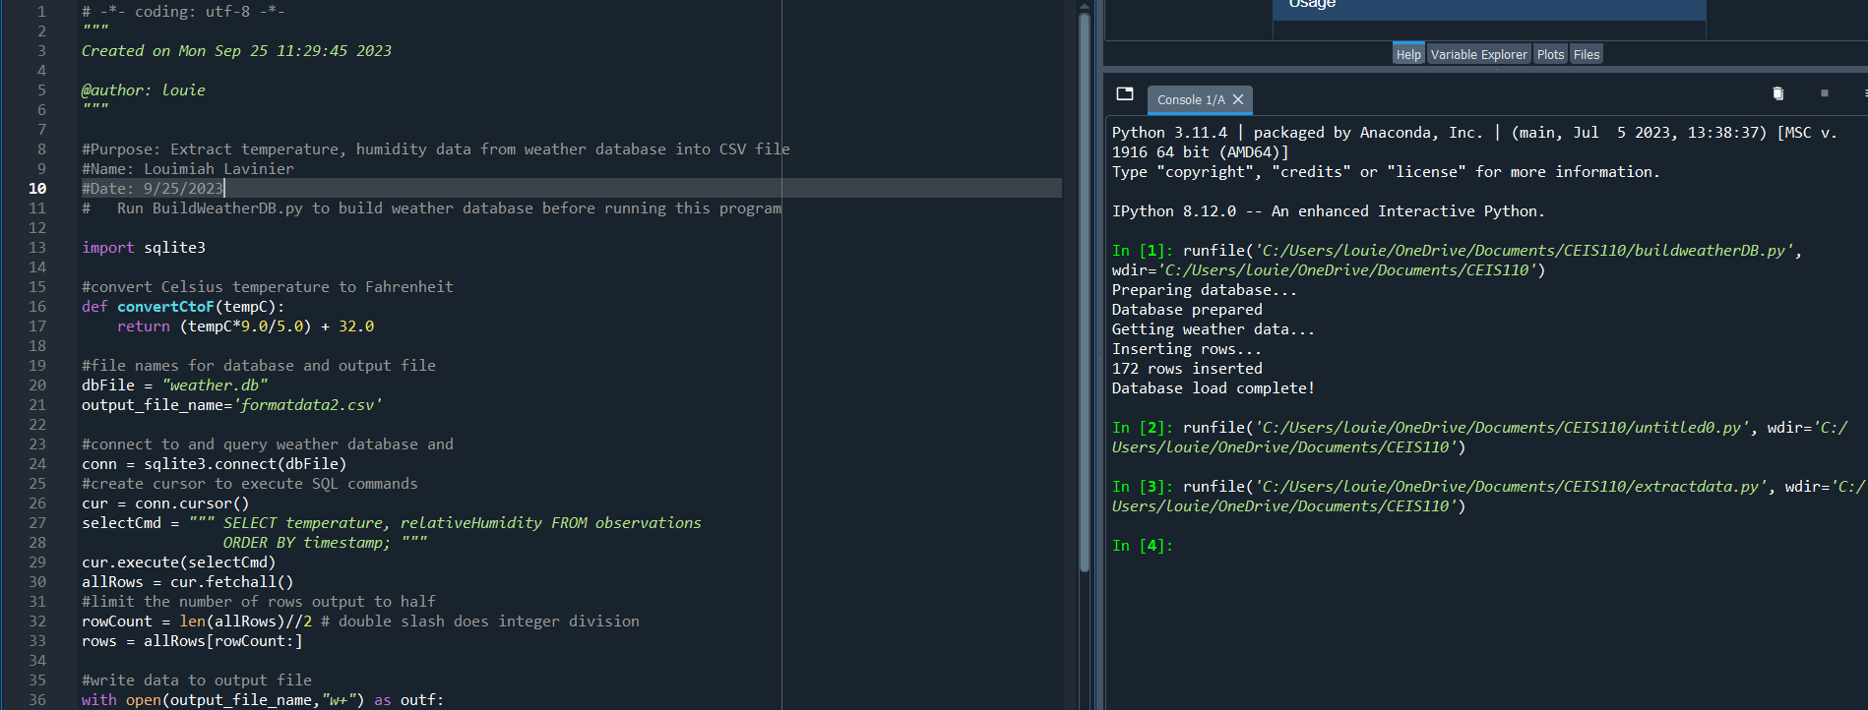
Python code (Screenshot or file)
ExtractTempHumidity.py Python code with your name and date in comments

Slide 19
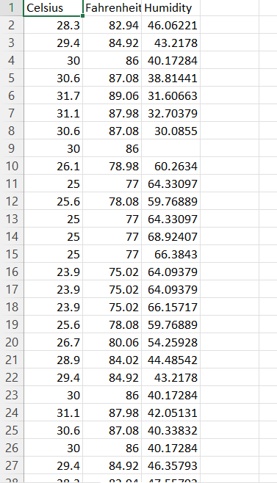
Retrieve and Convert Data to CSV Format (Screenshot)
Format data file open in Excel showing 3 columns of data

Slide 20
Temperature and Humidity Chart
(Graph)
Excel chart based on temperature and humidity data from database

Slide 21
Data Analytics
Python data analytics modules enable users to create visual representations of data through charts and graphs. These modules also provide the ability to manipulate and save data sets in tabular format. Anaconda offers a range of data analytics modules. In this study, multiple plots were generated to analyze the relationship between humidity and temperature, followed by prediction based on the data.

Slide 22
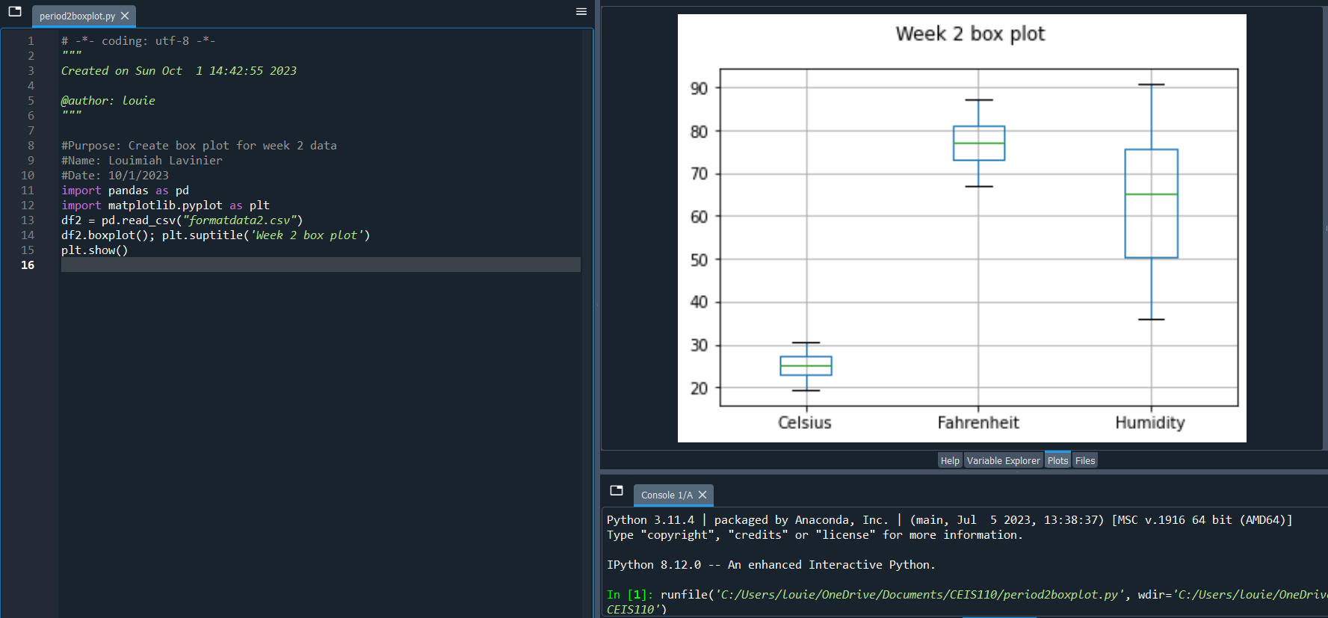
Plot #1
(Screenshots)
Box plot and code used to generate it

Slide 23
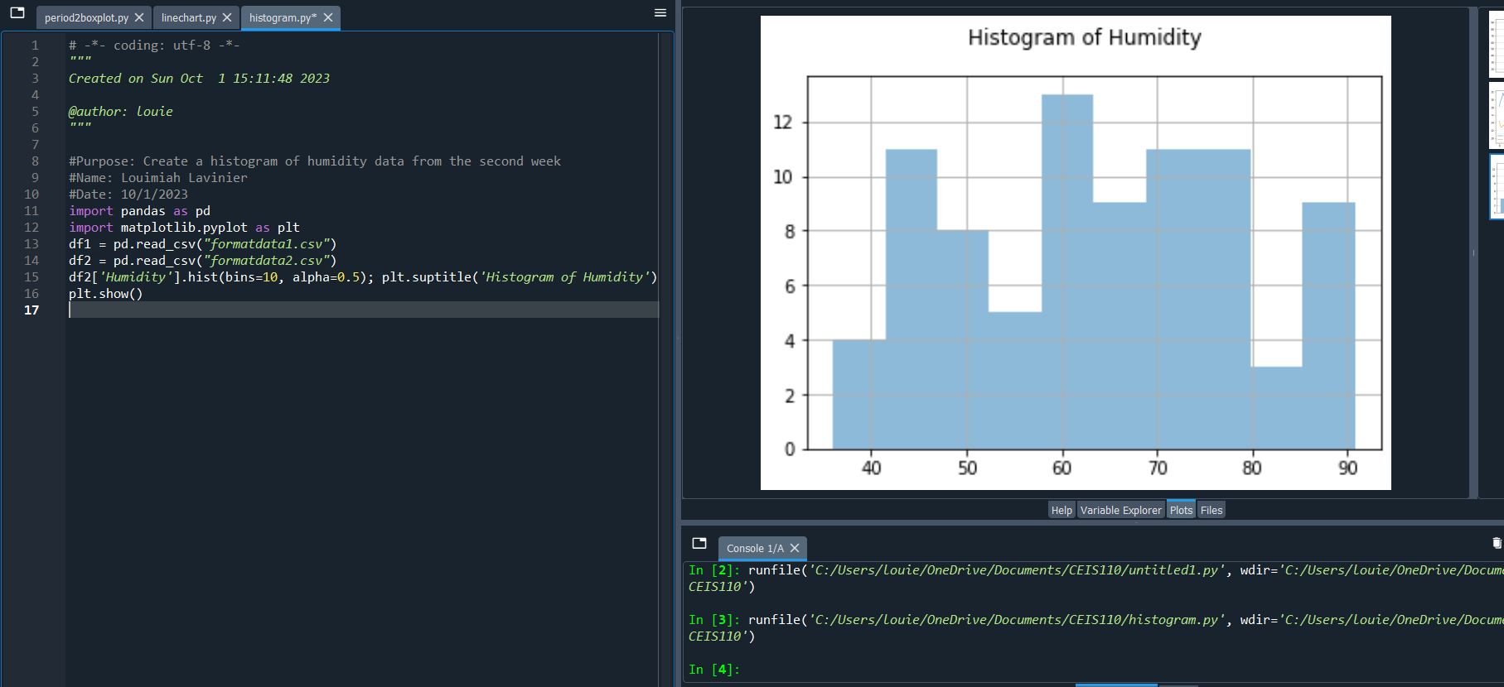
Plot #2
(Screenshots)
Histogram Plot and code used to generate it

Slide 24
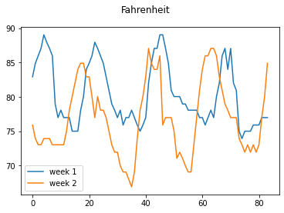
Analysis
Think of your own question and create a chart/graph to answer it
Your own question: Was week 1 hotter than week 2?
Answer supported by Chart: I created a line chart in Fahrenheit that show’s that week 1 was hotter than week 2. As you can see in the chart the temperature from week 2 was higher at times but week 1 was hotter.

Slide 25
Prediction
Develop a prediction based on the data. What variations in temperature and humidity do you expect over the next few hours or days? How would humidity change if temperature goes up or down? My prediction based on all the data I have collected is that week 3 will be cooler than weeks 1 and 2. From reviewing all the data I have collected and because I am predicting week 3 to be cooler, I am also expecting the air to have a higher humidity

Slide 26

Challenges
My first challenge was fixing my weather.db database because it got corrupted. After troubleshooting I deleted it and redid the database and it worked. Another challenge was making sure when creating the program, it was in the same directory as weather.db so when I run the program it looks in the right path and a file not found error does not occur.

Slide 27

Career Skills
Programming using Python
Database development
Troubleshooting errors in the code and data cleansing
Using flowcharts to depict the plan of a project
Reviewing charts and graphs to make predictions on the data

Slide 28

Conclusion
In this project, we covered the fundamentals of programming with data by gathering data from a cloud service in order to perform data analytics operations using the data collected. The purpose of this project is to provide students with the chance to put into practice the topics covered in the course through hands-on learning.

