Slide 1



Linux Final Presentation
By: Louimiah J. Lavinier

Slide 2

Introduction
According to the latest Linux usage statistics, 47.7% of the top 1,000 websites use Linux, while 38.8% of the top 10,000 use it. Globally, 96.3% percent of web servers and 32.8 million Linux users worldwide. In the corporate world Linux is very popular and devices we use everyday like android, uses Linux. Linux is also used in cyber security, specifically Kali Linux. The security parameters of Linux are well-known, and viruses or malware rarely infect them. It is supported on almost all major computer platforms and is one of the most widely supported operating systems.

Slide 3

Linux File Systems Hierarchy
Navigate the Linux filesystem tree
Create directories and files
Copy and remove directories and files
Locate directories and files

Slide 4


Navigate the Linux filesystem tree
1. What is the pwd command an acronym for? What about the cd command?
pwd (print working command) is used to display the current directory in the directory tree and cd (change directory) is used to change the current directory in the directory tree.
2. Explain the differences between a relative path and an absolute/full path in Linux.
A relative path is starts at your current location of the tree and an absolute path starts at the root of the tree.

Slide 5
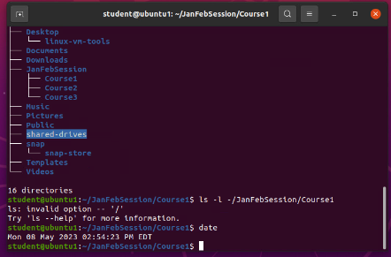
Create directories and files

Slide 6
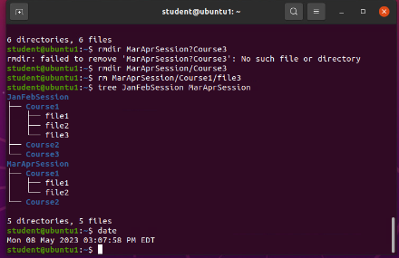
Copy and remove directories and files

Slide 7
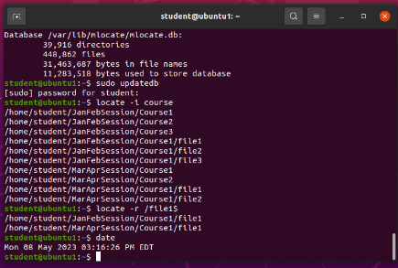
Locate directories and files

Slide 8

Linux Shell Scripts
Create a shell script
Change script file permissions
Set the PATH variable
Make the PATH variable permanent

Slide 9

Create a shell script
1. What are the file permissions of the script? rw- rw- r--
2. What’s the name of the user-defined variable in the script? text
3. Which redirection meta-character is used in the script? What does it do?
Redirection meta-character >> is used in the script and it is used to append the new file and retain the prior contents.

Slide 10
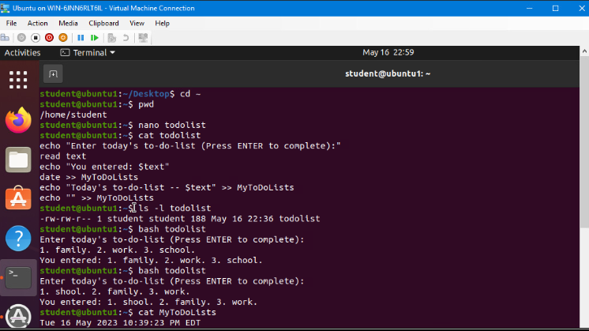
Change script file permissions

Slide 11
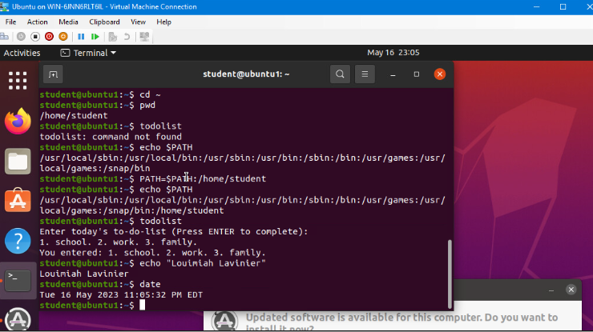
Set the PATH variable

Slide 12
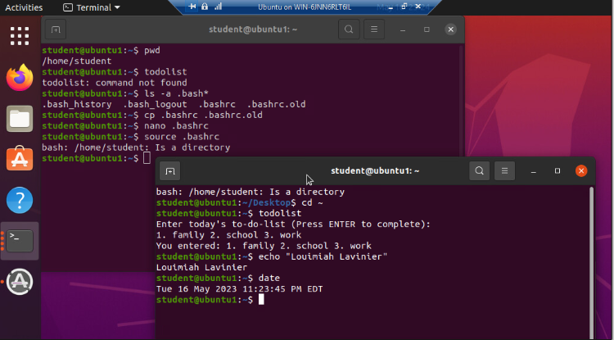
Make the PATH variable permanent

Slide 13

User and group management
Add users and groups in CLI
Test user and group settings
Add users in GUI
Remove users and groups

Slide 14
Add users and groups in CLI
1. What does the –m option in the useradd command do?
Allows you to copy all files from your system skeleton directory (/etc/skel) to newly created home directory. You can create a user home directory using the –m option.
2. What does the -3 option in the tail command do?
Prints the last 3 lines of a specified file.
3. Which line of the /etc/group file lists members of the “students” group?

Slide 15
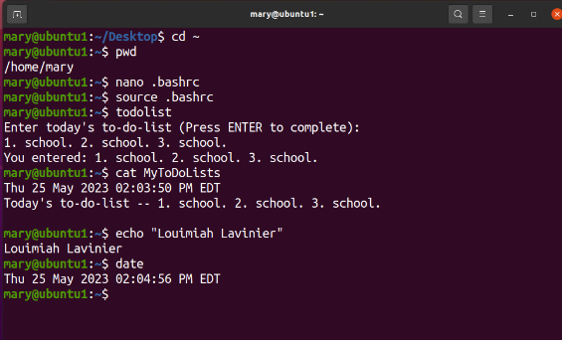
Test user and group settings

Slide 16
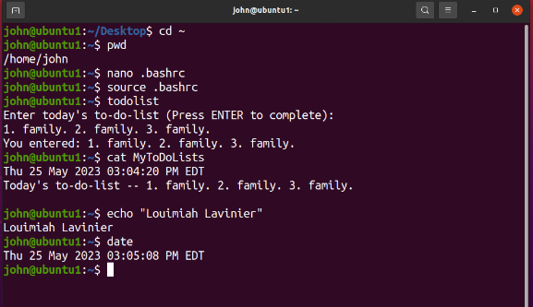
Add users in GUI

Slide 17
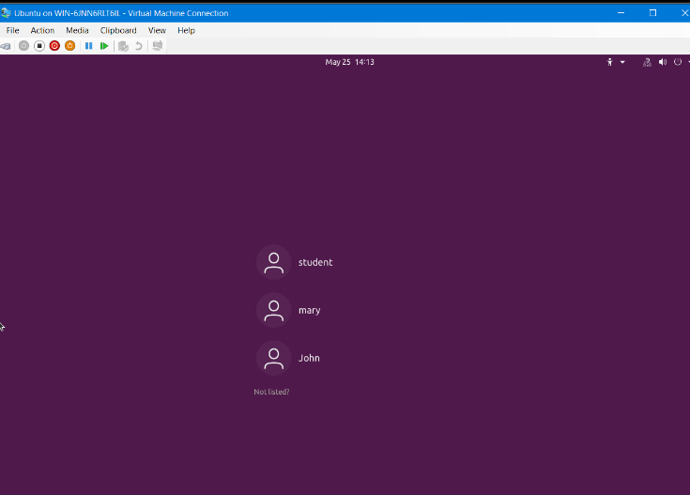
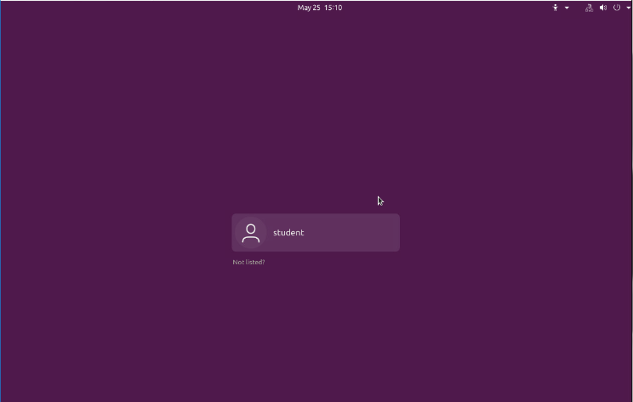
Remove users and groups

Slide 18

Network configuration
Discover host IP configurations
Manage network interfaces
User network utilities

Slide 19
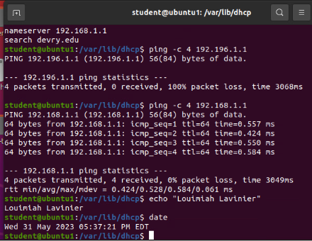
Discover host IP configurations
1. What is the IP address of your Ubuntu machine?
192.168.1.107
2. What is the IP address of its default gateway?
192.168.1.1
3. What is the IP address of its DHCP server?
192.168.1.1
4. What is the IP address of its DNS server?
192.168.1.1

Slide 20
Manage network interfaces
1. Which DHCP message is shown in the output of the sudo dhclient –v –r ens33 command?
DHCPRELEASE
2. Which four DHCP messages are shown in the output of the sudo dhclient –v ens33 command?
DHCPDISCOVER
DHCPOFFER
DHCPREQUEST
DHCPACK

Slide 21
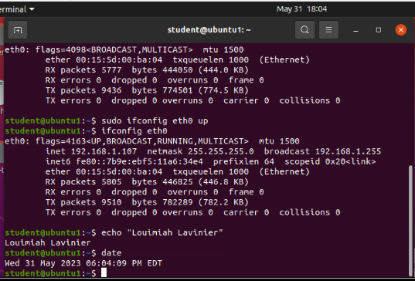
Use network utilities

Slide 22

System performance monitoring
Monitor processes
Monitor user activities
Monitor network bandwidth usage

Slide 23

Monitor Linux processes
1. What is the default action of the 15 SIGTERM kill signal?
Kill the highlighted process (SIGTERM is the default action of the kill command if you don’t specify an action. Kill ends a process by using the default signal SIGTERM which tells the process to shutdown.)
2. In the System Monitor window, click on % CPU to sort the processes by CPU load. Which process shows the highest percentage of CPU usage?
Gnome-shell (GUI)

Slide 24

Monitor user activities
1. What flag value is displayed in the output?
S (superuser)
2. Why is the name of the user who ran the processes shown as root, not student?
Because sudo was used in front of the command. (superuser)

Slide 25
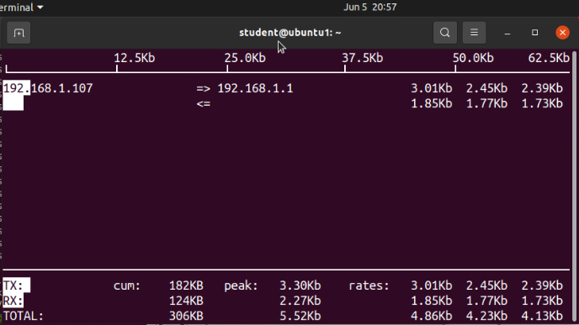
Monitor network bandwidth usage

Slide 26

Challenge's
First challenge I faced was remembering the parameters that go with certain commands. Instead of trying to memorize every single one at one time, I focused on the one’s that are mostly used in the field and just keep learning from there. Another challenge for me was putting long commands together but I realized that if I break down each part of what I would want to accomplish I’ll remember much easier. So, for example if I want to copy or move to another destination, I know I need to specify if I'm copying or moving the file, what's the name of the file, and what's the destination. Same thing for even longer commands just taking my time, understanding the outcome that I’m looking for and remembering that sometimes I must add parameters and so on. Lastly, remembering to us sudo to execute certain commands.

Slide 27

Career skills
Writing scripts
Learning Linux to set up corporate servers
Managing file and directories (creating and removing)
Configure and managing storage
Adding and removing permissions

Slide 28

Conclusion
Linux offers so many great feature. Some of those being multitasking, multiple users, groups, access control list support, flexibility, and cost efficiency. Many companies use Linux as part of there IT infrastructure. Learning to administer Linux operating systems is a skill that can be used in many IT career paths because of the broad us of Linux. Linux is an amazing operating system and because cyber security is what I'm interested in I can wait to dive deeper into Kali Linux.

