Slide 1

NETW211 Final
Course Project
By: Louimiah Lavinier

Slide 2

INTRODUCTION
In this Azure project, we'll delve into key components like VMs, VNets, NSGs, Blob Storage, and Azure Monitor. We start by deploying a VM, configuring it, and establishing secure connections via RDP and SSH. Moving on, we'll create secure network environments with VNets and subnets, ensuring VM connectivity and bolstering security through NSGs. Exploring Blob Storage comes next, leveraging its features for data storage and protection. Finally, we'll set up Azure Monitor for robust monitoring, including alert rules and notifications. Through this journey, I will gain a comprehensive understanding of Azure's core services and their practical applications in cloud environment management.

Slide 3

Virtual Machine (VM) Instances
A VM is a virtual server running applications, with configurable CPU, memory, storage, and networking capacities. In this project I will be Deploying a VM in Azure, Connecting to the VM using RDP, and completing the proper steps to Delete the VM.

Slide 4
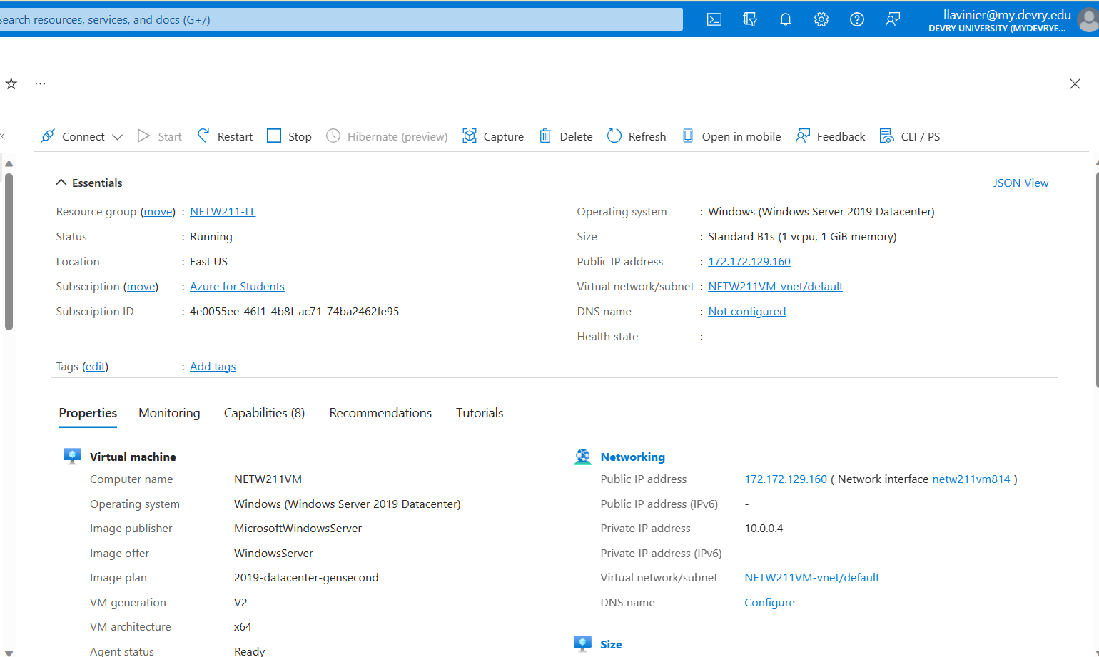
Deploying a VM in Azure
This screenshot should show the NETW211VM page with information such as the resource group name, subscription, public IP address, etc.
This screenshot should also show your DVU ID information in the top right corner of the Azure Portal.

Slide 5
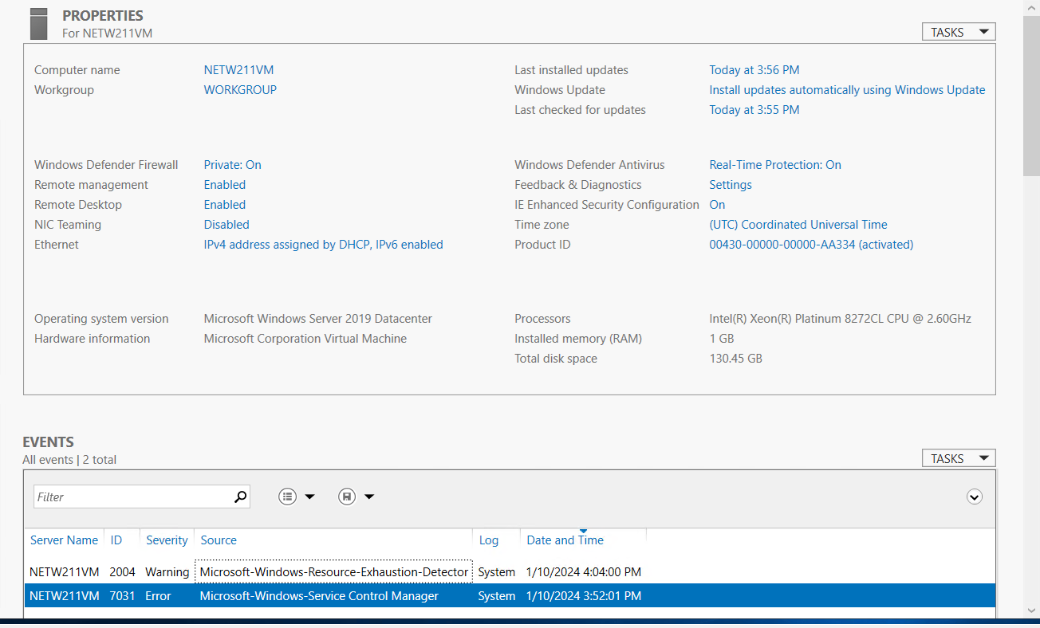
Connecting to the VM
This screenshot should show the PROPERTIES for NETW211VM page, including the computer name, operating system version, hardware information, etc.
This screenshot should also show the EVENTS section with the Date and Time information.

Slide 6
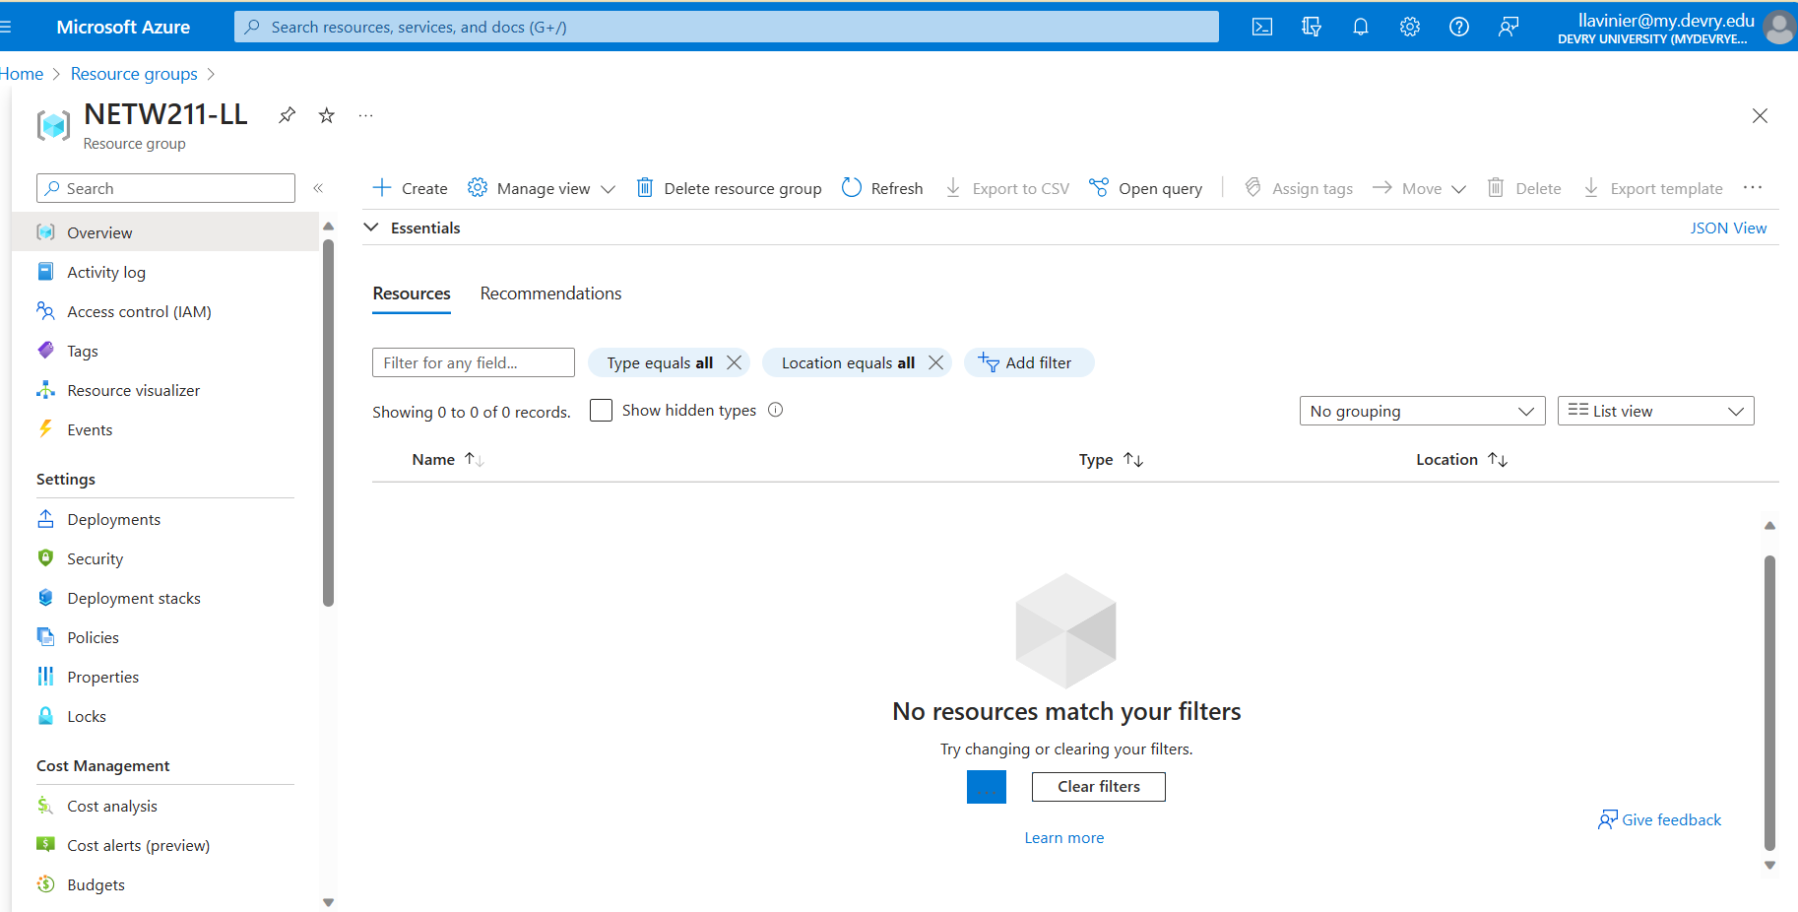
Deleting
the VM
This screenshot should show the NETW211-XX (Your Initials) Resource groups page, with the “No resources match your filters” message.
This screenshot should also show your DVU ID information in the top right corner of the Azure Portal.

Slide 7

Conclusion
This module emphasized Azure VM deployment using RDP and concluded with proper VM deletion, underscoring efficient management and streamlined cloud practices. The well-structured instruction videos ensured a smooth assignment completion. Gained skills include cloud computing, virtualization, and Azure navigation.

Slide 8
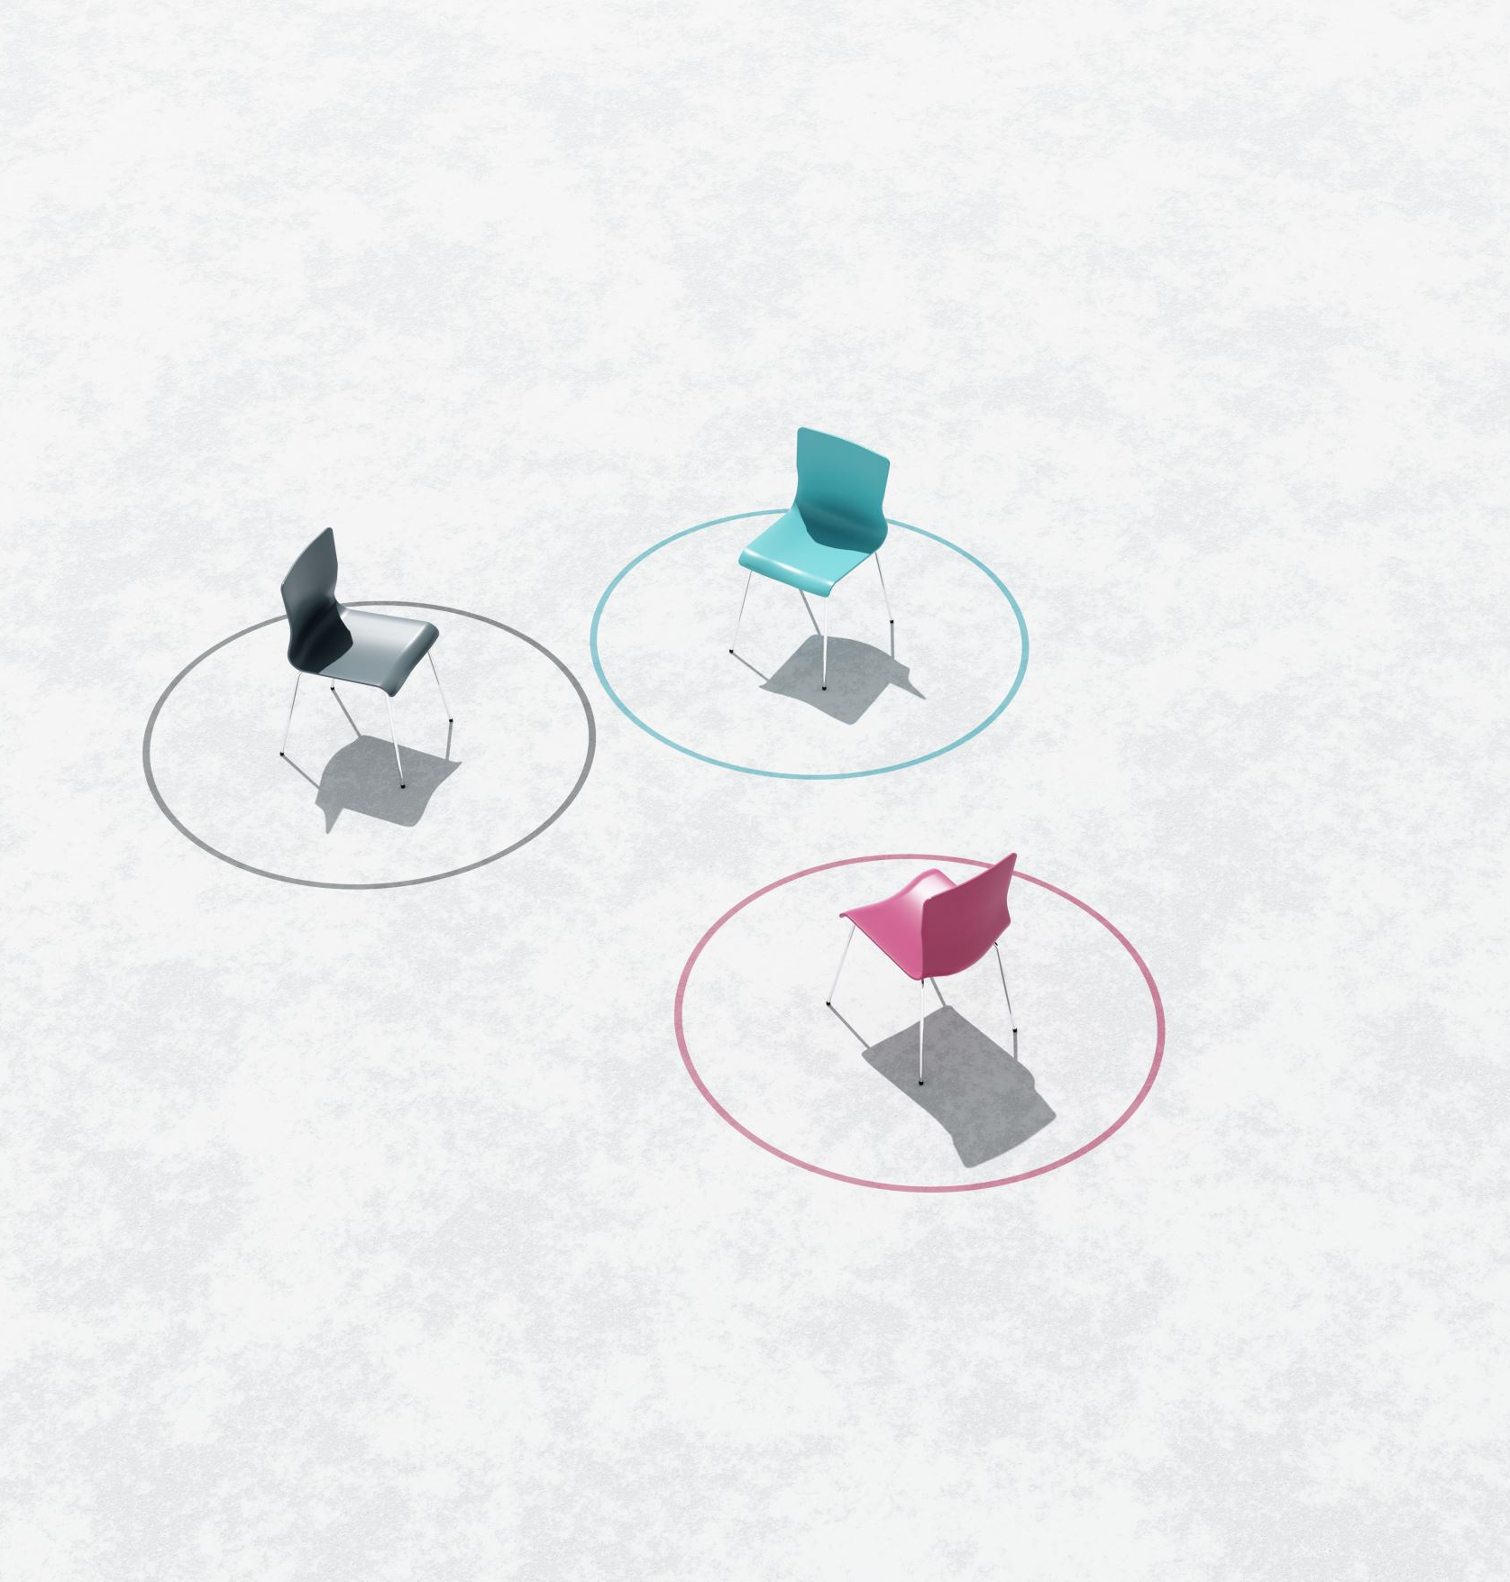
References
I used the week 2 project follow along instructional video and the resource I used to complete this assignment was https://azure.microsoft.com/en-us/free/students/

Slide 9

Azure VNet and Subnets
In this module, we will dive into the Azure Virtual Network (VNet) service, which empowers customers to provision a logically isolated section of the Azure cloud and deploy resources into a virtual network. The key objectives include creating a VNet with two subnets, deploying virtual machines (VMs) into those subnets, and verifying connectivity between the VMs.

Slide 10
Creating a VNet with Two Subnets
1. With a /24 network prefix, how many usable IPv4 host addresses are there? [hint: you learned this in NETW191]
Answer here: There will be 254 usable host addresses. 2⁸-2=256-2=254 usable host addresses
2. Given the answer above, why is the number of available IP addresses for Subnet0 (10.0.0.0/24) or Subnet1 (10.0.1.0/24) is 251 when you create an Azure VNet? [hint: where did the missing addresses go?]
Answer here: Azure reserves 5 of these addresses. 10.0.X.0: Network address, 10.0.X.1: Reserved by Azure for the default gateway, 10.0.X.2, 10.0.X.3: Reserved by Azure to map the Azure DNS IP addresses to the virtual network space. 10.0.X.255: Network broadcast address.
References (here are two examples to get your research started):
1. Configuring Azure virtual network subnets with CIDR notation. (n.d.). TECHCOMMUNITY.MICROSOFT.COM. Retrieved January 18, 2024, from https://techcommunity.microsoft.com/t5/itops-talk-blog/configuring-azure-virtual-network-subnets-with-cidr-notation/ba-p/2047809#:~:text=In%20our%20example%2C%20the%20recommended%20default
2. Class project video guide.

Slide 11
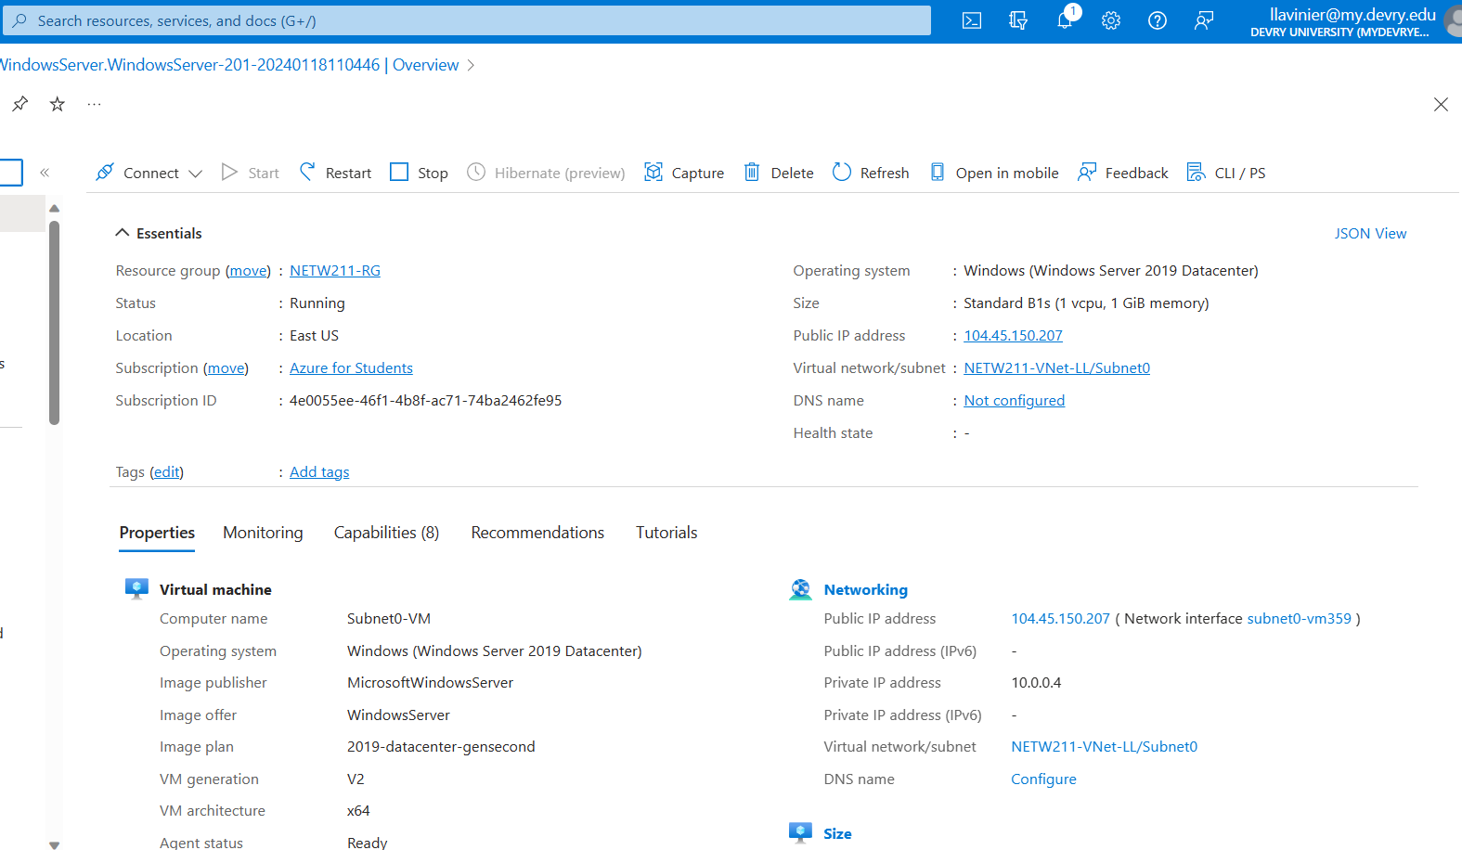
Deploying VMs into Subnets
(1 of 3)
This screenshot should include the Properties section of the Subnet0-VM page, showing the networking and size information of the VM.
This screenshot should also show your DVU email in the top right corner of the Azure Portal.

Slide 12
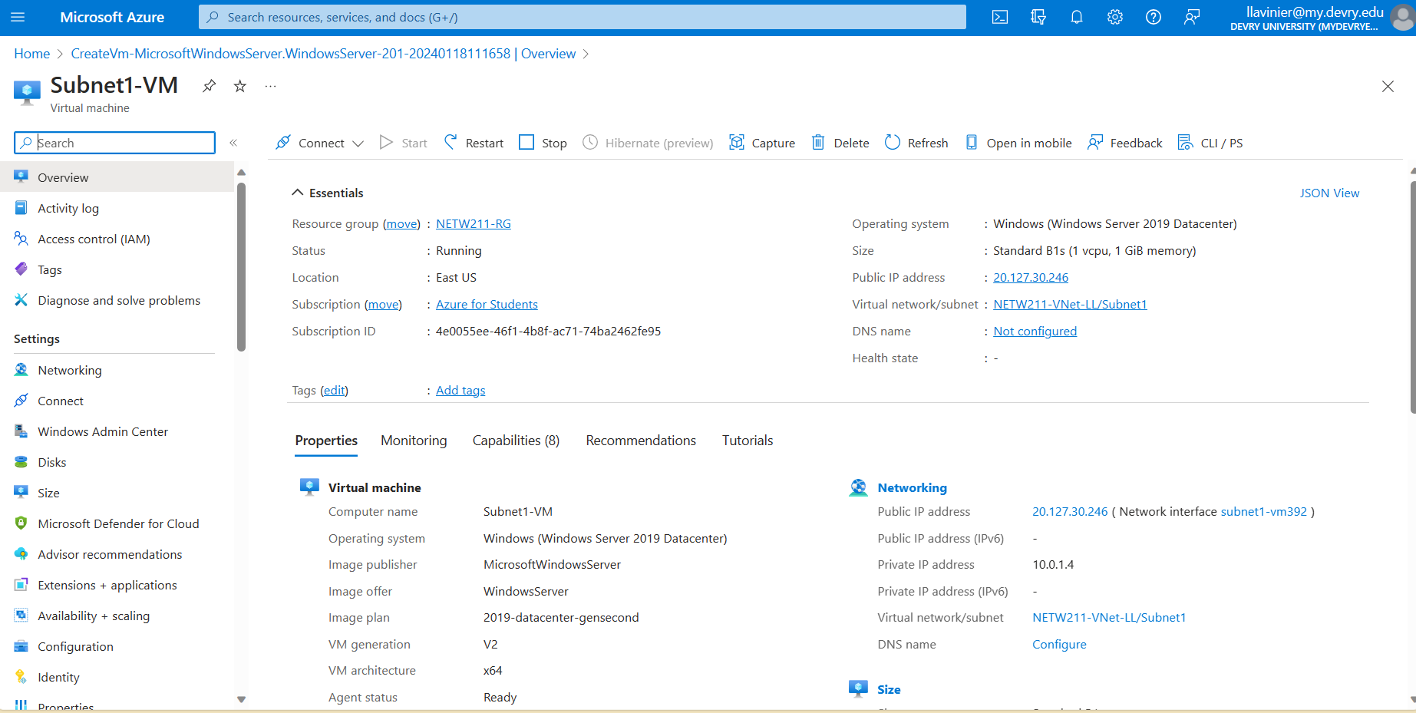
Deploying VMs into Subnets
(2 of 3)
This screenshot should include the Properties section of the Subnet1-VM page, showing the networking and size information of the VM.
This screenshot should also show your DVU email in the top right corner of the Azure Portal.

Slide 13
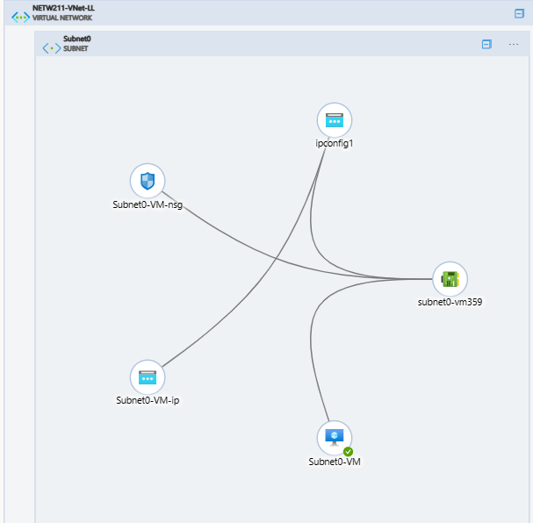
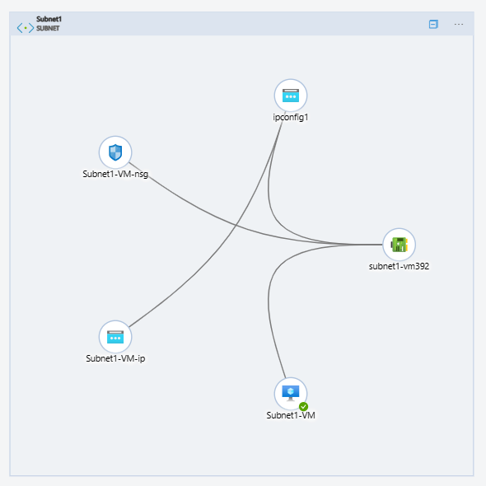
Deploying VMs into Subnets
(3 of 3)
This screenshot should show the topology diagram of your VNet (NETW211-VNet-Your Initials) with two subnets (Subnet0 and Subnet1) and one VM in each subnet (Subnet0-VM and Subnet1-VM).
This screenshot should also show your DVU email in the top right corner of the Azure Portal.

Slide 14
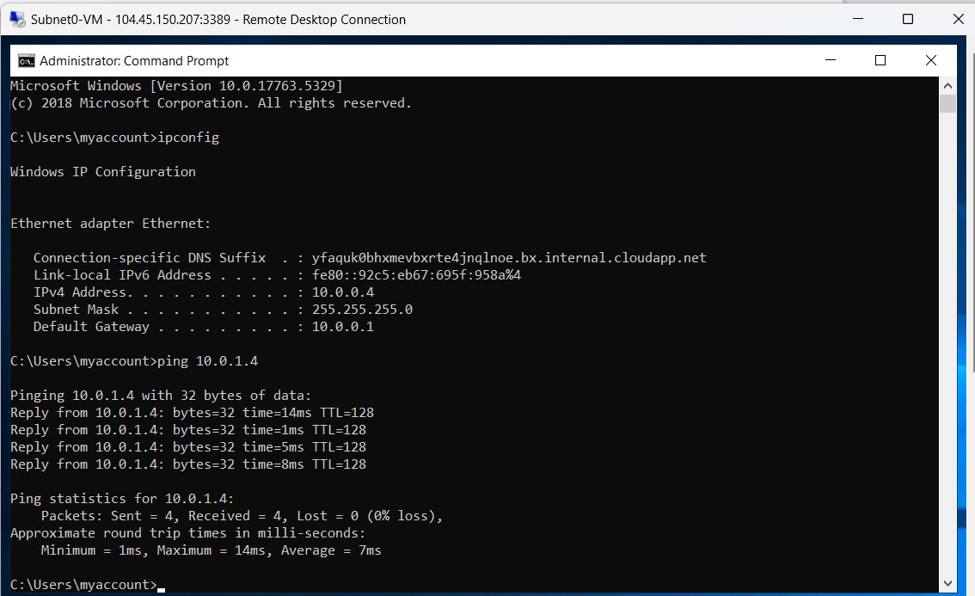
Verifying Connectivity between VMs
(1 of 2)
This screenshot should show the ipconfig and ping x.x.x.x results in the command prompt window of Subnet0-VM.
This screenshot should also show the Date/Time information in the bottom right corner of your desktop.

Slide 15
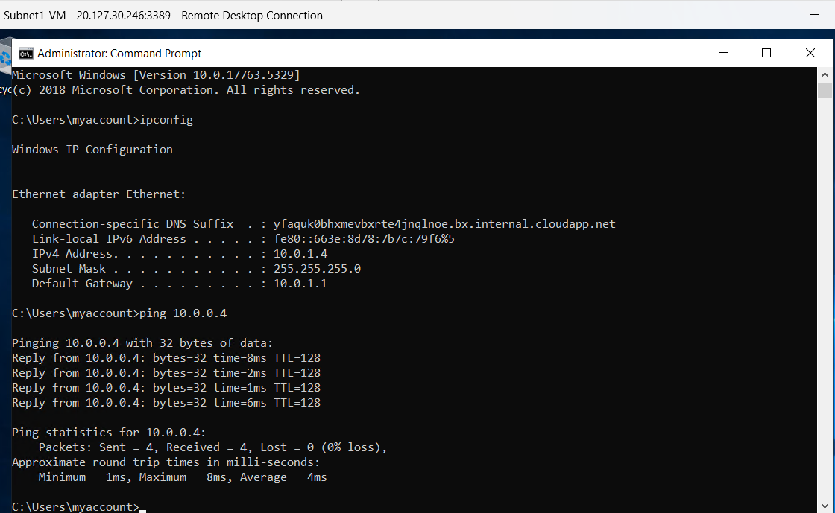
Verifying Connectivity between VMs
(2 of 2)
This screenshot should show the ipconfig and ping x.x.x.x results in the command prompt window of Subnet1-VM.
This screenshot should also show the Date/Time information in the bottom right corner of your desktop.

Slide 16

Conclusion
This project module successfully met its technical goals while fostering skill development and problem-solving. The insights acquired extend beyond Azure, forming a solid foundation for comprehending and applying cloud-based networking solutions professionally. The hands-on experience in creating VNets, configuring subnets, and deploying VMs greatly enhances our skill set, particularly in Azure cloud management, network architecture, and virtual machine deployment. These competencies are valuable assets in the dynamic field of cloud computing and networking. The instructional videos were easy to understand, so I did not encounter any challenges.

Slide 17

Configuring Azure virtual network subnets with CIDR notation. (n.d.). TECHCOMMUNITY.MICROSOFT.COM. Retrieved January 18, 2024, from https://techcommunity.microsoft.com/t5/itops-talk-blog/configuring-azure-virtual-network-subnets-with-cidr-notation/ba-p/2047809#:~:text=In%20our%20example%2C%20the%20recommended%20default
Project guide video
References

Slide 18

Azure VM Security
This module focuses on securing connections to an Azure Virtual Machine (VM) through SSH and configuring a Network Security Group (NSG) for controlling traffic. It begins with launching a VM to establish a secure computing environment. Then we will be connecting to the VM via SSH, enabling remote access. The final task involves configuring an NSG to regulate inbound and outbound network traffic, adding an extra layer of security.

Slide 19
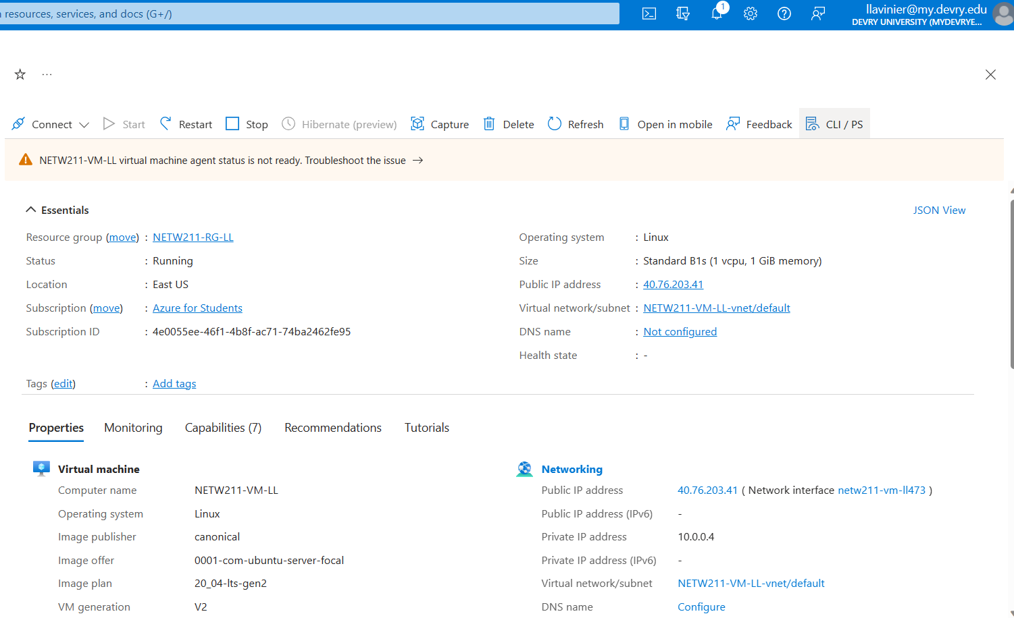
Launching a VM
This screenshot should show the NETW211-VM-Your Initials page, with information such as the resource group name, subscription, public IP address, etc.
This screenshot should also show your DVU email in the top right corner of the Azure Portal.

Slide 20
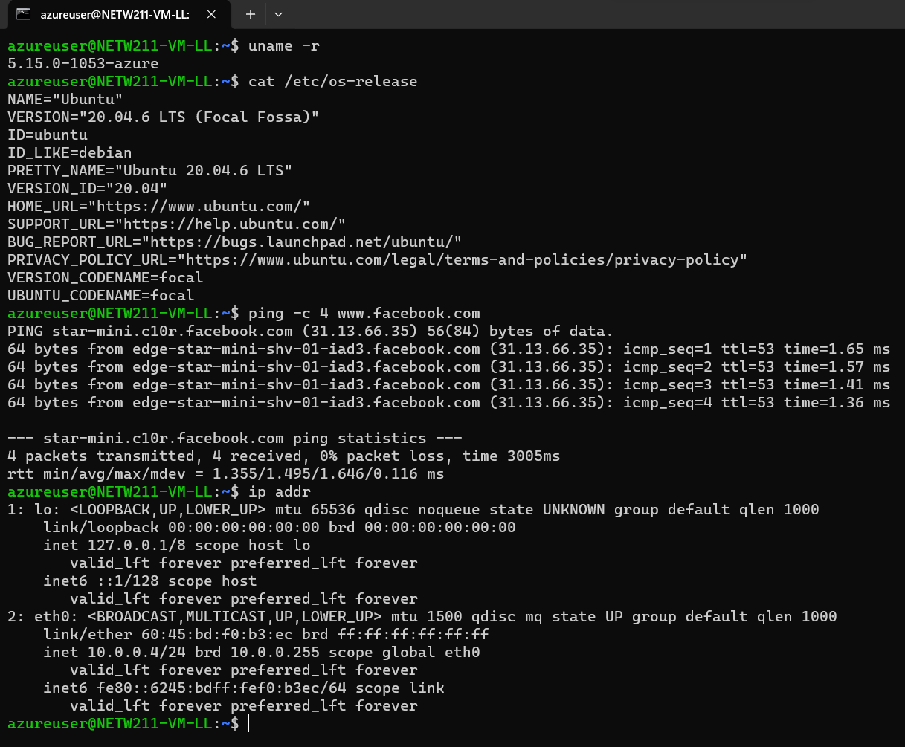
Connecting
to the VM
via SSH
This screenshot should include the azureuser@NETW211-VM-Your Initials window showing the IPv4 address of the VM in the Azure cloud.
Issue the date command in the same terminal window to include the system date and time in the screenshot.

Slide 21
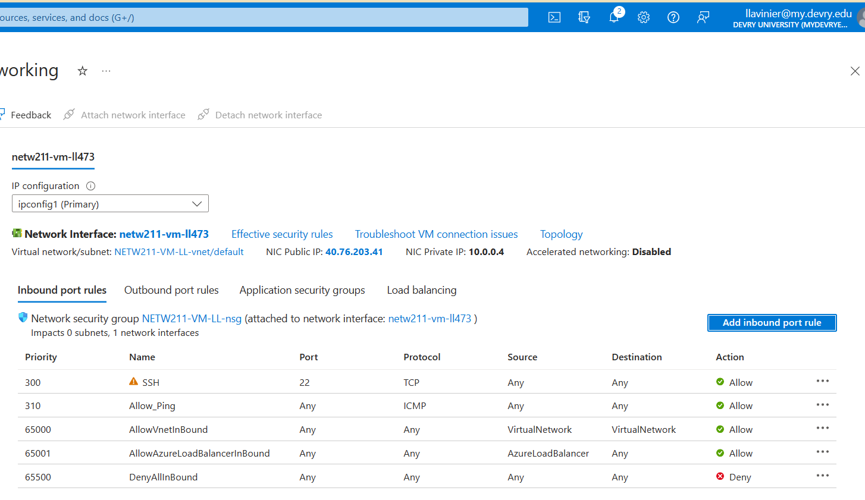
Configuring an NSG 1 of 2
This screenshot should show the Inbound port rules section with the newly added Allow_Ping rule.
This screenshot should also show your DVU email in the top right corner of the Azure Portal.

Slide 22
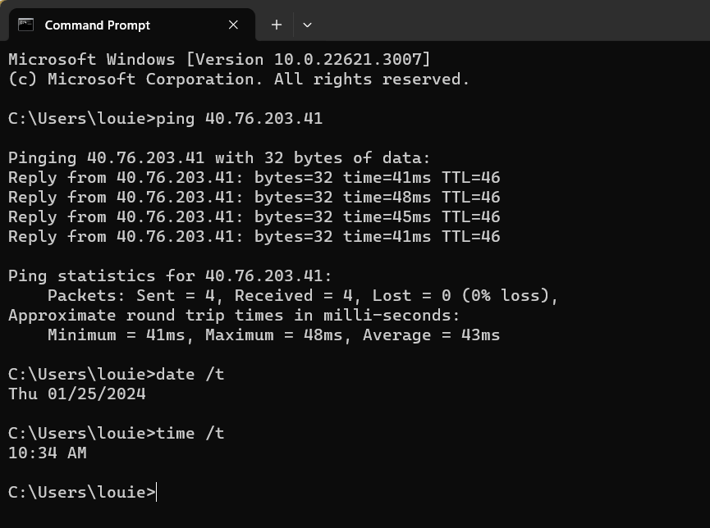
Configuring an NSG 2 of 2
This screenshot should show the successful ping result from your local computer to the VM in the Azure cloud.
Issue the date /t and time /t commands in the same command window to include the system date and time in the screenshot. Use the date command on a Mac computer.

Slide 23

Conclusion
This module provides a comprehensive guide to securing Azure Virtual Machines (VMs) through SSH and implementing effective traffic control with Network Security Groups (NSGs). By initiating the process with the launch of a VM, we establish a foundation for a secure computing environment. Connecting to the VM via SSH not only enables remote access but also ensures a robust and protected connection. The concluding task of configuring an NSG adds a crucial layer of security by regulating both inbound and outbound network traffic. Through these steps, I am equipped with the skills and knowledge necessary to enhance the security posture of their Azure VMs, emphasizing the significance of secure connections and network management in cloud environments.

Slide 24

References
Follow along module video guide and the downloadable pdf guide was the recourses that I used to complete this project.

Slide 25

Cloud Storage
This module introduces Azure's Blob storage—a key player in storing and safeguarding data for mobile apps, websites, backups, IoT devices, and big data analytics. I will cover tasks like creating a Storage Account, uploading files, and exploring Blob Snapshots, offering a practical glimpse into Blob storage's versatile functionality.

Slide 26
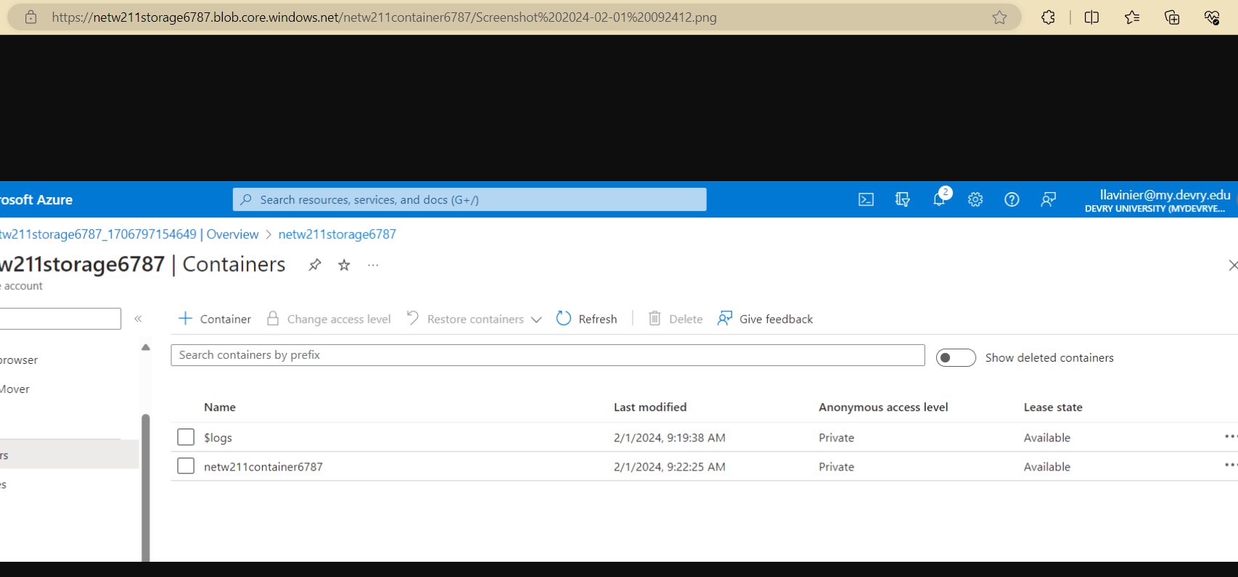
Uploading and Accessing a File
This screenshot should show the browser window with the image uploaded from your local computer and the URL on top of the window.
This screenshot should also show the Last modified property of the uploaded image.

Slide 27
Creating Blob Snapshots 1 of 2
1. What does the access tier setting do? What are the Azure blob storage access tiers?
[hint: in the Azure portal, on the Upload blob page, under Advanced, click the ? circle above the Access tier box.]
Answer here: When your data is stored in an online access tier (either hot, cool or cold), users can access it immediately. The archive tier is an offline tier for storing data that is rarely accessed.
Hot tier - An online tier optimized for storing data that is accessed or modified frequently. The hot tier has the highest storage costs, but the lowest access costs.
Cool tier - An online tier optimized for storing data that is infrequently accessed or modified. Data in the cool tier should be stored for a minimum of 30 days. The cool tier has lower storage costs and higher access costs compared to the hot tier.
Cold tier - An online tier optimized for storing data that is rarely accessed or modified, but still requires fast retrieval. Data in the cold tier should be stored for a minimum of 90 days. The cold tier has lower storage costs and higher access costs compared to the cool tier.
Archive tier - An offline tier optimized for storing data that is rarely accessed, and that has flexible latency requirements, on the order of hours. Data in the archive tier should be stored for a minimum of 180 days.
References (here are two examples to get your research started):
1. Hot, Cool, and Archive access tiers for blob data, https://docs.microsoft.com/en-us/azure/storage/blobs/access-tiers-overview
2. Azure Blob Storage Access Tiers, https://devry.percipio.com/courses/c7ef0333-8560-403f-a004-9c5c843866b0/videos/2658bbe6-ee97-438b-a376-fbb079c3b3a0
3. Instructional project video guide.

Slide 28
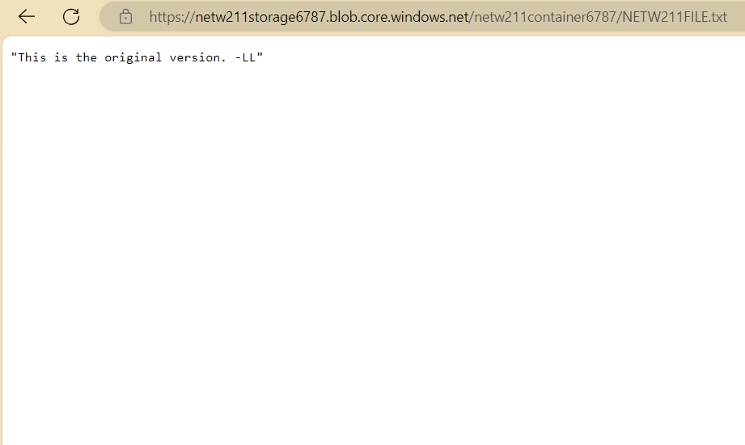
Creating Blob Snapshots
2 of 2
This screenshot should show the browser window with the “This is the original version. –Your Initials” message and the URL on top of the window.

Slide 29
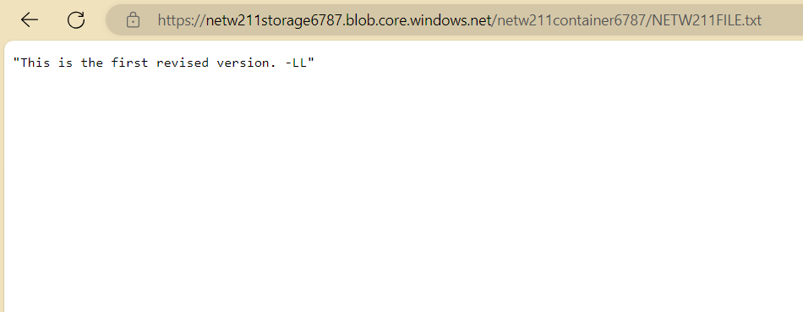
Enabling Blob Versioning
This screenshot should show the browser window with the “This is the first revised version. –Your Initials” message and the URL on top of the window.

Slide 30

Conclusion
This module has provided a comprehensive introduction to Azure's Blob storage, highlighting its vital role in securely managing data for diverse applications. Through tasks like creating a Storage Account, uploading files, and exploring Blob Snapshots, I gained practical insights into the versatile functionality of Blob storage. As I navigate the dynamic landscape of data storage, this newfound understanding equips me to harness the full potential of Azure's Blob storage for my specific needs, be it for mobile apps, websites, backups, IoT devices, or intricate big data analytics.

Slide 31

References
Hot, Cool, and Archive access tiers for blob data, https://docs.microsoft.com/en-us/azure/storage/blobs/access-tiers-overview
Azure Blob Storage Access Tiers, https://devry.percipio.com/courses/c7ef0333-8560-403f-a004-9c5c843866b0/videos/2658bbe6-ee97-438b-a376-fbb079c3b3a0
Instructional project video guide.

Slide 32

Cloud Monitoring
In this module, I will explore Azure Monitor, a service used to monitor Azure resources. I will be setting up an action group and Notifications, setting up alert rules, and testing Alerts.

Slide 33
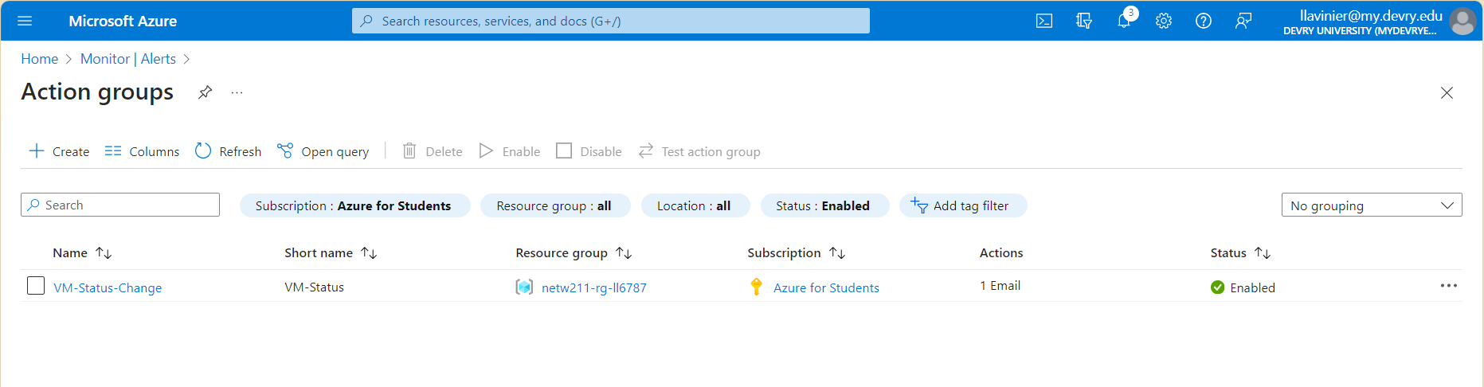
This screenshot should show the “VM-Status-Change” action group on the Manage actions page.
This screenshot should also show your DVU email in the top right corner of the Azure Portal.
Setting up an Action Group and Notifications

Slide 34
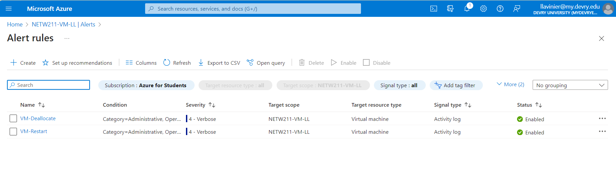
This screenshot should show the Alert rules window showing the VM-Deallocate and VM-Restart rules.
This screenshot should also show your DVU email in the top right corner of the Azure Portal.
Setting up Alert Rules

Slide 35
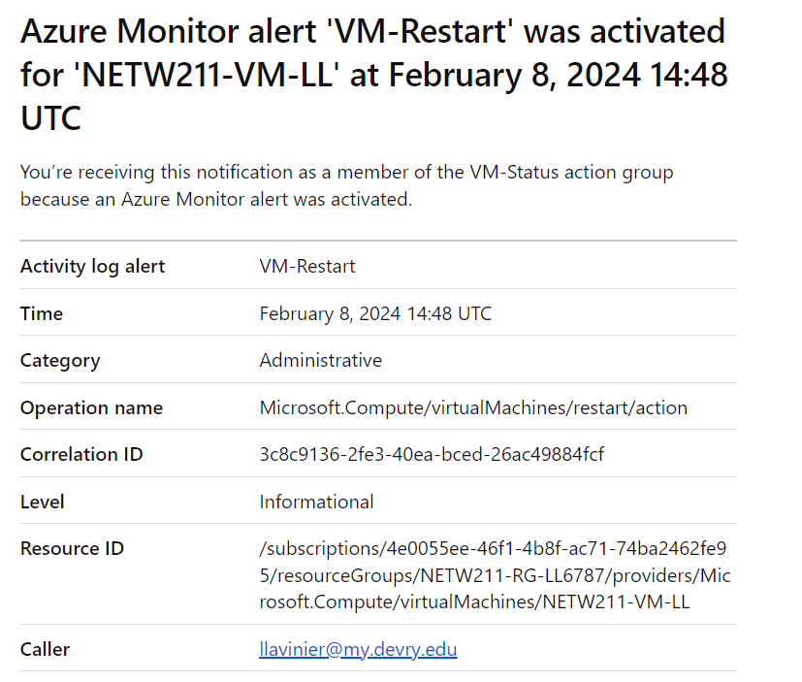
Testing Alerts
1 of 2
This screenshot should show the ‘VM-Restart’ was activated email message with the date and time of the alert.

Slide 36
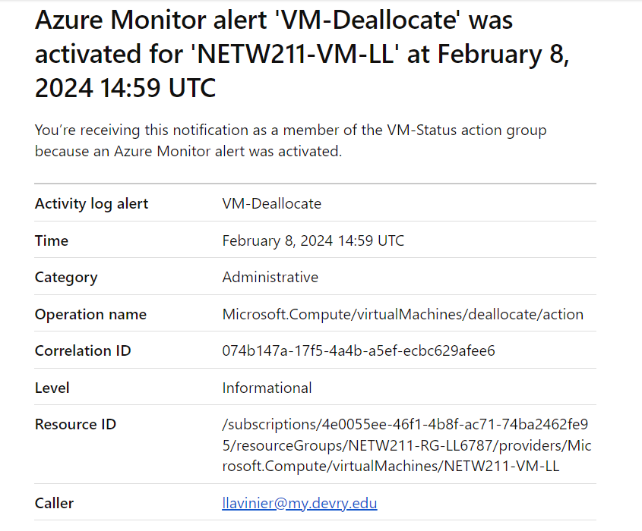
Testing Alerts 2 of 2
This screenshot should show the ‘VM-Deallocate’ was activated email message with the date and time of the alert.

Slide 37

Conclusion
In this module, I explored Azure Monitor, a service for monitoring Azure resources. I covered setting up action groups and notifications, configuring alert rules, and testing alerts. By doing so, I gained the ability to proactively manage critical events in our Azure environment. Leveraging Azure Monitor's capabilities, I can enhance reliability, minimize downtime, and optimize resource utilization. Armed with this knowledge, I am well-equipped to drive operational excellence and maximize the value of Azure investments through effective monitoring strategies.

Slide 38

References
Course project instructional video and PDF reading guide.

Slide 39

CHALLENGES
The primary challenge encountered pertained to understanding why Azure reserves five addresses. While it was known that the first address is designated for the network address and the last for the broadcast address, the rationale behind the allocation of the remaining three addresses required research for clarification. Notwithstanding, the presence of a supportive academic environment, including a knowledgeable professor and comprehensive resources, facilitated the completion of projects with relative ease.

Slide 40

SKILLS
Hands-on experience in cloud computing, virtualization, and Azure navigation has enhanced my skills. I can create VNets, configure subnets, and deploy VMs proficiently, improving Azure cloud management and network architecture. Exploring Azure Blob storage has equipped me to utilize it effectively for various purposes. Additionally, I've mastered proactive event management in Azure environments using Azure Monitor, ensuring operational excellence and maximizing Azure investments.

Slide 41

CONCLUSION
In this project, we covered a range of Azure services and functionalities, including the deployment and management of virtual machines, creation of virtual networks, implementation of security measures like Network Security Groups, utilization of Blob storage for data management, and monitoring of resources through Azure Monitor. Through hands-on tasks, we learned how to securely deploy and connect to virtual machines using SSH and RDP, configure networking settings, and enhance security with Network Security Groups. We also explored the capabilities of Blob storage for storing and managing various types of data, and how Azure Monitor can be used to proactively monitor and manage resources. By mastering these key Azure services and features, we've gained valuable insights and skills for designing, deploying, and managing resilient cloud solutions on the Azure platform.

Slide 42
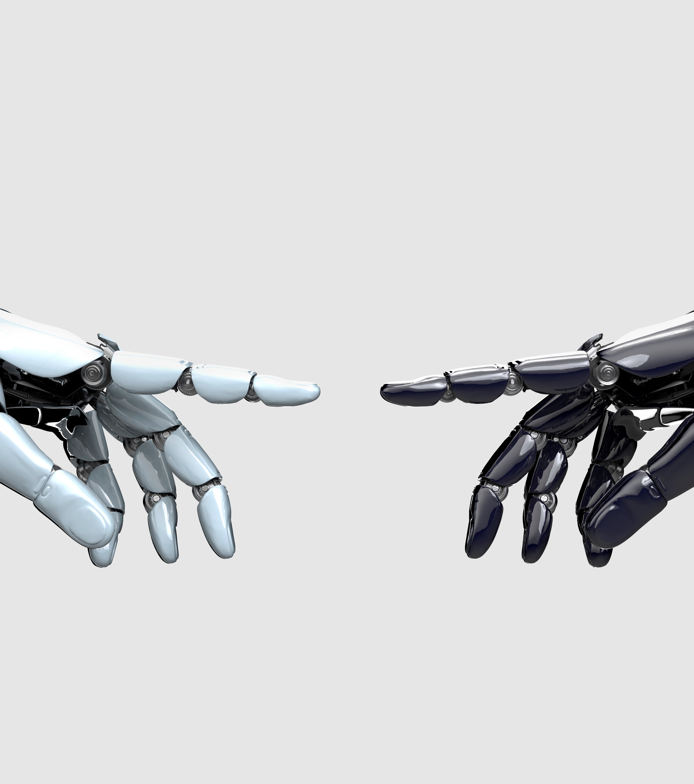
REFERENCES
Azure Blob Storage Access Tiers, https://devry.percipio.com/courses/c7ef0333-8560-403f-a004-9c5c843866b0/videos/2658bbe6-ee97-438b-a376-fbb079c3b3a0
Configuring Azure virtual network subnets with CIDR notation. (n.d.). TECHCOMMUNITY.MICROSOFT.COM. Retrieved January 18, 2024, from https://techcommunity.microsoft.com/t5/itops-talk-blog/configuring-azure-virtual-network-subnets-with-cidr-notation/ba-p/2047809#:~:text=In%20our%20example%2C%20the%20recommended%20default
Hot, Cool, and Archive access tiers for blob data, https://docs.microsoft.com/en-us/azure/storage/blobs/access-tiers-overview

