Slide 1



FUNDAMENTALS OF INFRASTRUCTURE SECURITY COURSE PROJECT
Presented by: Louimiah J. Lavinier

Slide 2
Introduction
Welcome to my final project for SEC290: Fundamentals of Infrastructure Security. I'm Louimiah J. Lavinier, and in this presentation, I'll showcase the key security techniques and tools I've applied across various modules, including vulnerability analysis, intrusion detection, and live memory analysis. This project simulates real-world scenarios to demonstrate essential infrastructure security practices. Let's dive into the steps taken, challenges faced, and solutions implemented throughout this course.

Slide 3
Course Project
SEC290
Fundamentals of Infrastructure Security
Module 1 Manual Vulnerability Analysis (on a test VM network)

Slide 4
Manual Vulnerability Analysis (on a test VM network)
In this part of the project, we focus on identifying vulnerabilities like MS08-067 and MS17-010 using Nmap, and exploiting them with Metasploit, delving into managing Meterpreter sessions. We will concentrate on how to maintain access within compromised systems, highlighting practical exploitation techniques alongside critical defense mechanisms. By advancing from initial vulnerability detection to active exploitation management, we aim to gain a comprehensive understanding of both offensive and defensive strategies in infrastructure security, equipping us with the skills needed to address real-world cybersecurity challenges effectively.

Slide 5
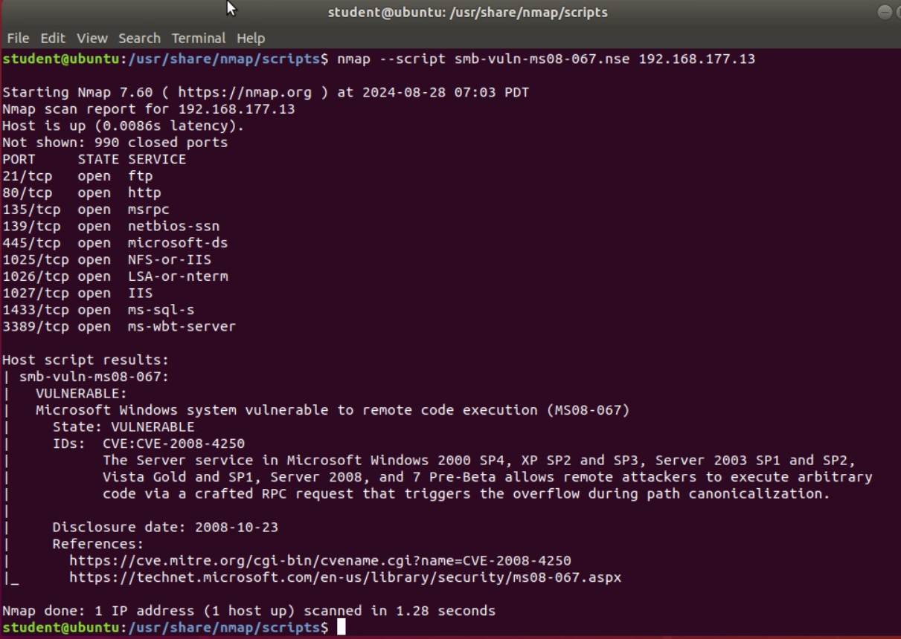
Microsoft Windows Bulletin MS08-067 Vulnerability
Take a screenshot of the output in Part 3 Step 2.
It should show that a vulnerability exists on the test VM.

Slide 6
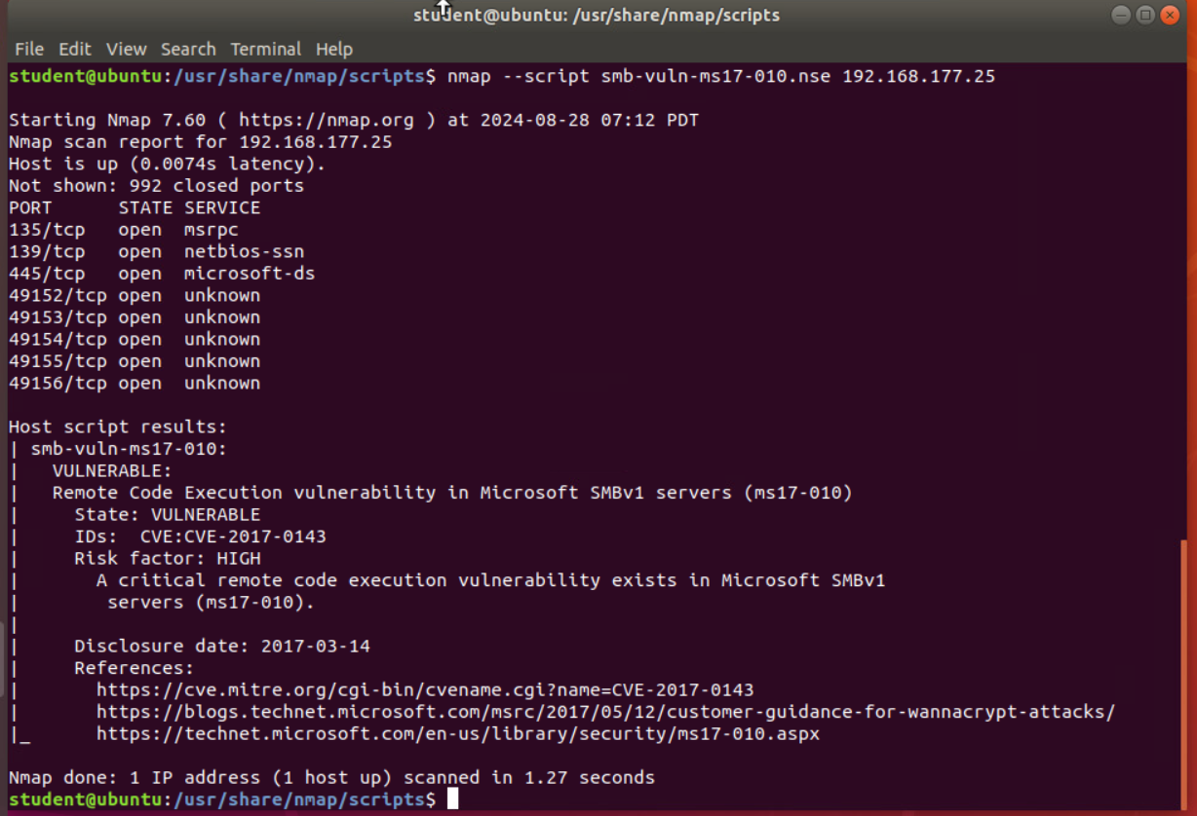
Microsoft Windows Bulletin MS17-010 Vulnerability
Take a screenshot of the output of nmap command in part 4.
It should show that a vulnerability exists on the test VM.

Slide 7
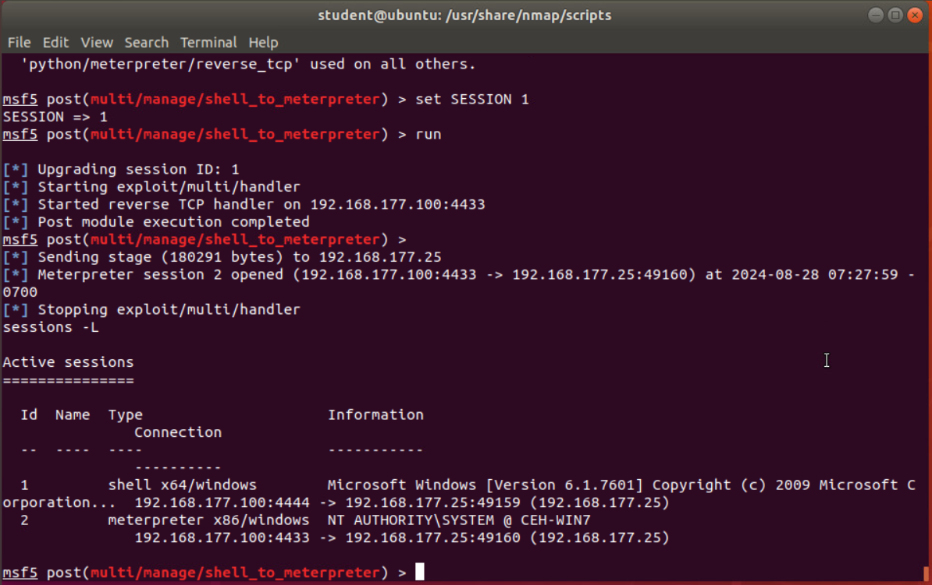
Meterpreter session command output
Take a screenshot of the output of the meterpreter session commands in Part 5, Step 19 or Step 20.

Slide 8
Course Project
SEC290
Fundamentals of Infrastructure Security
Module 2 Intrusion Analysis using Wireshark

Slide 9
Intrusion Analysis using Wireshark
As we proceed to the next stage of the project, we will shift our focus from vulnerability identification and exploitation to a basic attack analysis using packet captures. This part involves examining specific ICMP packets to identify subtle differences, researching operating systems based on their ping command characteristics, and analyzing suspicious network activity, such as half-open scans and SYN flood attacks. We will also explore the implications of packet flag settings and their roles in potential attacks. This analysis will deepen our understanding of common attack vectors and network behaviors, setting the stage for implementing effective security measures.

Slide 10
Basic attack analysis
Look at captures no. 20 and 22. (You can use the “Go” link at the top of the Wireshark screen to quickly go to a specific capture) Both packets are ICMP traffic but there are subtle differences between them. Compare the time-to-live and data field sizes in the two packets. What differences do you see? NO. 20 TTL 64 Data field size is 56 bytes NO. 22 TTL is 128 Data Field size 32 bytes.
Do a little Internet research to discover which operating systems use the specific values in their ping commands. What operating system generated the echo request in capture 20? A Linux/MAC OSX system was used to generate the echo request in capture 20.
Review packet no. 37 and beyond, what do you think is taking place here? _Half Open/Stealth Scan_______________
Look at capture 22846. What is suspicious about the flag settings in this packet? The presence of the FIN flag in this packet is suspicious because it suggests an attempt to close a connection that was never fully established. In a typical SYN flood attack, the connection is left half-open (SYN-ACK received but no ACK sent back).
What is the IP address of the host being targeted? 192.168.25.1

Slide 11
References
Hanna, K. T. (2021, July 22). SYN scanning. Networking. https://www.techtarget.com/searchnetworking/definition/SYN-scanning
ostechnix. “How to Identify Operating System Using TTL Value and Ping.” OSTechNix, 20 Sept. 2021, ostechnix.com/identify-operating-system-ttl-ping/.

Slide 12
Course Project
SEC290
Fundamentals of Infrastructure Security
Module 3 Open SSL

Slide 13
Open SSL
As we transition into the next segment of the project, our focus shifts from basic attack analysis to the intricacies of SSL/TLS communication. In this part, we will explore the creation and testing of SSL/TLS certificates, emphasizing the process of capturing and analyzing encrypted traffic. By examining GET requests and decrypting SSL streams, we will gain insights into secure data transmission and the role of encryption in protecting sensitive information. This will provide a practical understanding of how secure protocols function and their importance in safeguarding network communications.

Slide 14
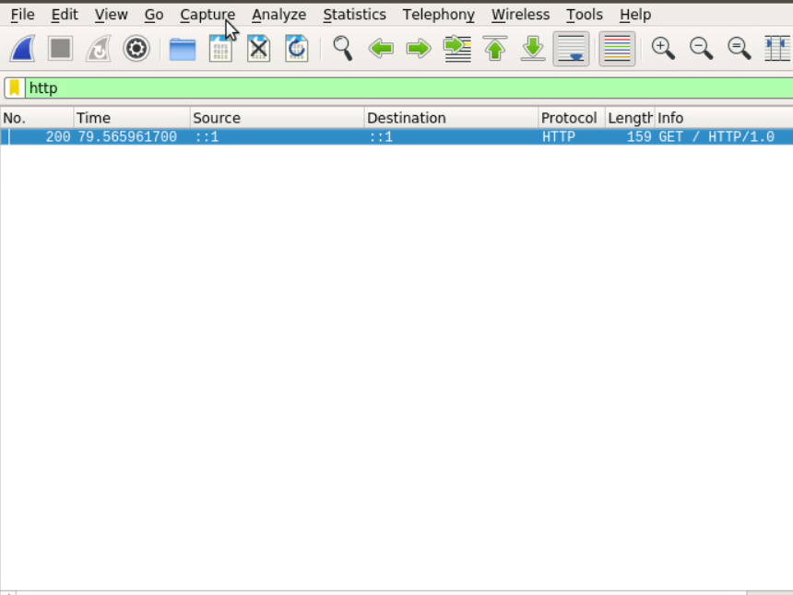
Creating and testing an SSL/TLS file
Take a screenshot of the output in Step 20.
It should show the GET request in the Info column.

Slide 15
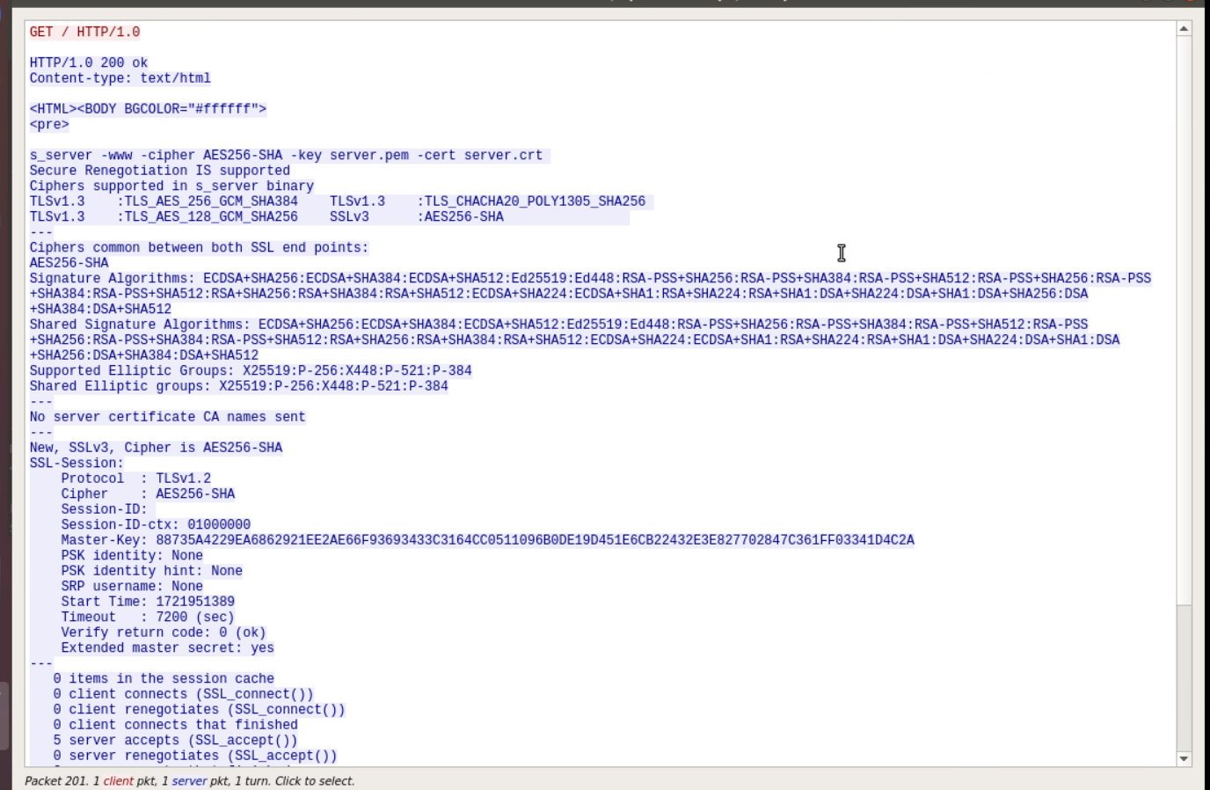
Creating and testing an SSL/TLS file cont’d
Take a screenshot of the output in Step 22.
It should show the decrypted SSL stream.

Slide 16
References
Module 3 project instructional video recording
Module 3 lab reading guide

Slide 17
Course Project
SEC290
Fundamentals of Infrastructure Security
Module 4 Snort

Slide 18
Snort
As we move on to the next part of the project, we will focus on testing and refining Snort rules to detect various network activities, including XMAS scans and ICMP ping alerts. This section will involve analyzing the output from Snort to identify how effectively our rules can detect and alert on suspicious traffic patterns. By examining the alerts generated during these scans, we will gain a deeper understanding of how intrusion detection systems function and the importance of customizing rules to enhance network security. This hands-on approach will equip us with practical skills in threat detection and response, crucial for maintaining robust security postures.

Slide 19
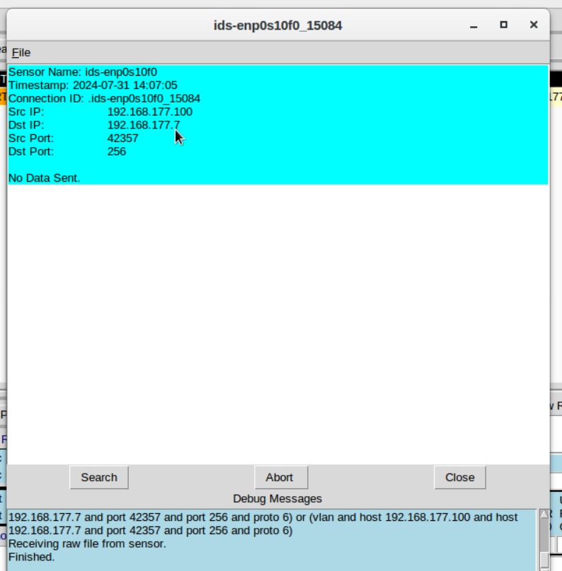
Testing Snort rules
Take a screenshot of the output in Part 1 Step 17.
It should show the transcript of the XMAS scan alert.

Slide 20
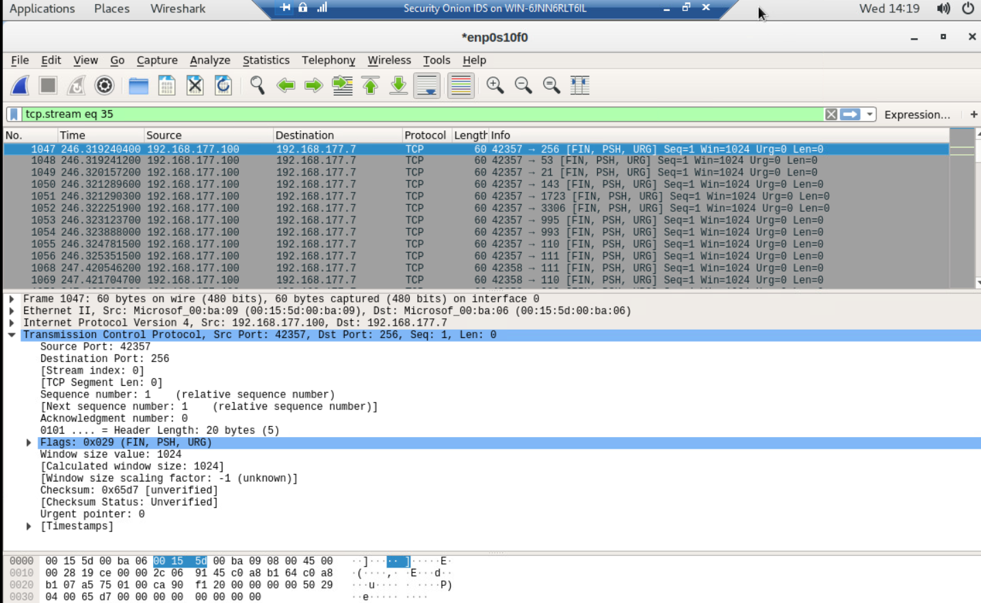
Testing Snort rules cont’d
Take a screenshot of the output in Part 1 Step 20.
It should show the TCP packets generated by the XMAS scan.

Slide 21
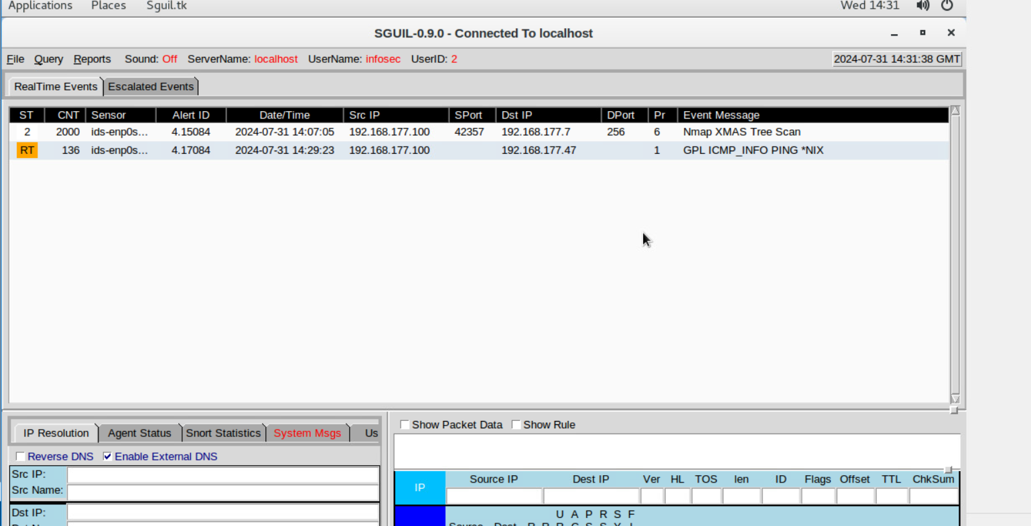
Creating Snort rules
Take a screenshot of the output in Part 2 Step 7.
It should show the ping activity alert.

Slide 22
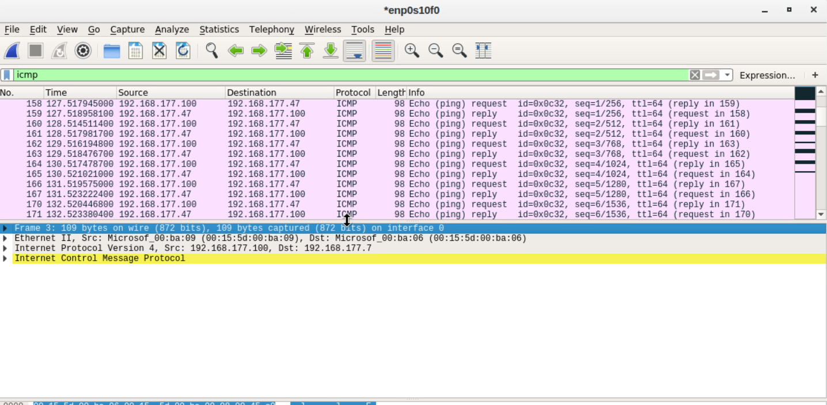
Creating Snort rules cont’d
Take a screenshot of the output in Part 2 Step 8.
It should show the ICMP packets generated by the ping activity.

Slide 23
Course Project
SEC290
Fundamentals of Infrastructure Security
Module 5 Live Memory Analysis

Slide 24
Live Memory Analysis
As we advance into the next section of our project, we will explore the management and monitoring of system processes on both Linux and Windows platforms. This part will involve examining active processes, their network connections, and understanding how different tools like Process Hacker and Process Monitor can be utilized to gain deeper insights into system operations. We will investigate process properties, open ports, and registry modifications, emphasizing how these observations can aid in identifying unusual or malicious activities. This exploration will enhance our ability to effectively monitor and manage system security across diverse environments.

Slide 25
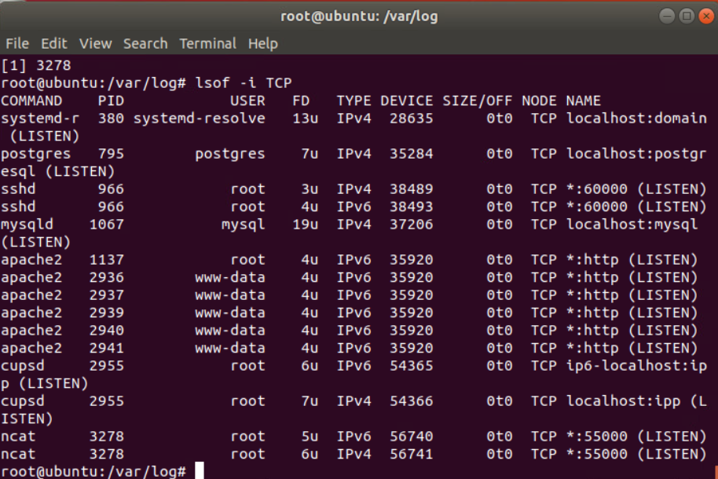
Linux Processes
Take a screenshot of the output in Part 1, Step 16.
It should show port 55000 open for both IPv4 and IPv6.

Slide 26
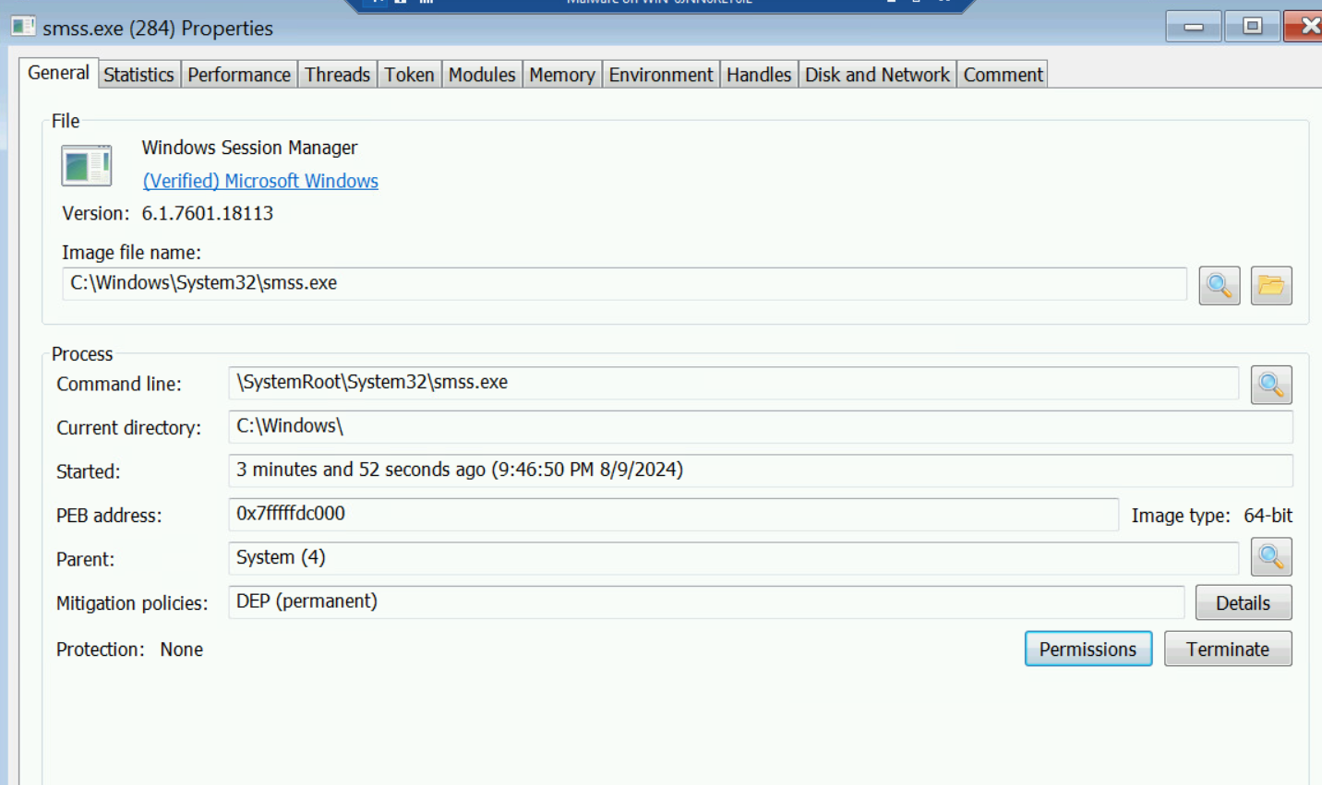
Process Hacker
Take a screenshot of the output in Part 2, Step 5.
It should show properties of a chosen process.

Slide 27
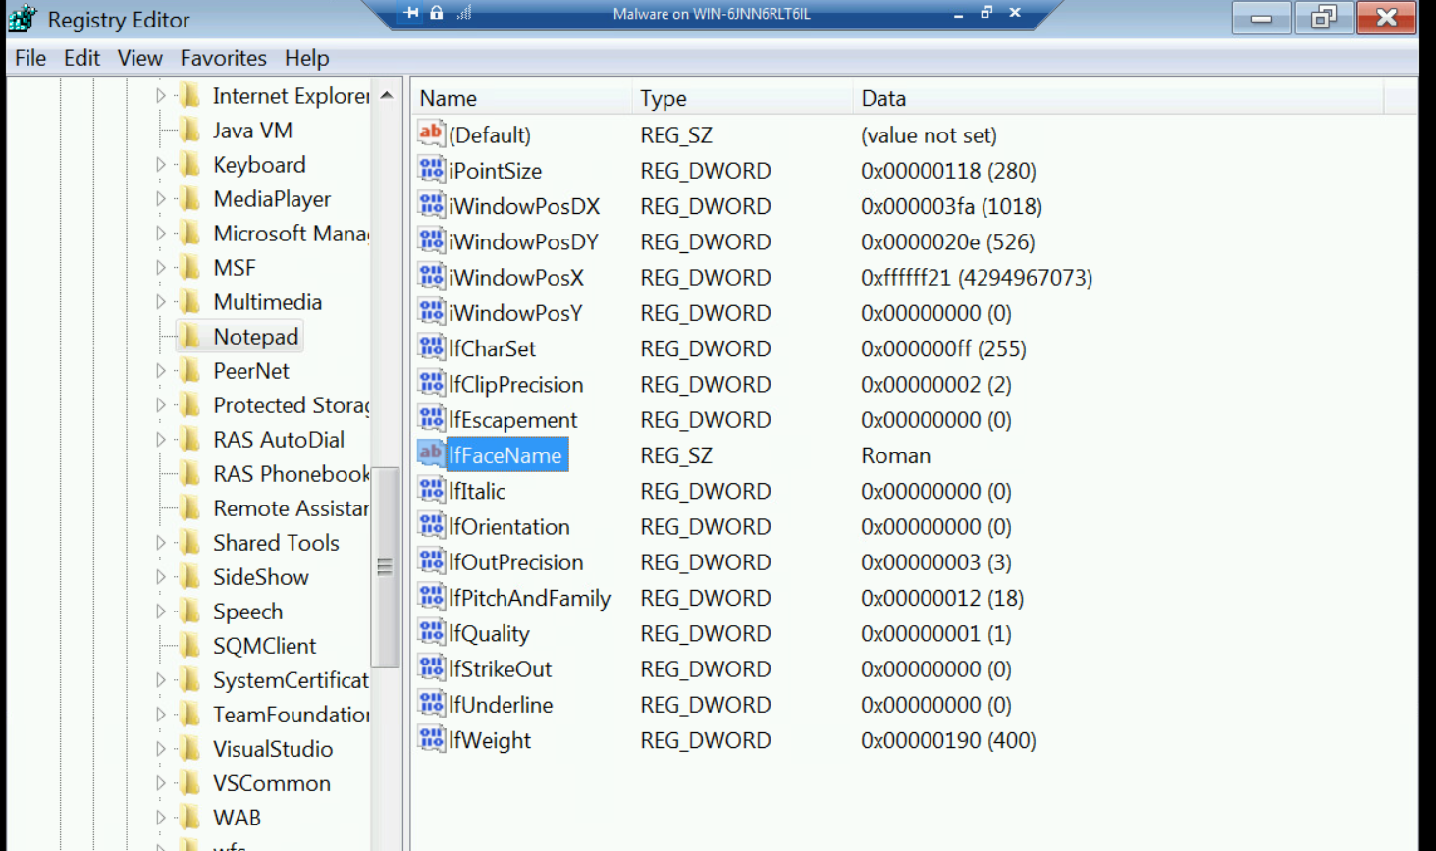
Process Monitor
Take a screenshot of the output in Part 3, Step 13.
It should show ifFaceName in the Path column and Data: Roman in the Detail column.

Slide 28
References
Module 5 Project Video Guide
ACI | Infosec Learning Lab follow along written Instructions

Slide 29
Course Project
SEC290
Fundamentals of Infrastructure Security
Module 6 Firewall

Slide 30
Firewall
In the last part of the project, our focus will shift to implementing and analyzing time-based access controls within a DMZ environment. This section involves configuring routing tables and access rules to regulate network communication based on specific time constraints. By examining outputs from tools like netstat and ping, we will validate the connectivity and effectiveness of these time-based access rules between the web VM and the DMZ VM. This final segment will underscore the significance of temporal access management as a critical layer in bolstering network security and controlling access within sensitive network zones.

Slide 31
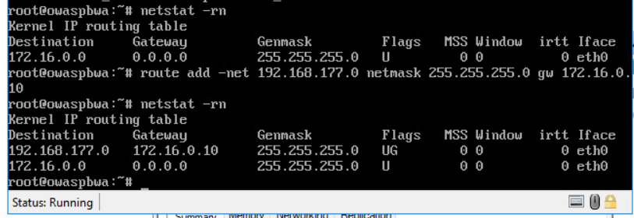
Time-based Access
Take a screenshot of the output in Part 1 Step 21.
It should show the output of the DMZ Route Table.

Slide 32
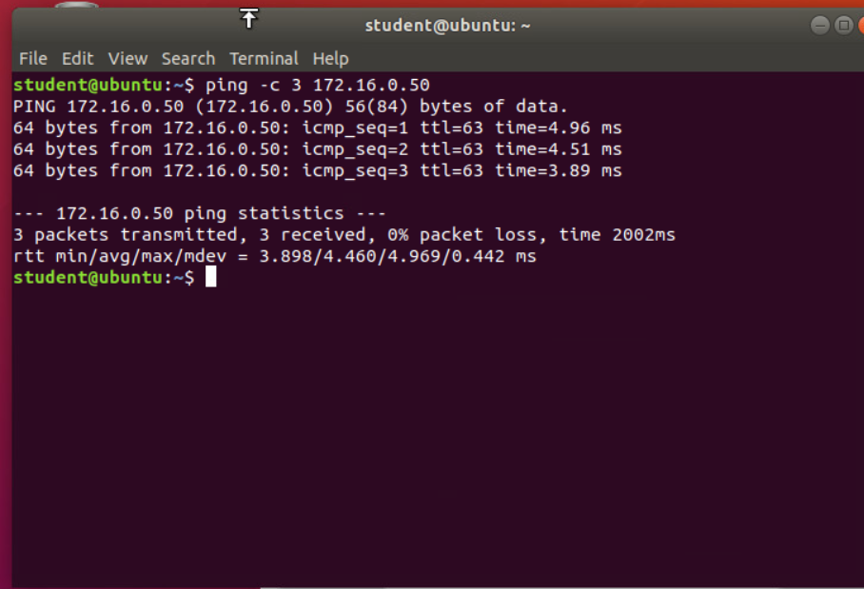
Time-based Access
Take a screenshot of the output in Part 1 Step 26.
It should show a successful ping from the Ubuntu Web VM and the DMZ VM.

Slide 33
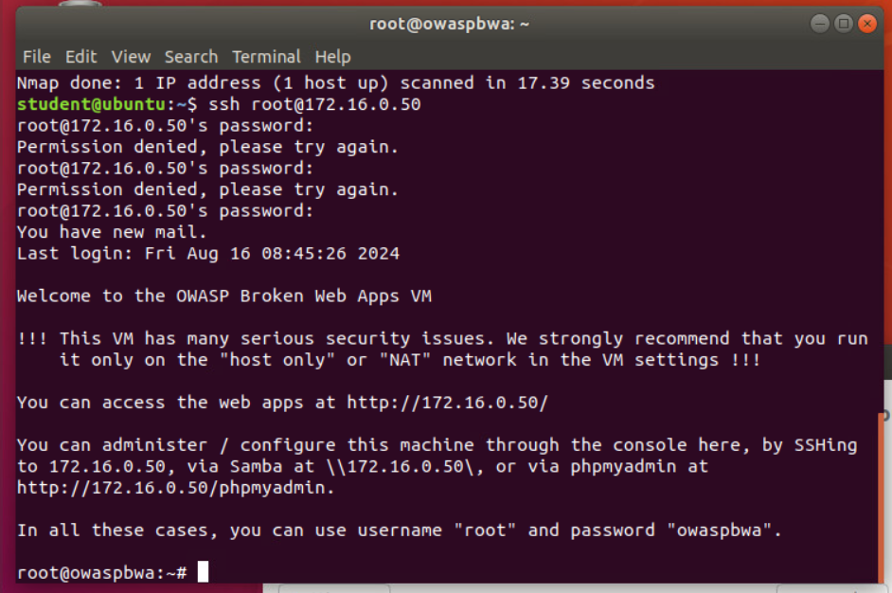
Time-based Access
Take a screenshot of the output in Part 1 Step 34.
It should show two time-based access rules in the FORWARD chain

Slide 34
References
Module 6 Project video follow along guide
Aci Learning Infosec Learning written follow along guide

Slide 35
Challenges
Due to the course's well-structured content, which included readings, instructional videos, and detailed lab instructions, I did not face any significant challenges. However, I recognize that continuous practice and improvement are essential for me to excel in this field. Overall, I had a great professor, and the lessons in this course were excellently designed, contributing to a positive learning experience.

Slide 36
Career Skills
Throughout this project, I have developed and refined several critical career skills that are essential in the field of cybersecurity:
Vulnerability Assessment: Conducted thorough manual and automated vulnerability assessments, identifying and prioritizing security risks in simulated environments.
Network Traffic Analysis: Gained proficiency in analyzing network traffic using tools like Wireshark, identifying potential threats and understanding attack patterns.
Intrusion Detection: Implemented and tested Snort rules to detect and respond to various types of network attacks, enhancing my ability to protect systems from intrusions.
Cryptographic Techniques: Applied SSL/TLS protocols for secure communication, learning the importance of encryption in safeguarding data.
Incident Response: Experienced live memory analysis and process monitoring, developing a strong foundation in incident detection and response strategies.
Problem-Solving: Overcame technical challenges, sharpening my ability to troubleshoot and solve complex security issues in real-time.

Slide 37
Conclusion
This project has provided a comprehensive exploration of critical infrastructure security principles. Through hands-on experience with tools like Wireshark, Snort, and Meterpreter, I've gained practical insights into identifying and mitigating vulnerabilities, analyzing network traffic, and securing systems against potential threats. Each module built upon the last, reinforcing the importance of a layered security approach in protecting IT infrastructures. The challenges faced during this project highlighted the complexity of cybersecurity, but also underscored the effectiveness of methodical, well-informed security practices. As I move forward in my cybersecurity career, the skills and knowledge acquired through this course will be invaluable in tackling real-world security challenges and contributing to the protection of digital environments.

