Slide 1
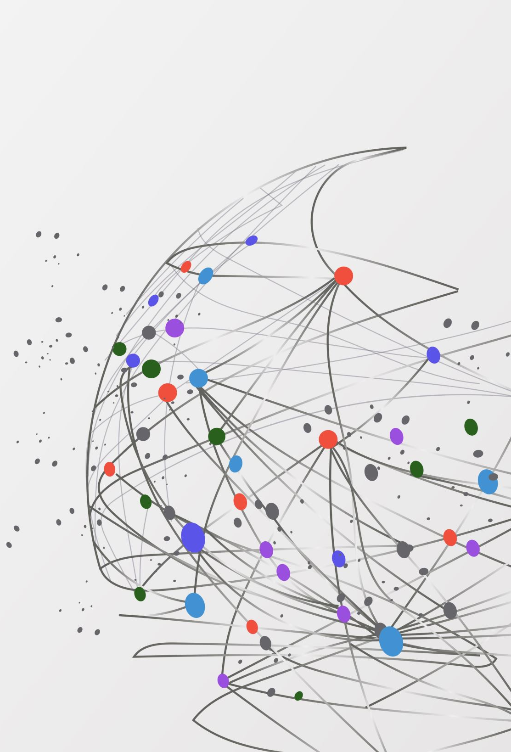
NETW191 Final Course Project
By: Louimiah Lavinier

Slide 2
Introduction
I allocated an IPv4 address to the SOHO router and ensured that computer 1 is successfully obtaining the new IPv4 address. To examine the connectivity between computer 1, computer 2, and the SOHO Router, I utilized the ping command on the command line terminal. Additionally, I performed a subnetting operation to complete the remaining entries in the subnetting table provided. Subsequently, I established Loopback 1 and Loopback 2 interfaces on the SOHO router, assigning appropriate first usable addresses and subnet masks to each Loopback interface. Afterwards, I conducted a connectivity assessment of the loopback interfaces on the SOHO router using computer 1. To visually represent the interconnection of the Computer 1 VM, Computer 2 VM, and the SOHO Router VM, I employed Microsoft Visio to create a network diagram.

Slide 3

IPv4 Addressing

Slide 4
Introduction
I will be assigning an IPv4 address to the SOHO router and verifying that computer 1 is receiving the new IPv4 address.
The material in this document is produced and maintained by DeVry University for the exclusive use by students and faculty and is copyrighted by DeVry University and/or the original owner. Content in this document cannot be duplicated, modified, distributed or used for any other purpose without the prior written consent of the copyright holder. @2023 DeVry University

Slide 5
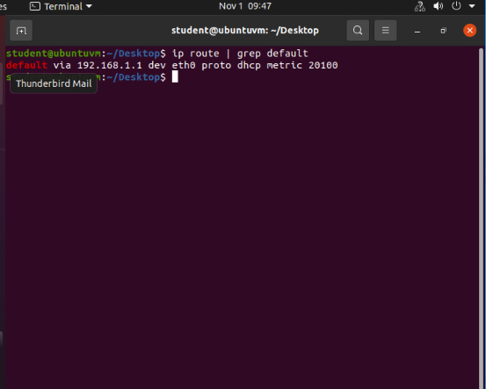
Preparation
This screenshot should include the terminal window that shows the default gateway IP address.
This screenshot should also show the date/time information on top of the Terminal window.

Slide 6
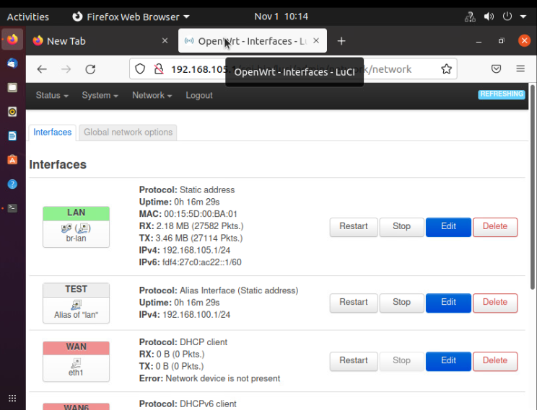
IPv4 Address Assignment
This screenshot should include the Interfaces page that shows the new IPv4 address on the LAN interface.
This screenshot should also show the date/time information next to the Firefox Web Browser tab.

Slide 7
Conclusions
I successfully assigned an IPv4 address to the SOHO router. I didn't face any difficulties as I carefully followed the steps. I acquired skills like setting the eth0 up and down, checking the IP address with ip addr in the terminal, and assigning an IP address to the router.

Slide 8
References
I followed the lab instructions other than that I didn’t have any references.

Slide 9

Connectivity Test

Slide 10
Introduction
I will be testing the connectivity between computer 1, computer 2, and the SOHO Router on the command line terminal using the ping command.

Slide 11
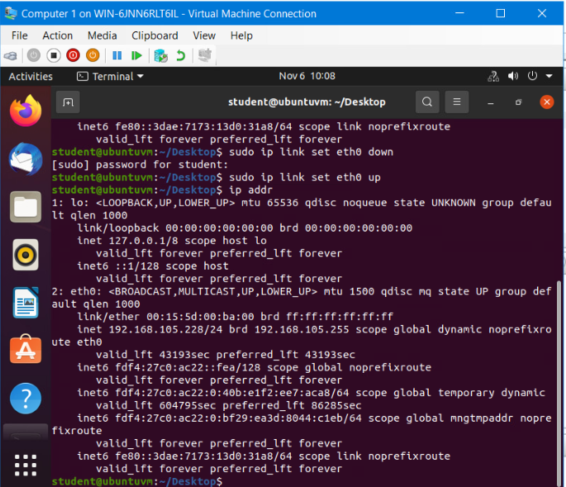
Dynamic IP Address Assignment
Take a screenshot of the Terminal window.
This screenshot should show the IPv4 address of the Computer 1 VM.
This screenshot should also show the date/time information on top of the Terminal window.

Slide 12
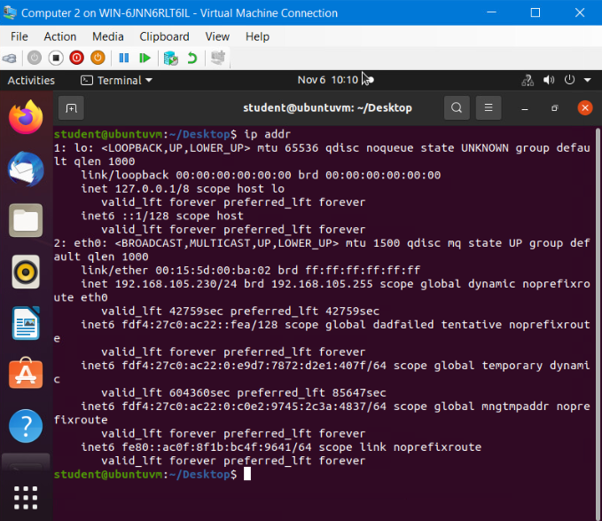
Dynamic IP Address Assignment
Take a screenshot of the Terminal window.
This screenshot should show the IPv4 address of the Computer 2 VM.
This screenshot should also show the date/time information on top of the Terminal window.

Slide 13
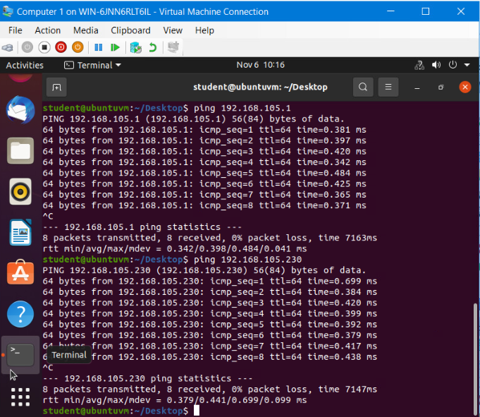
Connectivity Test
Take a screenshot of the Terminal window.
This screenshot should show 1) the connectivity test FROM the Computer 1 VM TO the SOHO Router VM, and 2) the connectivity test FROM the Computer 1 VM TO the Computer 2 VM.
This screenshot should also show the date/time information on top of the Terminal window.

Slide 14
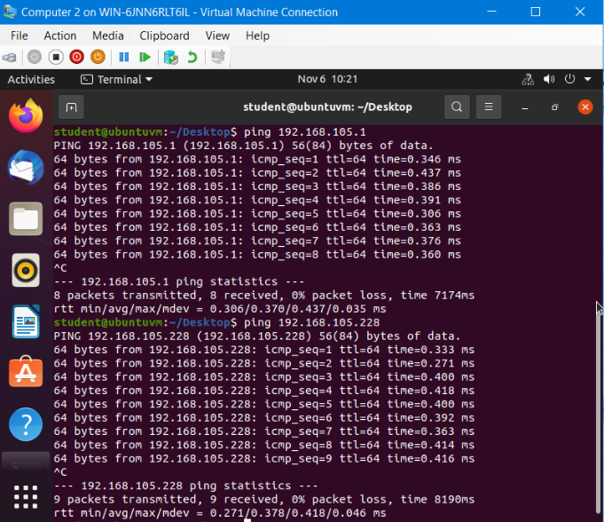
Connectivity Test
Take a screenshot of the Terminal window.
This screenshot should show 1) the connectivity test FROM the Computer 2 VM TO the SOHO Router VM, and 2) the connectivity test FROM the Computer 2 VM TO the Computer 1 VM.
This screenshot should also show the date/time information on top of the Terminal window.

Slide 15
Conclusions
This project was well put together, so I didn’t have any challenges. It was a great hands-on lab exercise that helped me acquire the skills that I would need to check the connection between routers and machines. I was able to use computer 1 to find a connection between the SOHO router and Computer 2. Then I used computer 2 to test the connection with computer 1 and the SOHO router as well making this assignment a success.

Slide 16
References
I followed the lab instructions other than that I didn’t have any references.

Slide 17

IP Subnetting and Loopback Interfaces

Slide 18
Introduction
I will be performing a subnetting operation to full out the rest of the subnetting table below. Then I will create Loopback 1 and Loopback 2 interfaces on the SOHO router using the proper first usable addresses and subnet masks for each Loopback interface. Then I will do a connectivity check of the loopback interfaces on the SOHO router using computer 1.

Slide 19
IP Subnetting
Subnet ID | Network Mask (/prefix) | Network Mask (Dotted decimal) | Network Address | First Usable Host Address | Last Usable Host Address | Broadcast Address
0 | /25 | 255.255.255.128 | 192.168.5.0 | 192.168.5.1 | 192.168.5.126 | 192.168.5.127
1 | /25 | 255.255.255.128 | 192.168.5.128 | 192.168.5.129 | 192.168.5.254 | 192.168.5.255
This table should include two /25 subnets, listing
Subnet notation
Network address
First usable host address
Last usable host address
Broadcast address

Slide 20
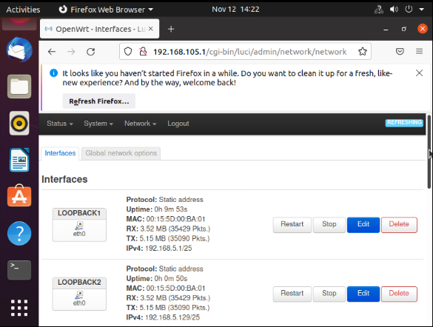
Loopback Interfaces
This screenshot should show both Loopback1 and Loopback2 interfaces and their correct IPv4 addresses.
This screenshot should also show the date/time information on top of the desktop window.

Slide 21
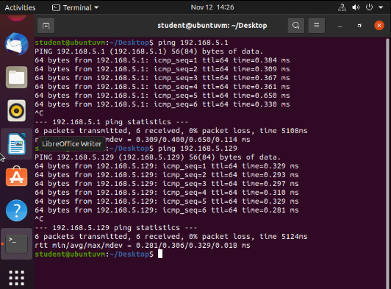
Connectivity Tests
This screenshot should show two successful ping tests:
from the Computer 1 VM to the Loopback 1 interface
from the Computer 1 VM to the Loopback 2 interface
This screenshot should also show the date/time information on top of the desktop window.

Slide 22
Conclusions
After completing this project, I will say that the subnetting portion was the most challenging for me but when I got past that part everything else went smoothly. I created the loopback interfaces, pinged both IPv4 address, and as the screenshot shows, it worked perfectly.

Slide 23
References
MindTap - Cengage Learning. (n.d.). Ng.cengage.com. https://ng.cengage.com/static/nb/ui/evo/index.html?deploymentId=6052882453344196748019703862&eISBN=9780357508183&id=1920950174&snapshotId=3691120&
‌
For this project I followed the project directions, the MindTap video on subnetting shortcuts, and the module 4 live class recording to complete this assignment.

Slide 24

Visio Network Diagram

Slide 25
Introduction
I will be using Microsoft Visio to create a network diagram that depicts the interconnection of the Computer 1 VM, the Computer 2 VM, and the SOHO Router VM.

Slide 26
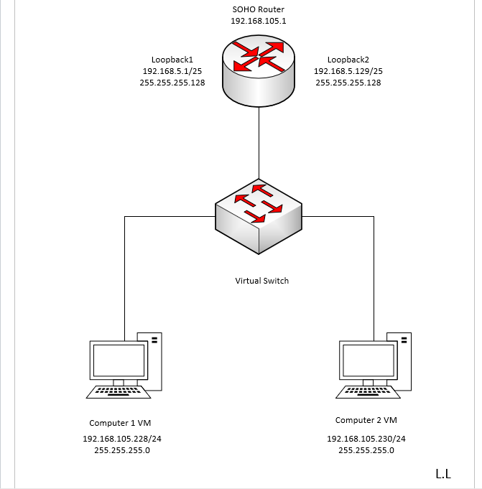
Microsoft Visio Network Diagram
This diagram should illustrate the interconnection of the Computer 1 VM, the Computer 2 VM, and the SOHO Router VM along with proper IP addresses and labeling.
This diagram should also show your initials in the bottom right corner.

Slide 27
Conclusions
I learned how to use Microsoft Visio to create a network diagram that shows the network connectivity of computer 1, computer 2, the SOHO router, and a virtual switch with the right IP address and labeling. This project was useful in helping me develop my skills in building network connectivity diagrams.

Slide 28
References
For this course project I watched the class live recording to help me complete this project.

Slide 29

SOHO Wireless Network Security

Slide 30
SOHO Wireless Network Security
1. What are the factory default username and password of a TP-Link router? Why is it important to change the default username and password of a SOHO router?
Answer: The default username for a TP-Link router is admin and the default password is admin. It's crucial to change the default username and password of a SOHO router to avoid unauthorized access and configuration changes. Hackers and crackers are familiar with the commonly used default credentials, which makes it easier for them to take over the device, hijack the network, or lock out the owner. To prevent this, it's necessary to set a private password instead of relying on the default one.
2. To protect a SOHO wireless network with a small number of devices, which address management method provides more control, configuring the device IP addresses manually (static IP) or using a DHCP server (dynamic IP)? Why?
Answer: Static IP addresses are set up manually, whereas dynamic IP addresses are assigned by your router. In a small-scale wireless network, static IP addresses give the network administrator direct control enabling remote network access, enhanced stability, and security.
3. What does MAC filtering do? If needed, when would you use deny filtering rules and when would you use allow filtering rules? What happens to devices that want to connect, if the “Allow the stations specified by any enabled entries in the list to access” function is enabled but there are no entries in the list?
Answer: MAC filtering provides an extra layer of security by cross-checking a device's MAC address with a list of approved addresses. If the client's IP address matches one on the router's list, access is granted otherwise, it is denied. To block specific devices from accessing the network, I would use deny filtering rules. To allow specific devices to access the network, I would use allow filtering rules. If the "Allow the stations specified by any enabled entries in the list to access" feature is turned on but there are no entries in the list, no devices will be able to connect to the network.

Slide 31
SOHO Wireless Network Security
1. What wireless security settings are displayed on the Wireless Security page? Which one is recommended by the vendor? Why?
Answer: The wireless security settings that are displayed are WPA2-PSK AES encryption and the one that’s recommended is the same (WPA2- PSK AES encryption) because it’s the strongest wireless encryption standard.
2. Among the configurations you explored in this module, which one is a true security function? Why?
Answer: Changing your SOHO router credentials, changing IP address, and MAC filtering are all good ways to secure your network but, in my opinion, WPA2 is a true security function because dynamic key encryption is used resulting in the key being changed frequently making it more difficult to crack.
3. What would you do to protect your wireless network at home? Why?
Answer: Honestly, I would try to incorporate all of them. I know it might seem a bit too much but When properly configured and combined, I think it can make it more challenging for crackers and hackers to take control of my device. Although it may seem sufficient to have the bare minimum-security measures in place for our homes, we must remember that employees can be a gateway into a business. If they can't access your home system, they won't be able to obtain your information. By ensuring this, both the company you work for, your family, and yourself will be protected.

Slide 32
References
GeeksforGeeks. (2023, April 16). MAC filtering in computer network. https://www.geeksforgeeks.org/mac-filtering-in-computer-network/
McKay, D. (2023, September 21). Static IP vs. Dynamic IP: What Is the Difference? How-To Geek. https://www.howtogeek.com/891148/static-ip-vs-dynamic-ip/
McDonald, R. (n.d.). Configuring security on SOHO Networks | Security | Pearson IT Certification. https://www.pearsonitcertification.com/articles/article.aspx?p=2990394&seqNum=11
TP-LINK router login | TP-LINK Default Router Password & Username. (n.d.). Router Passwords. https://www.routerpasswords.com/tp-link-default-router-password/
TP-Link Emulators | TP-Link. (n.d.). Www.tp-Link.com. https://www.tp-link.com/us/support/emulator/
‌

Slide 33

Challenges
The subnetting section proved to be the only challenge I encountered, as all other assignments were accompanied by excellent instructions that, if adhered to, facilitated the completion of each project effortlessly.

Slide 34

Career Skills
I gained valuable skills through practical exercises such as configuring the eth0 interface, using the ip addr command to verify IP addresses in the terminal, and assigning IP addresses to routers. This hands-on lab exercise was instrumental in equipping me with the necessary skills to troubleshoot connections between routers and machines. Additionally, I acquired knowledge in subnetting. Furthermore, I became proficient in utilizing Microsoft Visio to create network diagrams that accurately depict the connectivity of various components, including computer 1, computer 2, the SOHO router, and a virtual switch, complete with appropriate IP addresses and labels. Lastly, I expanded my understanding of different wireless network security protocols.

Slide 35

Conclusion
There are numerous components within the network that contribute to its functionality. Each element, such as the IP address, loopback interface, and security measures, plays a crucial role. Through the completion of this project, I have gained valuable insights into the significance of configuring and connecting a network correctly. By doing so, one can establish an exceptionally efficient and secure network.

Slide 36
References
GeeksforGeeks. (2023, April 16). MAC filtering in computer network. https://www.geeksforgeeks.org/mac-filtering-in-computer-network/
McKay, D. (2023, September 21). Static IP vs. Dynamic IP: What Is the Difference? How-To Geek. https://www.howtogeek.com/891148/static-ip-vs-dynamic-ip/
McDonald, R. (n.d.). Configuring security on SOHO Networks | Security | Pearson IT Certification. https://www.pearsonitcertification.com/articles/article.aspx?p=2990394&seqNum=11
MindTap - Cengage Learning. (n.d.). Ng.cengage.com. https://ng.cengage.com/static/nb/ui/evo/index.html?deploymentId=6052882453344196748019703862&eISBN=9780357508183&id=1920950174&snapshotId=3691120&
TP-LINK router login | TP-LINK Default Router Password & Username. (n.d.). Router Passwords. https://www.routerpasswords.com/tp-link-default-router-password/
TP-Link Emulators | TP-Link. (n.d.). Www.tp-Link.com. https://www.tp-link.com/us/support/emulator/
‌

